Slide 1
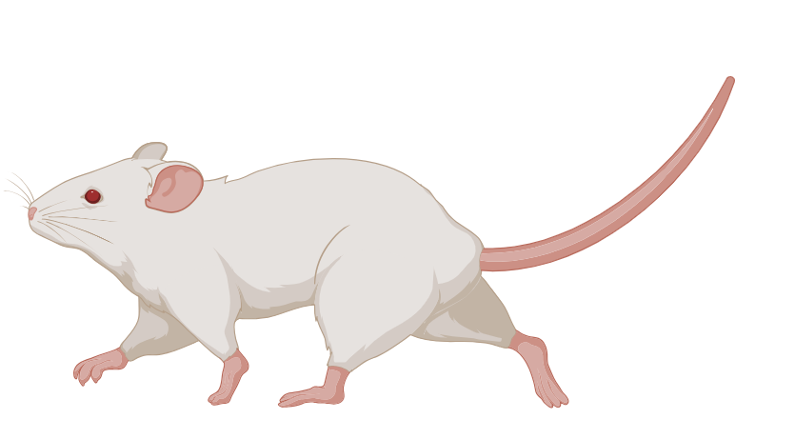
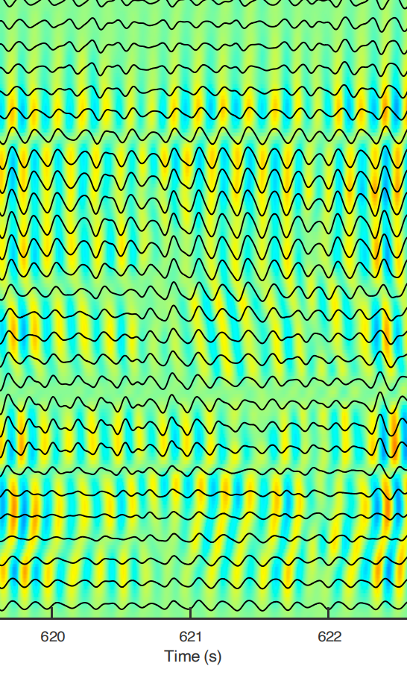
Neural and Behavioral State Switching During Hippocampal Dentate Spikes
Online / Theta State
Beyond the "Online/Offline" Binary: How the Brain Grounds Itself in Reality
Analysis of Farrell et al., Nature (2024)
Feburary 11th – Presented By: Shahriar Tafti

Slide 2
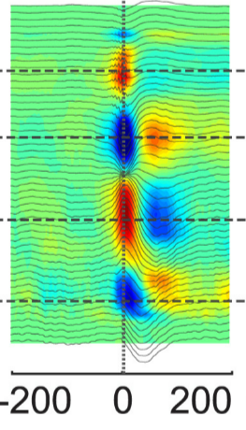
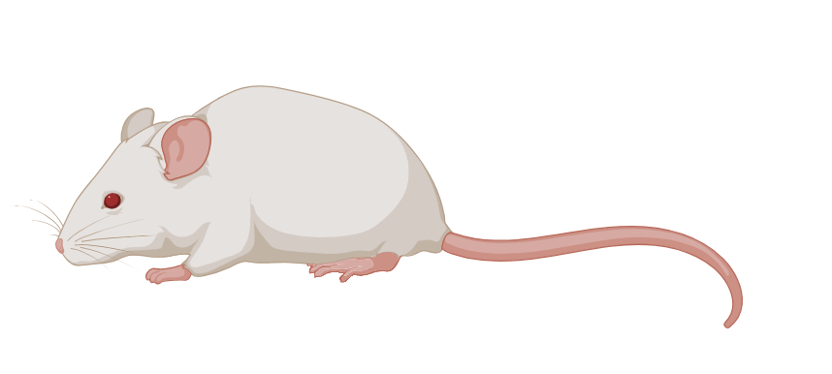
The "Online" vs. "Offline“ Gap
Online / Theta State
Offline / Sharp-Wave Ripple
Time (ms)
High-arousal (Online) and Rest (Offline) State have been well characterized
The Paradox: When "offline" (SPW-R), the brain is disconnected from sensory input.
The Question: How does a resting animal monitor threats or update its location?
Notes:
SWR: https://www.researchgate.net/figure/Triggered-LFP-averages-and-current-source-density-CSD-analysis-from-a-16-site-probe_fig8_254265427
Theta: In house

Slide 3
The "Online" vs. "Offline“ Gap
Online / Theta State
Offline / Sharp-Wave Ripple
Time (ms)
The missing gaps: Not well understood how the brain switches state
Authors Goal: Attempt to characterize the Neural Mechanism during a shift from Offline to Online
Notes:
SWR: https://www.researchgate.net/figure/Triggered-LFP-averages-and-current-source-density-CSD-analysis-from-a-16-site-probe_fig8_254265427
Theta: In house

Slide 4
The "Online" vs. "Offline“ Gap
Online / Theta State
Offline / Sharp-Wave Ripple
Time (ms)
The missing gaps: Not well understood how the brain switches state
Authors Goal: Attempt to characterize the Neural Mechanism during a shift from Offline to Online
Notes:
SWR: https://www.researchgate.net/figure/Triggered-LFP-averages-and-current-source-density-CSD-analysis-from-a-16-site-probe_fig8_254265427
Theta: In house

Slide 5
The "Online" vs. "Offline“ Gap
Online / Theta State
Offline / Sharp-Wave Ripple
Time (ms)
The missing gaps: Not well understood how the brain switches state
Authors Goal: Attempt to characterize the Neural Mechanism during a shift from Offline to Online
Notes:
SWR: https://www.researchgate.net/figure/Triggered-LFP-averages-and-current-source-density-CSD-analysis-from-a-16-site-probe_fig8_254265427
Theta: In house

Slide 6
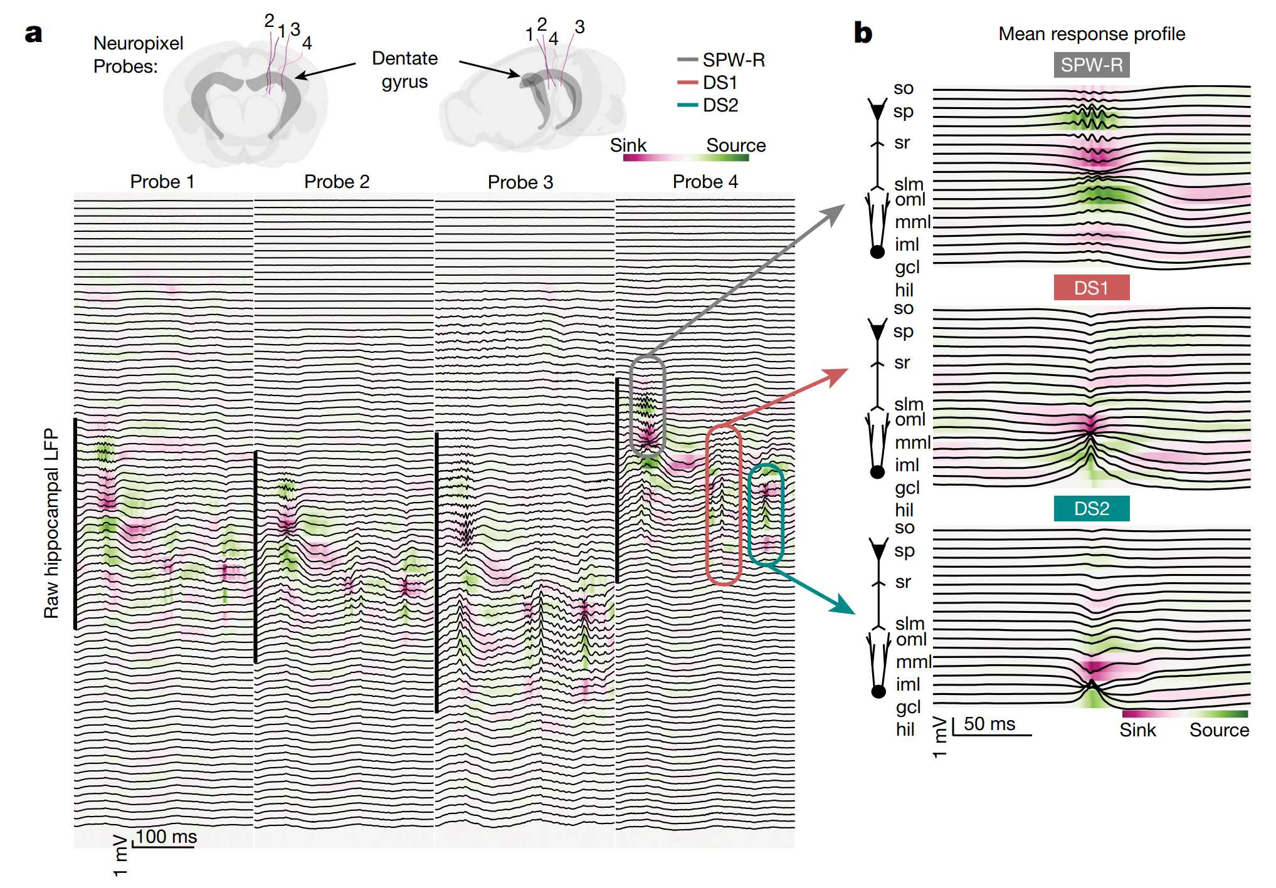
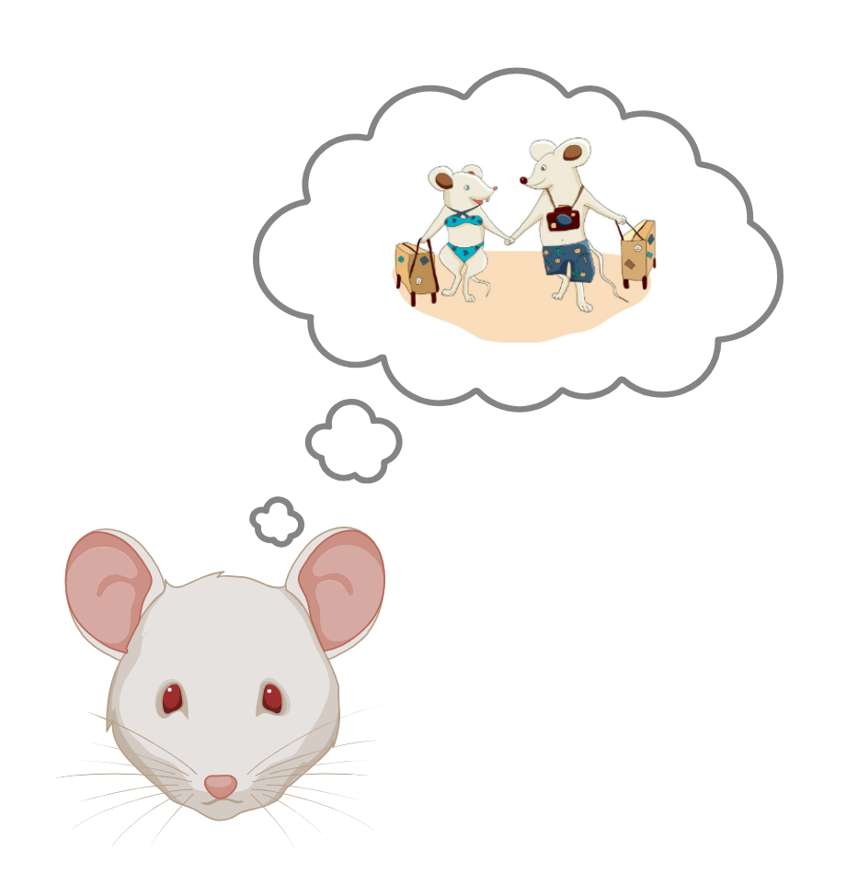
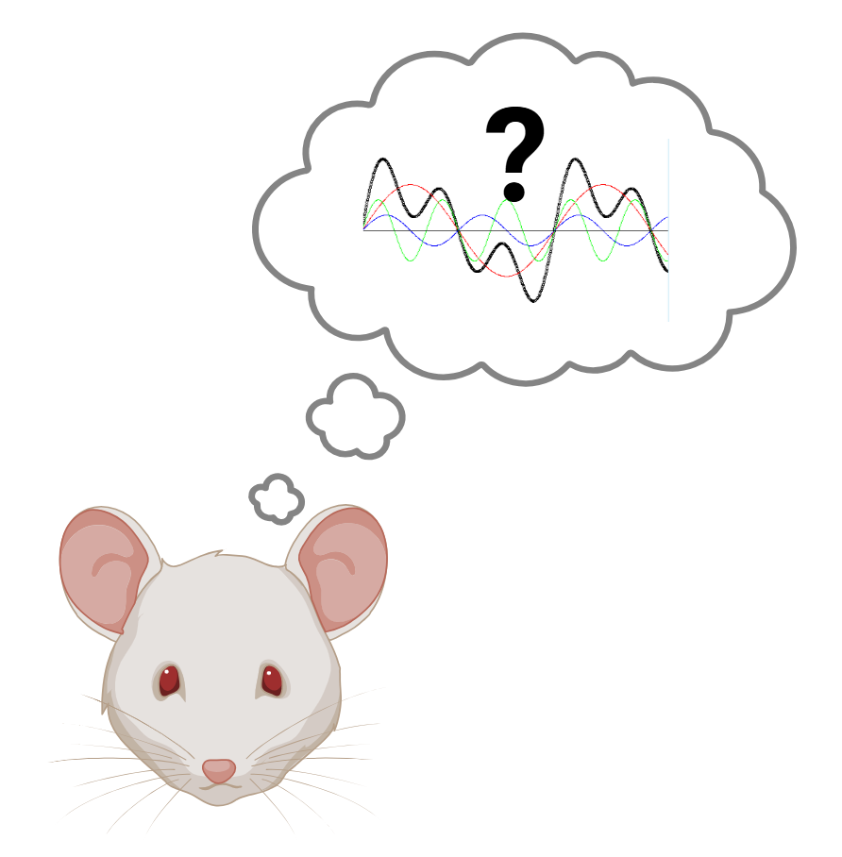
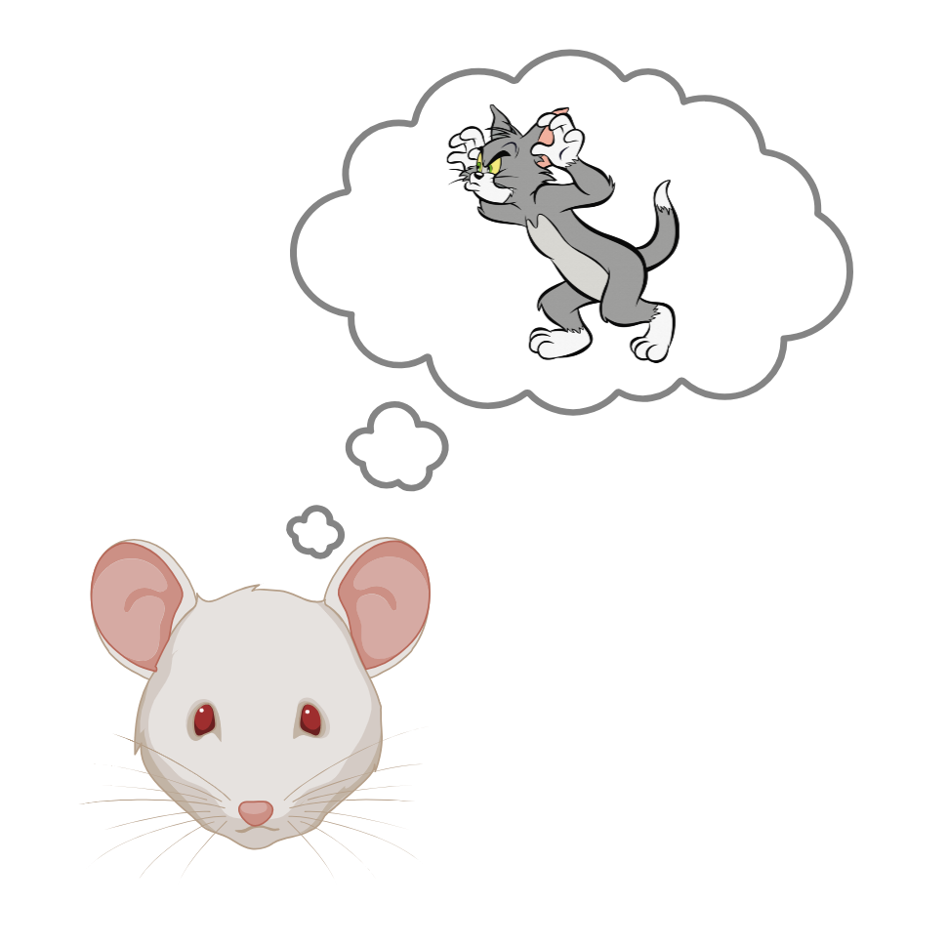


The "Online" vs. "Offline" Gap
SPW-R: Internal memory consolidation (Offline).
The Dentate Spike!
DS1: Processing objects/context (LEC Input).
DS2: Processing of spatial coordinates and arousal (MEC Input).
The missing gaps: Not well understood how the brain switches state
Authors Goal: Attempt to characterize the Neural Mechanism during a shift from Offline to Online
How does the brain snap back to reality?
How does the brain snap back to reality?
Notes:
SWR: https://www.researchgate.net/figure/Triggered-LFP-averages-and-current-source-density-CSD-analysis-from-a-16-site-probe_fig8_254265427
Theta: In house

Slide 7
Not All Spikes Are Created Equal
The Dentate Spike!
SPW-R: Internal memory consolidation (Offline).
DS1: Processing objects/context (LEC Input).
DS2: Processing of spatial coordinates and arousal (MEC Input).
How does the brain snap back to reality?
Notes:
SO (Stratum Oriens)
SP (Stratum Pyramidale)
SR (Stratum Radiatum)
SLM (Stratum Lacunosum-Moleculare)
SM (Stratum Moleculare)
(Stratum Granulare / Granule Cell Layer)

Slide 8
Not All Spikes Are Created Equal
SPW-R: Internal memory consolidation (Offline).
Notes:
SO (Stratum Oriens)
SP (Stratum Pyramidale)
SR (Stratum Radiatum)
SLM (Stratum Lacunosum-Moleculare)
SM (Stratum Moleculare)
(Stratum Granulare / Granule Cell Layer)

Slide 9
Not All Spikes Are Created Equal
SPW-R: Internal memory consolidation (Offline).
Notes:
SO (Stratum Oriens)
SP (Stratum Pyramidale)
SR (Stratum Radiatum)
SLM (Stratum Lacunosum-Moleculare)
SM (Stratum Moleculare)
(Stratum Granulare / Granule Cell Layer)

Slide 10
Not All Spikes Are Created Equal
SPW-R: Internal memory consolidation (Offline).
Notes:
SO (Stratum Oriens)
SP (Stratum Pyramidale)
SR (Stratum Radiatum)
SLM (Stratum Lacunosum-Moleculare)
SM (Stratum Moleculare)
(Stratum Granulare / Granule Cell Layer)

Slide 11
Not All Spikes Are Created Equal
SPW-R: Internal memory consolidation (Offline).
Notes:
SO (Stratum Oriens)
SP (Stratum Pyramidale)
SR (Stratum Radiatum)
SLM (Stratum Lacunosum-Moleculare)
SM (Stratum Moleculare)
(Stratum Granulare / Granule Cell Layer)

Slide 12
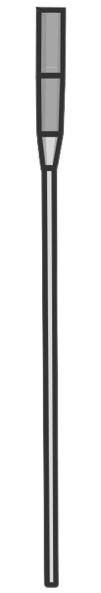
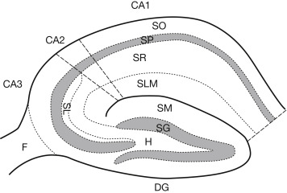
Not All Spikes Are Created Equal
SPW-R: Internal memory consolidation (Offline).
Notes:
SO (Stratum Oriens)
SP (Stratum Pyramidale)
SR (Stratum Radiatum)
SLM (Stratum Lacunosum-Moleculare)
SM (Stratum Moleculare)
(Stratum Granulare / Granule Cell Layer)

Slide 13
Not All Spikes Are Created Equal
SPW-R: Internal memory consolidation (Offline).
DS1: Processing objects/context (LEC Input).
Notes:
SO (Stratum Oriens)
SP (Stratum Pyramidale)
SR (Stratum Radiatum)
SLM (Stratum Lacunosum-Moleculare)
SM (Stratum Moleculare)
(Stratum Granulare / Granule Cell Layer)

Slide 14
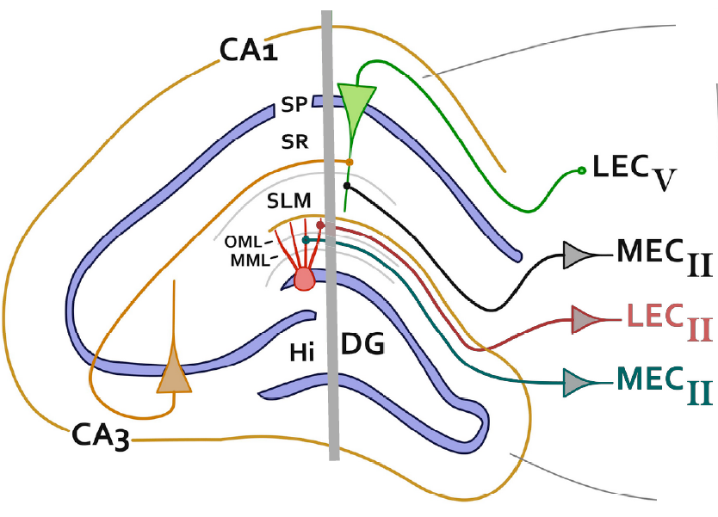
Not All Spikes Are Created Equal
SPW-R: Internal memory consolidation (Offline).
DS1: Processing objects/context (LEC Input).
Notes:
SO (Stratum Oriens)
SP (Stratum Pyramidale)
SR (Stratum Radiatum)
SLM (Stratum Lacunosum-Moleculare)
SM (Stratum Moleculare)
(Stratum Granulare / Granule Cell Layer)

Slide 15
Not All Spikes Are Created Equal
SPW-R: Internal memory consolidation (Offline).
DS1: Processing objects/context (LEC Input).
Notes:
SO (Stratum Oriens)
SP (Stratum Pyramidale)
SR (Stratum Radiatum)
SLM (Stratum Lacunosum-Moleculare)
SM (Stratum Moleculare)
(Stratum Granulare / Granule Cell Layer)

Slide 16
Not All Spikes Are Created Equal
SPW-R: Internal memory consolidation (Offline).
DS1: Processing objects/context (LEC Input).
DS2: Processing of spatial coordinates and arousal (MEC Input).
Notes:
SO (Stratum Oriens)
SP (Stratum Pyramidale)
SR (Stratum Radiatum)
SLM (Stratum Lacunosum-Moleculare)
SM (Stratum Moleculare)
(Stratum Granulare / Granule Cell Layer)

Slide 17
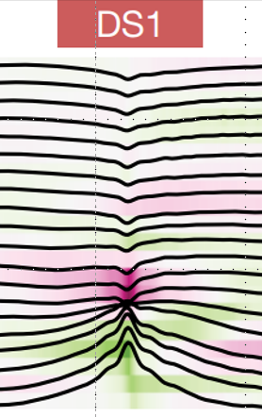
Not All Spikes Are Created Equal
SPW-R: Internal memory consolidation (Offline).
DS1: Processing objects/context (LEC Input).
DS2: Processing of spatial coordinates and arousal (MEC Input).
Notes:
SO (Stratum Oriens)
SP (Stratum Pyramidale)
SR (Stratum Radiatum)
SLM (Stratum Lacunosum-Moleculare)
SM (Stratum Moleculare)
(Stratum Granulare / Granule Cell Layer)

Slide 18
Not All Spikes Are Created Equal
SPW-R: Internal memory consolidation (Offline).
DS1: Processing objects/context (LEC Input).
DS2: Processing of spatial coordinates and arousal (MEC Input).
Notes:
SO (Stratum Oriens)
SP (Stratum Pyramidale)
SR (Stratum Radiatum)
SLM (Stratum Lacunosum-Moleculare)
SM (Stratum Moleculare)
(Stratum Granulare / Granule Cell Layer)

Slide 19
Not All Spikes Are Created Equal
SPW-R: Internal memory consolidation (Offline).
DS1: Processing objects/context (LEC Input).
DS2: Processing of spatial coordinates and arousal (MEC Input).
Notes:
SO (Stratum Oriens)
SP (Stratum Pyramidale)
SR (Stratum Radiatum)
SLM (Stratum Lacunosum-Moleculare)
SM (Stratum Moleculare)
(Stratum Granulare / Granule Cell Layer)

Slide 20
Not All Spikes Are Created Equal
SPW-R: Internal memory consolidation (Offline).
DS1: Processing objects/context (LEC Input).
DS2: Processing of spatial coordinates and arousal (MEC Input).
DS2: Processing of spatial coordinates and arousal (MEC Input).
Notes:
SO (Stratum Oriens)
SP (Stratum Pyramidale)
SR (Stratum Radiatum)
SLM (Stratum Lacunosum-Moleculare)
SM (Stratum Moleculare)
(Stratum Granulare / Granule Cell Layer)

Slide 21
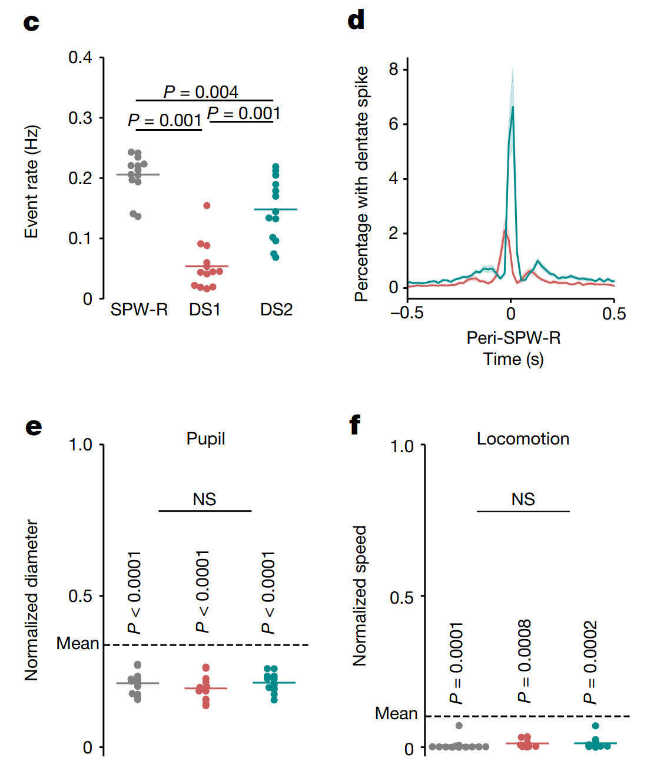
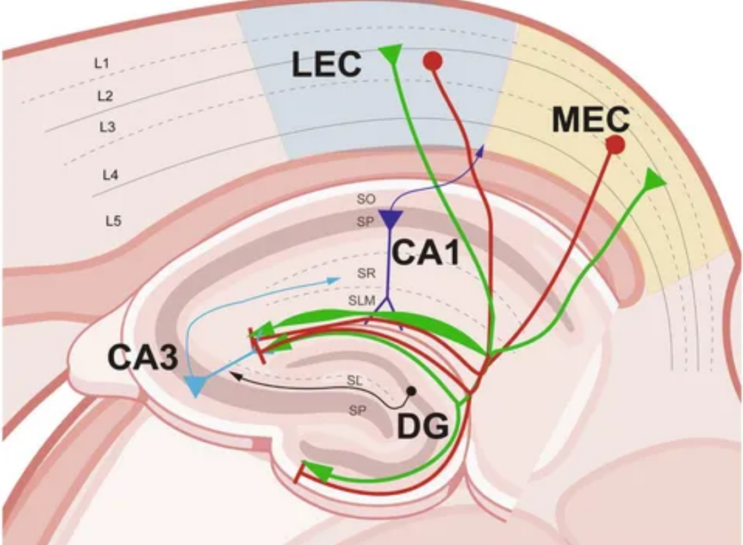
Getting To Know Our Offline Spikes
SPW-R: Internal memory consolidation (Offline).
DS1: Processing objects/context (LEC Input).
DS2: Processing of spatial coordinates and arousal (MEC Input).
DS2: Processing of spatial coordinates and arousal (MEC Input).
Notes:
Double check arrow locaiton
Role: It processes non-spatial information, specifically Object and Context information.
Connection: It provides the upstream input that drives Type 1 Dentate Spikes (DS1).
Anatomical Target: Its inputs target the Outer Molecular Layer (OML) of the Dentate Gyrus.

Slide 22
Getting To Know Our Offline Spikes
Fig. 1c (Frequency): DS2 is as frequent as Ripples.
Fig. 1c (Frequency): DS2 is as frequent as Ripples.
Fig. 1c (Frequency): DS2 is as frequent as Ripples.
Fig. 1c (Frequency): DS2 is as frequent as Ripples.
Notes:
Double check arrow locaiton
Role: It processes non-spatial information, specifically Object and Context information.
Connection: It provides the upstream input that drives Type 1 Dentate Spikes (DS1).
Anatomical Target: Its inputs target the Outer Molecular Layer (OML) of the Dentate Gyrus.

Slide 23
Getting To Know Our Offline Spikes
Fig. 1c (Frequency): DS2 is as frequent as Ripples.
Fig. 1d (Independence): DS2 and Ripples are mutually exclusive.
Fig. 1c (Frequency): DS2 is as frequent as Ripples.
Fig. 1c (Frequency): DS2 is as frequent as Ripples.
Notes:
Double check arrow locaiton
Role: It processes non-spatial information, specifically Object and Context information.
Connection: It provides the upstream input that drives Type 1 Dentate Spikes (DS1).
Anatomical Target: Its inputs target the Outer Molecular Layer (OML) of the Dentate Gyrus.

Slide 24
Getting To Know Our Offline Spikes
Fig. 1c (Frequency): DS2 is as frequent as Ripples.
Fig. 1d (Independence): DS2 and Ripples are mutually exclusive.
Fig. 1c (Frequency): DS2 is as frequent as Ripples.
Fig. 1c (Frequency): DS2 is as frequent as Ripples.
Notes:
Double check arrow locaiton
Role: It processes non-spatial information, specifically Object and Context information.
Connection: It provides the upstream input that drives Type 1 Dentate Spikes (DS1).
Anatomical Target: Its inputs target the Outer Molecular Layer (OML) of the Dentate Gyrus.

Slide 25
Getting To Know Our Offline Spikes
Fig. 1c (Frequency): DS2 is as frequent as Ripples.
Fig. 1d (Independence): DS2 and Ripples are mutually exclusive.
Fig. 1e (State): DS2 tracks with low physiological arousal (Pupil constriction).
Fig. 1c (Frequency): DS2 is as frequent as Ripples.
Notes:
Double check arrow locaiton
Role: It processes non-spatial information, specifically Object and Context information.
Connection: It provides the upstream input that drives Type 1 Dentate Spikes (DS1).
Anatomical Target: Its inputs target the Outer Molecular Layer (OML) of the Dentate Gyrus.

Slide 26
Getting To Know Our Offline Spikes
Fig. 1c (Frequency): DS2 is as frequent as Ripples.
Fig. 1d (Independence): DS2 and Ripples are mutually exclusive.
Fig. 1e (State): DS2 tracks with low physiological arousal (Pupil constriction).
Fig. 1c (Frequency): DS2 is as frequent as Ripples.
Notes:
Double check arrow locaiton
Role: It processes non-spatial information, specifically Object and Context information.
Connection: It provides the upstream input that drives Type 1 Dentate Spikes (DS1).
Anatomical Target: Its inputs target the Outer Molecular Layer (OML) of the Dentate Gyrus.

Slide 27
Getting To Know Our Offline Spikes
Fig. 1c (Frequency): DS2 is as frequent as Ripples.
Fig. 1d (Independence): DS2 and Ripples are mutually exclusive.
Fig. 1e (State): DS2 tracks with low physiological arousal (Pupil constriction).
Fig. 1c (Frequency): DS2 is as frequent as Ripples.
Notes:
Double check arrow locaiton
Role: It processes non-spatial information, specifically Object and Context information.
Connection: It provides the upstream input that drives Type 1 Dentate Spikes (DS1).
Anatomical Target: Its inputs target the Outer Molecular Layer (OML) of the Dentate Gyrus.

Slide 28
Getting To Know Our Offline Spikes
CORE INSIGHT
DS2 is a frequent, independent network event that occurs exclusively during low-arousal immobility.
Fig. 1c (Frequency): DS2 is as frequent as Ripples.
Fig. 1d (Independence): DS2 and Ripples are mutually exclusive.
Fig. 1e (State): DS2 tracks with low physiological arousal (Pupil constriction).
Fig. 1f (Behavior): DS2 occurs strictly during immobility.
Notes:
Double check arrow locaiton
Role: It processes non-spatial information, specifically Object and Context information.
Connection: It provides the upstream input that drives Type 1 Dentate Spikes (DS1).
Anatomical Target: Its inputs target the Outer Molecular Layer (OML) of the Dentate Gyrus.

Slide 29
Getting To Know Our Offline Spikes
CORE INSIGHT
DS2 is a frequent, independent network event during low arousal and immobility.
Fig. 1c (Frequency): DS2 is as frequent as Ripples.
Fig. 1d (Independence): DS2 and Ripples are mutually exclusive.
Fig. 1e (State): DS2 tracks with low physiological arousal (Pupil constriction).
Fig. 1f (Behavior): DS2 occurs strictly during immobility.
Notes:
Double check arrow locaiton
Role: It processes non-spatial information, specifically Object and Context information.
Connection: It provides the upstream input that drives Type 1 Dentate Spikes (DS1).
Anatomical Target: Its inputs target the Outer Molecular Layer (OML) of the Dentate Gyrus.

Slide 30
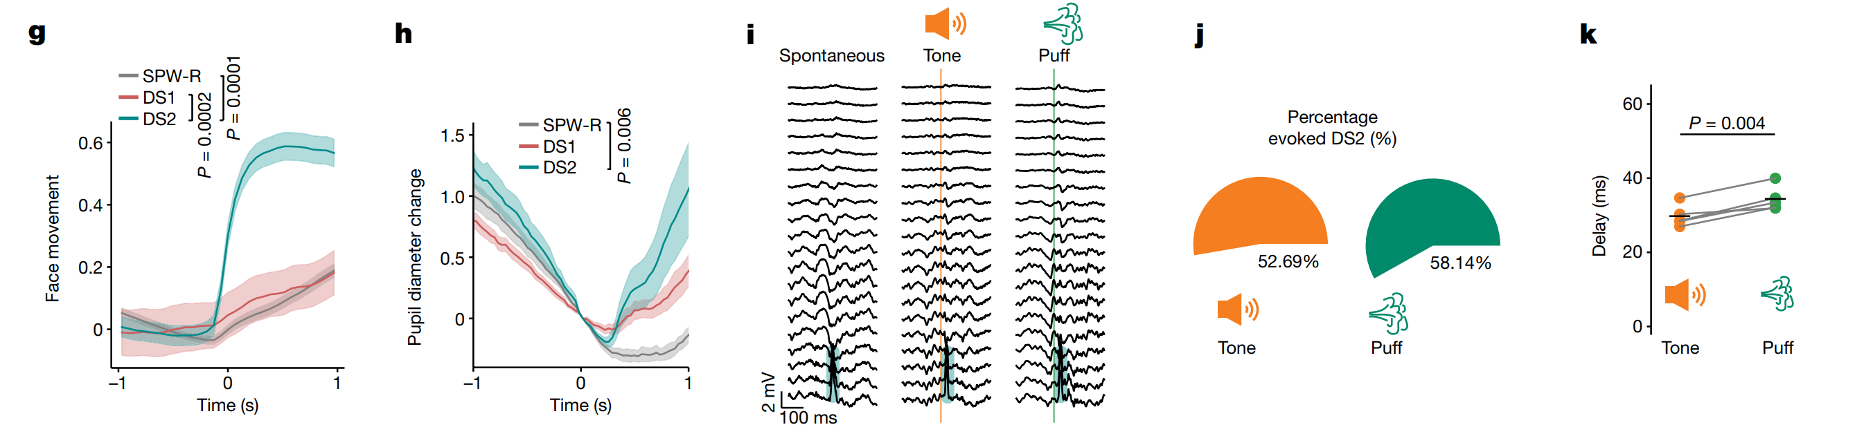
Getting To Know Our Offline Spikes
CORE INSIGHT
DS2 is a frequent, independent network event during low arousal and immobility.
Fig. 1c (Frequency): DS2 is as frequent as Ripples.
Fig. 1d (Independence): DS2 and Ripples are mutually exclusive.
Fig. 1e (State): DS2 tracks with low physiological arousal (Pupil constriction).
Fig. 1f (Behavior): DS2 occurs strictly during immobility.
Notes:
Double check arrow locaiton
Role: It processes non-spatial information, specifically Object and Context information.
Connection: It provides the upstream input that drives Type 1 Dentate Spikes (DS1).
Anatomical Target: Its inputs target the Outer Molecular Layer (OML) of the Dentate Gyrus.

Slide 31
Getting To Know Our Offline Spikes
CORE INSIGHT
DS2 is a frequent, independent network event that occurs exclusively during low-arousal immobility.
Fig. 1c (Frequency): DS2 is as frequent as Ripples.
Fig. 1d (Independence): DS2 and Ripples are mutually exclusive.
Fig. 1e (State): DS2 tracks with low physiological arousal (Pupil constriction).
Why DS2 Is Unique
Fig. 1f (Behavior): DS2 occurs strictly during immobility.
Fig. 1f (Behavior): DS2 occurs strictly during immobility.
Notes:
Double check arrow locaiton
Role: It processes non-spatial information, specifically Object and Context information.
Connection: It provides the upstream input that drives Type 1 Dentate Spikes (DS1).
Anatomical Target: Its inputs target the Outer Molecular Layer (OML) of the Dentate Gyrus.

Slide 32
Why DS2 Is Unique
CORE INSIGHT
DS2 is a frequent, independent network event that occurs exclusively during low-arousal immobility.
Fig. 1g (Micro-Arousal): DS2 is time-locked to facial movement.
Fig. 1h (Micro-Arousal): DS2 aligns with rapid pupil dilation.
Fig. 1h (Physiology): DS2 drives sympathetic arousal, marked by immediate and rapid pupil dilation.
Fig. 1i (Reactivity): Sensory startles can evoke DS2 events.
Fig. 1j (Robustness): DS2 is a reliable alarm system, responding to sensory triggers in the majority (>50%) of trials.
Notes:
Double check arrow locaiton
Role: It processes non-spatial information, specifically Object and Context information.
Connection: It provides the upstream input that drives Type 1 Dentate Spikes (DS1).
Anatomical Target: Its inputs target the Outer Molecular Layer (OML) of the Dentate Gyrus.

Slide 33
Why DS2 Is Unique
CORE INSIGHT
DS2 is a frequent, independent network event that occurs exclusively during low-arousal immobility.
Fig. 1h (Micro-Arousal): DS2 aligns with rapid pupil dilation.
Fig. 1i (Reactivity): Sensory startles can evoke DS2 events.
Fig. 1j (Robustness): DS2 is a reliable alarm system, responding to sensory triggers in the majority (>50%) of trials.
Fig. 1g (Micro-Arousal): DS2 is time-locked to facial movement.
Notes:
Double check arrow locaiton
Role: It processes non-spatial information, specifically Object and Context information.
Connection: It provides the upstream input that drives Type 1 Dentate Spikes (DS1).
Anatomical Target: Its inputs target the Outer Molecular Layer (OML) of the Dentate Gyrus.

Slide 34
Why DS2 Is Unique
CORE INSIGHT
DS2 is a frequent, independent network event that occurs exclusively during low-arousal immobility.
Fig. 1i (Reactivity): Sensory startles reliably evoke DS2 events.
Fig. 1j (Robustness): Sensory startles reliably evoke DS2 events.
Fig. 1i (Reactivity): Sensory startles can evoke DS2 events.
Fig. 1j (Robustness): DS2 is a reliable alarm system, responding to sensory triggers in the majority (>50%) of trials.
Fig. 1g (Micro-Arousal): DS2 is time-locked to facial movement.
Fig. 1h (Micro-Arousal): DS2 aligns with rapid pupil dilation.
Notes:
Double check arrow locaiton
Role: It processes non-spatial information, specifically Object and Context information.
Connection: It provides the upstream input that drives Type 1 Dentate Spikes (DS1).
Anatomical Target: Its inputs target the Outer Molecular Layer (OML) of the Dentate Gyrus.

Slide 35
Why DS2 Is Unique
CORE INSIGHT
DS2 is a frequent, independent network event that occurs exclusively during low-arousal immobility.
Fig. 1j (Robustness): Sensory startles reliably evoke DS2 events.
Fig. 1j (Robustness): DS2 is a reliable alarm system, responding to sensory triggers in the majority (>50%) of trials.
Fig. 1g (Micro-Arousal): DS2 is time-locked to facial movement.
Fig. 1h (Micro-Arousal): DS2 aligns with rapid pupil dilation.
Fig. 1i (Reactivity): Sensory startles reliably evoke DS2 events.
Notes:
Double check arrow locaiton
Role: It processes non-spatial information, specifically Object and Context information.
Connection: It provides the upstream input that drives Type 1 Dentate Spikes (DS1).
Anatomical Target: Its inputs target the Outer Molecular Layer (OML) of the Dentate Gyrus.

Slide 36
Why DS2 Is Unique
Fig. 1k (Speed): DS2 follows sensation within 30-40 milliseconds.
CORE INSIGHT
"DS2 is a high-speed, sensory-driven reflex which toggles the brain from 'Offline' to 'Online'."
Fig. 1g (Micro-Arousal): DS2 is time-locked to facial movement.
Fig. 1h (Micro-Arousal): DS2 aligns with rapid pupil dilation.
Fig. 1i (Reactivity): Sensory startles reliably evoke DS2 events.
Fig. 1j (Robustness): Sensory startles reliably evoke DS2 events.
Notes:
Double check arrow locaiton
Role: It processes non-spatial information, specifically Object and Context information.
Connection: It provides the upstream input that drives Type 1 Dentate Spikes (DS1).
Anatomical Target: Its inputs target the Outer Molecular Layer (OML) of the Dentate Gyrus.

Slide 37
Why DS2 Is Unique
CORE INSIGHT
"DS2 is a high-speed, sensory-driven reflex which toggles the brain from 'Offline' to 'Online'."
Fig. 1g (Micro-Arousal): DS2 is time-locked to facial movement.
Fig. 1h (Micro-Arousal): DS2 aligns with rapid pupil dilation.
Fig. 1i (Reactivity): Sensory startles reliably evoke DS2 events.
Fig. 1j (Robustness): Sensory startles reliably evoke DS2 events.
Fig. 1k (Speed): DS2 follows sensation within 30-40 milliseconds.
Notes:
Double check arrow locaiton
Role: It processes non-spatial information, specifically Object and Context information.
Connection: It provides the upstream input that drives Type 1 Dentate Spikes (DS1).
Anatomical Target: Its inputs target the Outer Molecular Layer (OML) of the Dentate Gyrus.

Slide 38

Why DS2 Is Unique
CORE INSIGHT
"DS2 is a high-speed, sensory-driven reflex that instantly toggles the brain from 'Offline' to 'Online'."
Not convinced?
Fig. 1g (Micro-Arousal): DS2 is time-locked to facial movement.
Fig. 1h (Micro-Arousal): DS2 aligns with rapid pupil dilation.
Fig. 1i (Reactivity): Sensory startles can evoke DS2 events.
Fig. 1j (Robustness): Sensory startles reliably evoke DS2 events.
Fig. 1k (Speed): DS2 follows sensation within 30-40 milliseconds.
Notes:
Double check arrow locaiton
Role: It processes non-spatial information, specifically Object and Context information.
Connection: It provides the upstream input that drives Type 1 Dentate Spikes (DS1).
Anatomical Target: Its inputs target the Outer Molecular Layer (OML) of the Dentate Gyrus.

Slide 39
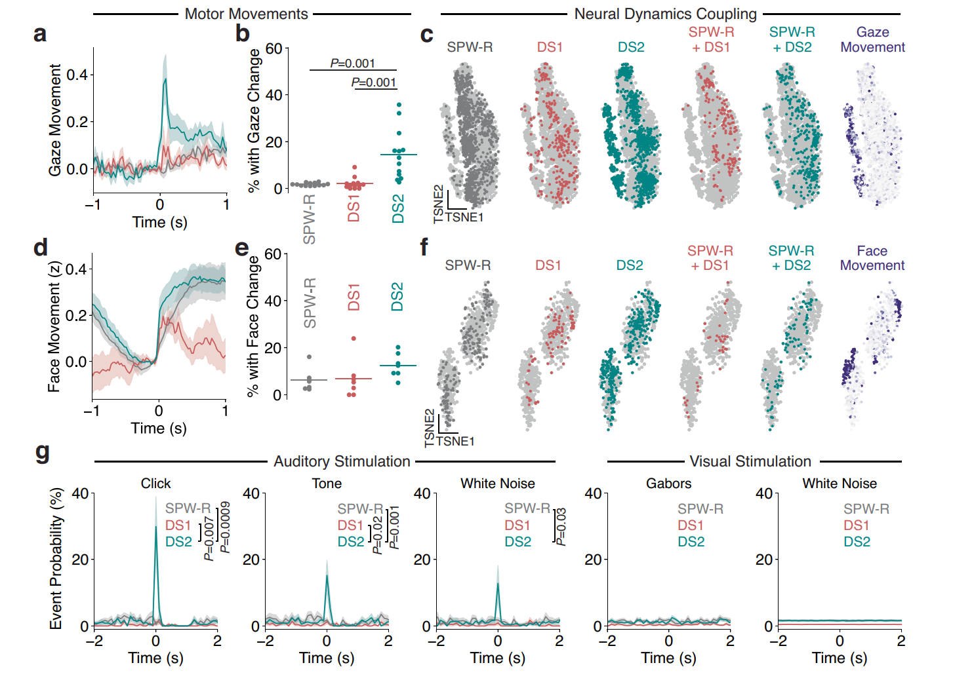
Extended Data Fig. 3a, b, d, e (Motor Coupling): DS2 linked with transient physiological arousal; Ripples are absent.
CORE INSIGHT
"DS2 is a high-speed, sensory-driven reflex that instantly toggles the brain from 'Offline' to 'Online'."
Events exceeding the 97.5th percentile (P < 0.05)
Why DS2 Is Unique… Extended Figures
Fig. 1g (Micro-Arousal): DS2 is time-locked to facial movement.
Fig. 1h (Micro-Arousal): DS2 aligns with rapid pupil dilation.
Fig. 1i (Reactivity): Sensory startles can evoke DS2 events.
Fig. 1j (Robustness): Sensory startles reliably evoke DS2 events.
Fig. 1k (Speed): DS2 follows sensation within 30-40 milliseconds.
Notes:
Double check arrow locaiton
Role: It processes non-spatial information, specifically Object and Context information.
Connection: It provides the upstream input that drives Type 1 Dentate Spikes (DS1).
Anatomical Target: Its inputs target the Outer Molecular Layer (OML) of the Dentate Gyrus.

Slide 40
Why DS2 Is Unique: Extended Figures
Extended Data Fig. 3a, b, d, e (Motor Coupling):
DS2 linked with transient physiological arousal; Ripples are absent.
CORE INSIGHT
"DS2 is a high-speed, sensory-driven reflex that instantly toggles the brain from 'Offline' to 'Online'."
Events exceeding the 97.5th percentile (P < 0.05)
Fig. 1h (Micro-Arousal): DS2 aligns with rapid pupil dilation.
Fig. 1i (Reactivity): Sensory startles can evoke DS2 events.
Fig. 1j (Robustness): Sensory startles reliably evoke DS2 events.
Fig. 1k (Speed): DS2 follows sensation within 30-40 milliseconds.
Notes:
Double check arrow locaiton
Role: It processes non-spatial information, specifically Object and Context information.
Connection: It provides the upstream input that drives Type 1 Dentate Spikes (DS1).
Anatomical Target: Its inputs target the Outer Molecular Layer (OML) of the Dentate Gyrus.

Slide 41
Why DS2 Is Unique: Extended Figures
Extended Data Fig. 3a, b, d, e (Motor Coupling):
DS2 linked with transient physiological arousal; Ripples are absent.
CORE INSIGHT
"DS2 is a high-speed, sensory-driven reflex that instantly toggles the brain from 'Offline' to 'Online'."
Note: Panel a (Trace): Gaze Speed (Arbitrary Units / a.u.)
Events exceeding the 97.5th percentile (P < 0.05)
Fig. 1h (Micro-Arousal): DS2 aligns with rapid pupil dilation.
Fig. 1i (Reactivity): Sensory startles can evoke DS2 events.
Fig. 1j (Robustness): Sensory startles reliably evoke DS2 events.
Fig. 1k (Speed): DS2 follows sensation within 30-40 milliseconds.
Notes:
Double check arrow locaiton
Role: It processes non-spatial information, specifically Object and Context information.
Connection: It provides the upstream input that drives Type 1 Dentate Spikes (DS1).
Anatomical Target: Its inputs target the Outer Molecular Layer (OML) of the Dentate Gyrus.

Slide 42
Why DS2 Is Unique: Extended Figures
Extended Data Fig. 3a, b, d, e (Motor Coupling):
DS2 linked with transient physiological arousal; Ripples are absent.
CORE INSIGHT
"DS2 is a high-speed, sensory-driven reflex that instantly toggles the brain from 'Offline' to 'Online'."
Events exceeding the 97.5th percentile (P < 0.05)
Fig. 1h (Micro-Arousal): DS2 aligns with rapid pupil dilation.
Fig. 1i (Reactivity): Sensory startles can evoke DS2 events.
Fig. 1j (Robustness): Sensory startles reliably evoke DS2 events.
Fig. 1k (Speed): DS2 follows sensation within 30-40 milliseconds.
Notes:
Double check arrow locaiton
Role: It processes non-spatial information, specifically Object and Context information.
Connection: It provides the upstream input that drives Type 1 Dentate Spikes (DS1).
Anatomical Target: Its inputs target the Outer Molecular Layer (OML) of the Dentate Gyrus.

Slide 43
Why DS2 Is Unique: Extended Figures
Extended Data Fig. 3a, b, d, e (Motor Coupling):
DS2 linked with transient physiological arousal; Ripples are absent.
CORE INSIGHT
"DS2 is a high-speed, sensory-driven reflex that instantly toggles the brain from 'Offline' to 'Online'."
Events exceeding the 97.5th percentile (P < 0.05)
Extended Data Fig. 3c, f (Neural State): DS2 neural dynamics map to arousal
Neural activity patterns were grouped by similarity to show if specific brain states overlapped
Notes:
Double check arrow locaiton
Role: It processes non-spatial information, specifically Object and Context information.
Connection: It provides the upstream input that drives Type 1 Dentate Spikes (DS1).
Anatomical Target: Its inputs target the Outer Molecular Layer (OML) of the Dentate Gyrus.

Slide 44
Why DS2 Is Unique: Extended Figures
Extended Data Fig. 3a, b, d, e (Motor Coupling): DS2 linked with transient physiological arousal; Ripples are absent.
Note: The probability plot (e) resolves the ambiguous overlap in averages (d) by confirming that only DS2 consistently crosses the statistical threshold for a significant motor response.
CORE INSIGHT
"DS2 is a high-speed, sensory-driven reflex that instantly toggles the brain from 'Offline' to 'Online'."
Extended Data Fig. 3c, f (Neural State):
DS2 neural dynamics map to arousal
Neural activity patterns were grouped by similarity to show if specific brain states overlapped
Fig. 1h (Micro-Arousal): DS2 aligns with rapid pupil dilation.
Fig. 1i (Reactivity): Sensory startles can evoke DS2 events.
Fig. 1j (Robustness): Sensory startles reliably evoke DS2 events.
Fig. 1k (Speed): DS2 follows sensation within 30-40 milliseconds.
Notes:
Double check arrow locaiton
Role: It processes non-spatial information, specifically Object and Context information.
Connection: It provides the upstream input that drives Type 1 Dentate Spikes (DS1).
Anatomical Target: Its inputs target the Outer Molecular Layer (OML) of the Dentate Gyrus.

Slide 45
Why DS2 Is Unique: Extended Figures
Extended Data Fig. 3a, b, d, e (Motor Coupling): DS2 linked with transient physiological arousal; Ripples are absent.
Note: The probability plot (e) resolves the ambiguous overlap in averages (d) by confirming that only DS2 consistently crosses the statistical threshold for a significant motor response.
CORE INSIGHT
"DS2 is a high-speed, sensory-driven reflex that instantly toggles the brain from 'Offline' to 'Online'."
Extended Data Fig. 3c, f (Neural State):
DS2 neural dynamics map to arousal
Fig. 1h (Micro-Arousal): DS2 aligns with rapid pupil dilation.
Fig. 1i (Reactivity): Sensory startles can evoke DS2 events.
Fig. 1j (Robustness): Sensory startles reliably evoke DS2 events.
Fig. 1k (Speed): DS2 follows sensation within 30-40 milliseconds.
Notes:
Double check arrow locaiton
Role: It processes non-spatial information, specifically Object and Context information.
Connection: It provides the upstream input that drives Type 1 Dentate Spikes (DS1).
Anatomical Target: Its inputs target the Outer Molecular Layer (OML) of the Dentate Gyrus.

Slide 46
Why DS2 Is Unique: Extended Figures
Extended Data Fig. 3a, b, d, e (Motor Coupling): DS2 linked with transient physiological arousal; Ripples are absent.
Note: The probability plot (e) resolves the ambiguous overlap in averages (d) by confirming that only DS2 consistently crosses the statistical threshold for a significant motor response.
CORE INSIGHT
"DS2 is a high-speed, sensory-driven reflex that instantly toggles the brain from 'Offline' to 'Online'."
Extended Data Fig. 3c, f (Neural State):
DS2 neural dynamics map to arousal
DS2 neural activity patterns overlapped with Gaze Movement and Face Movement
Fig. 1h (Micro-Arousal): DS2 aligns with rapid pupil dilation.
Fig. 1i (Reactivity): Sensory startles can evoke DS2 events.
Fig. 1j (Robustness): Sensory startles reliably evoke DS2 events.
Fig. 1k (Speed): DS2 follows sensation within 30-40 milliseconds.
Notes:
Double check arrow locaiton
Role: It processes non-spatial information, specifically Object and Context information.
Connection: It provides the upstream input that drives Type 1 Dentate Spikes (DS1).
Anatomical Target: Its inputs target the Outer Molecular Layer (OML) of the Dentate Gyrus.

Slide 47
Why DS2 Is Unique: Extended Figures
Extended Data Fig. 3g (Sensory Tuning): DS2 functions as a specific alarm, reliably triggered by auditory startles (clicks, tones) but completely unresponsive to visual stimulation (Gabors, white noise).
z
Extended Data Fig. 3a, b, d, e (Motor Coupling): DS2 linked with transient physiological arousal; Ripples are absent.
CORE INSIGHT
"DS2 is a high-speed, sensory-driven reflex that instantly toggles the brain from 'Offline' to 'Online'."
Extended Data Fig. 3c, f (Neural State):
DS2 neural dynamics map to arousal
Neural activity patterns were grouped by similarity to show if specific brain states overlapped
Notes:
Double check arrow locaiton
Role: It processes non-spatial information, specifically Object and Context information.
Connection: It provides the upstream input that drives Type 1 Dentate Spikes (DS1).
Anatomical Target: Its inputs target the Outer Molecular Layer (OML) of the Dentate Gyrus.

Slide 48
CORE INSIGHT
"DS2 is a high-speed, sensory-driven reflex that instantly toggles the brain from 'Offline' to 'Online'."
Why DS2 Is Unique: Extended Figures
Extended Data Fig. 3a, b, d, e (Motor Coupling): DS2 linked with transient physiological arousal; Ripples are absent.
Extended Data Fig. 3g (Sensory Tuning): Auditory stimuli selectively trigger DS2
Extended Data Fig. 3c, f (Neural State): DS2 neural dynamics map to arousal
Notes:
Double check arrow locaiton
Role: It processes non-spatial information, specifically Object and Context information.
Connection: It provides the upstream input that drives Type 1 Dentate Spikes (DS1).
Anatomical Target: Its inputs target the Outer Molecular Layer (OML) of the Dentate Gyrus.

Slide 49

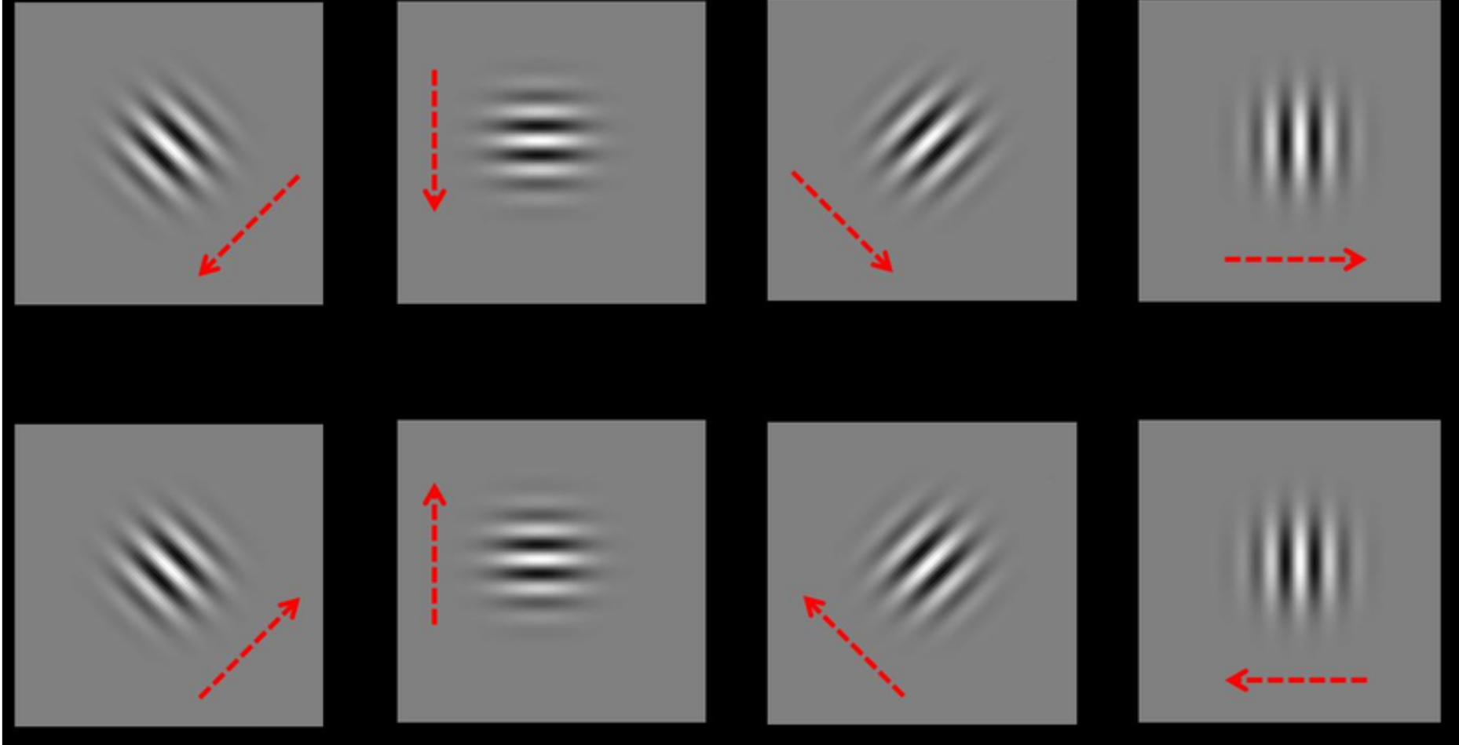
CORE INSIGHT
"DS2 is a high-speed, sensory-driven reflex that instantly toggles the brain from 'Offline' to 'Online'."
Why DS2 Is Unique: Extended Figures
Extended Data Fig. 3a, b, d, e (Motor Coupling): DS2 linked with transient physiological arousal; Ripples are absent.
Extended Data Fig. 3g (Sensory Tuning): Auditory stimuli selectively trigger DS2
Neural activity patterns were grouped by similarity to show if specific brain states overlapped
Extended Data Fig. 3c, f (Neural State): DS2 neural dynamics map to arousal
Notes:
Double check arrow locaiton
Role: It processes non-spatial information, specifically Object and Context information.
Connection: It provides the upstream input that drives Type 1 Dentate Spikes (DS1).
Anatomical Target: Its inputs target the Outer Molecular Layer (OML) of the Dentate Gyrus.

Slide 50
Why DS2 Is Unique: Extended Figures
Extended Data Fig. 3a, b, d, e (Motor Coupling): DS2 linked with transient physiological arousal; Ripples are absent.
Extended Data Fig. 3g (Sensory Tuning): Auditory stimuli selectively trigger DS2
Neural activity patterns were grouped by similarity to show if specific brain states overlapped
Extended Data Fig. 3c, f (Neural State): DS2 neural dynamics map to arousal
Notes:
Double check arrow locaiton
Role: It processes non-spatial information, specifically Object and Context information.
Connection: It provides the upstream input that drives Type 1 Dentate Spikes (DS1).
Anatomical Target: Its inputs target the Outer Molecular Layer (OML) of the Dentate Gyrus.

Slide 51
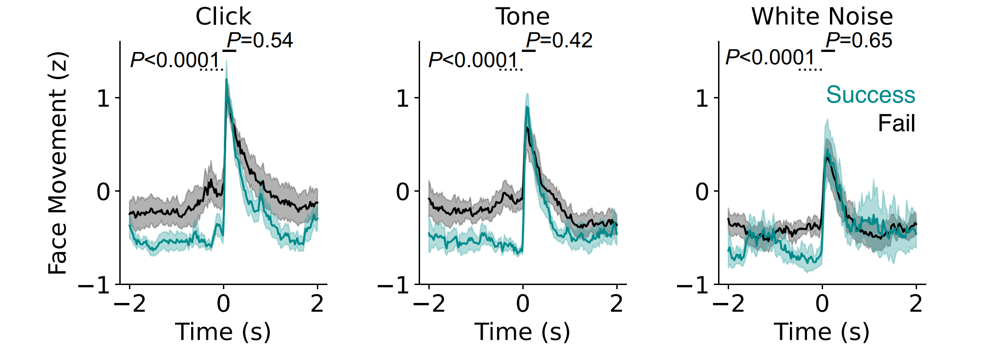
Why DS2 Is Unique: Extended Figures
Extended Data Fig. 3a, b, d, e (Motor Coupling): DS2 linked with transient physiological arousal; Ripples are absent.
Extended Data Fig. 3g (Sensory Tuning): Auditory stimuli selectively trigger DS2
Extended Data Fig. 5 (The "Offline" Precondition): Low prior arousal predicts evoked DS2
Reflex magnitude is identical across trials (P>0.5), yet DS2 generation is strictly gated by pre-stimulus immobility (P<0.0001).
Extended Data Fig. 3c, f (Neural State): DS2 neural dynamics map to arousal
CORE INSIGHT
"DS2 is a high-speed, sensory-driven reflex that instantly toggles the brain from 'Offline' to 'Online'."
Notes:
Double check arrow locaiton
Role: It processes non-spatial information, specifically Object and Context information.
Connection: It provides the upstream input that drives Type 1 Dentate Spikes (DS1).
Anatomical Target: Its inputs target the Outer Molecular Layer (OML) of the Dentate Gyrus.

Slide 52
Why DS2 Is Unique: Extended Figures
Extended Data Fig. 3a, b, d, e (Motor Coupling): DS2 linked with transient physiological arousal; Ripples are absent.
Extended Data Fig. 5 (The "Offline" Precondition): Low prior arousal predicts evoked DS2
Reflex magnitude is identical across trials (P>0.5), yet DS2 generation is strictly gated by pre-stimulus immobility (P<0.0001).
Extended Data Fig. 3c, f (Neural State): DS2 neural dynamics map to arousal
Extended Data Fig. 3g (Sensory Tuning): Auditory stimuli selectively trigger DS2
Notes:
Double check arrow locaiton
Role: It processes non-spatial information, specifically Object and Context information.
Connection: It provides the upstream input that drives Type 1 Dentate Spikes (DS1).
Anatomical Target: Its inputs target the Outer Molecular Layer (OML) of the Dentate Gyrus.

Slide 53
Why DS2 Is Unique: Extended Figures
Extended Data Fig. 3a, b, d, e (Motor Coupling): DS2 linked with transient physiological arousal; Ripples are absent.
Extended Data Fig. 5 (The "Offline" Precondition): Low prior arousal predicts evoked DS2
Extended Data Fig. 3c, f (Neural State): DS2 neural dynamics map to arousal
Extended Data Fig. 3g (Sensory Tuning): Auditory stimuli selectively trigger DS2
CORE INSIGHT
"DS2 is a high-speed, sensory-driven reflex which coincides with Arousal onset "
Notes:
Double check arrow locaiton
Role: It processes non-spatial information, specifically Object and Context information.
Connection: It provides the upstream input that drives Type 1 Dentate Spikes (DS1).
Anatomical Target: Its inputs target the Outer Molecular Layer (OML) of the Dentate Gyrus.

Slide 54
Why DS2 Is Unique: Extended Figures
Extended Data Fig. 3a, b, d, e (Motor Coupling): DS2 linked with transient physiological arousal; Ripples are absent.
Extended Data Fig. 5 (The "Offline" Precondition): Low prior arousal predicts evoked DS2
Reflex magnitude is identical across trials (P>0.5), yet DS2 generation is strictly gated by pre-stimulus immobility (P<0.0001).
Extended Data Fig. 3c, f (Neural State): DS2 neural dynamics map to arousal
Extended Data Fig. 3g (Sensory Tuning): Auditory stimuli selectively trigger DS2
CORE INSIGHT
"DS2 is a high-speed, sensory-driven reflex which coincides with arousal onset "
Notes:
Double check arrow locaiton
Role: It processes non-spatial information, specifically Object and Context information.
Connection: It provides the upstream input that drives Type 1 Dentate Spikes (DS1).
Anatomical Target: Its inputs target the Outer Molecular Layer (OML) of the Dentate Gyrus.

Slide 55
Extended Data Fig. 3a, b, d, e (Motor Coupling): DS2 linked with transient physiological arousal; Ripples are absent.
Circuit Mechanisms (The Gatekeepers)
Extended Data Fig. 5 (The "Offline" Precondition): Low prior arousal predicts evoked DS2
Reflex magnitude is identical across trials (P>0.5), yet DS2 generation is strictly gated by pre-stimulus immobility (P<0.0001).
Extended Data Fig. 3c, f (Neural State): DS2 neural dynamics map to arousal
Extended Data Fig. 3g (Sensory Tuning): Auditory stimuli selectively trigger DS2
The Question: How does the hippocampus toggle between "Offline" (SPW-R) and "Online" (via DS2)?
The Answer: Two distinct inhibitory cell types act as opposing “Gatekeepers"
CORE INSIGHT
"DS2 is a high-speed, sensory-driven reflex that instantly toggles the brain from 'Offline' to 'Online'."
Notes:
Double check arrow locaiton
Role: It processes non-spatial information, specifically Object and Context information.
Connection: It provides the upstream input that drives Type 1 Dentate Spikes (DS1).
Anatomical Target: Its inputs target the Outer Molecular Layer (OML) of the Dentate Gyrus.

Slide 56
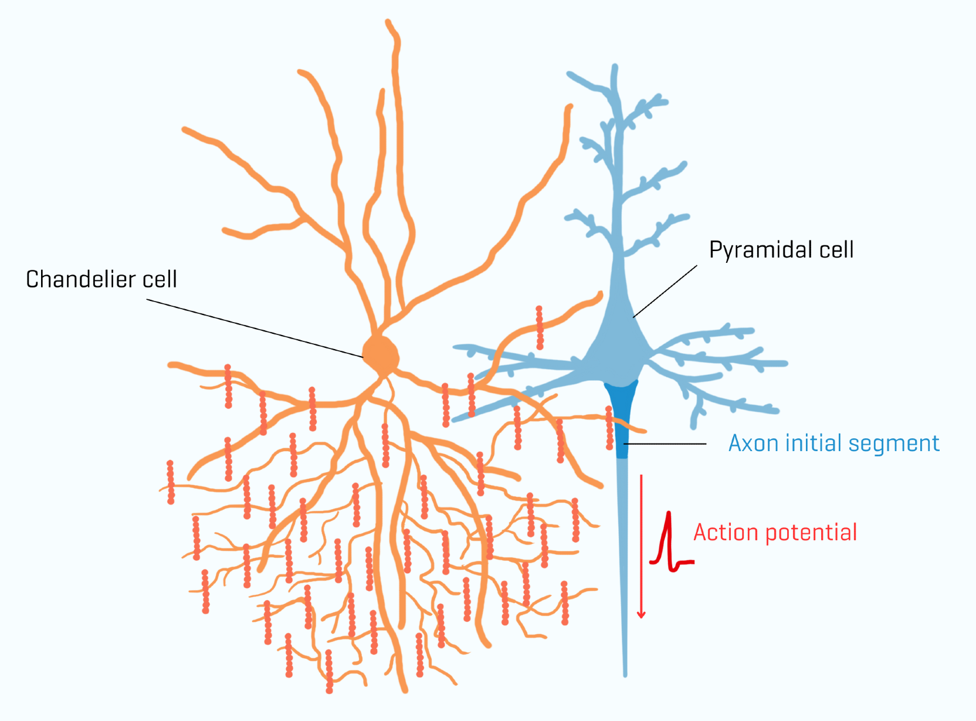
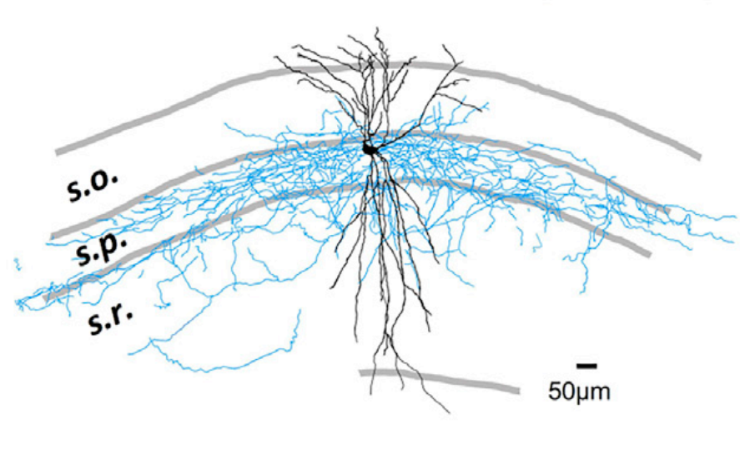
Extended Data Fig. 3a, b, d, e (Motor Coupling): DS2 linked with transient physiological arousal; Ripples are absent.
Circuit Mechanisms (The Gatekeepers)
Extended Data Fig. 5 (The "Offline" Precondition): Low prior arousal predicts evoked DS2
Reflex magnitude is identical across trials (P>0.5), yet DS2 generation is strictly gated by pre-stimulus immobility (P<0.0001).
Extended Data Fig. 3c, f (Neural State): DS2 neural dynamics map to arousal
GABAergic axo-axonic cell (AAC)
a.k.a AACs (ChC)
"Theta Off, Ripple On" (TORO) cells.
Extended Data Fig. 3g (Sensory Tuning): Auditory stimuli selectively trigger DS2
The Question: How does the hippocampus toggle between "Offline" (SPW-R) and "Online" (via DS2)?
CORE INSIGHT
"DS2 is a high-speed, sensory-driven reflex that instantly toggles the brain from 'Offline' to 'Online'."
The Answer: Two distinct inhibitory cell types act as opposing “Gatekeepers"
Notes:
Double check arrow locaiton
Role: It processes non-spatial information, specifically Object and Context information.
Connection: It provides the upstream input that drives Type 1 Dentate Spikes (DS1).
Anatomical Target: Its inputs target the Outer Molecular Layer (OML) of the Dentate Gyrus.

Slide 57
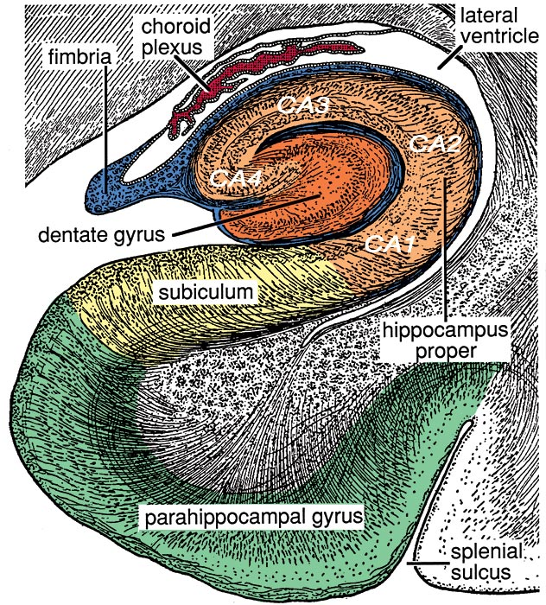
The Gatekeepers
The Question: How does the hippocampus toggle between “Offline" (SPW-R) and “Online" (
)?
Two distinct inhibitory cell types act as opposing “Gatekeepers"
The Identity: Inhibitory interneurons visually famous for their chandelier-like shape
GABAergic axo-axonic cell (AAC)
a.k.a Chandelier Cells (ChC)
"Theta Off, Ripple On" (TORO) cells.
YOU ARE HERE
Notes:
Double check arrow locaiton
Role: It processes non-spatial information, specifically Object and Context information.
Connection: It provides the upstream input that drives Type 1 Dentate Spikes (DS1).
Anatomical Target: Its inputs target the Outer Molecular Layer (OML) of the Dentate Gyrus.

Slide 58
The Gatekeepers
The Question: How does the hippocampus toggle between “Offline" (SPW-R) and “Online" (DS2)?
Two distinct inhibitory cell types act as opposing “Gatekeepers"
The Identity: Inhibitory interneurons visually famous for their chandelier-like shape
GABAergic axo-axonic cell (AAC)
a.k.a Chandelier Cells (ChC)
"Theta Off, Ripple On" (TORO) cells.
YOU ARE HERE
Notes:
Double check arrow locaiton
Role: It processes non-spatial information, specifically Object and Context information.
Connection: It provides the upstream input that drives Type 1 Dentate Spikes (DS1).
Anatomical Target: Its inputs target the Outer Molecular Layer (OML) of the Dentate Gyrus.

Slide 59
The Gatekeepers: Meet The AACs
AAC
The Identity: Inhibitory interneurons visually famous for their chandelier-like shape
The "Choke Point" Control: Synapse directly on Axon Initial Segment (AIS), granting them ultimate veto power to stop a signal.
"Theta Off, Ripple On" (TORO) cells.
YOU ARE HERE
Notes:
Double check arrow locaiton
Role: It processes non-spatial information, specifically Object and Context information.
Connection: It provides the upstream input that drives Type 1 Dentate Spikes (DS1).
Anatomical Target: Its inputs target the Outer Molecular Layer (OML) of the Dentate Gyrus.

Slide 60
The Gatekeepers: Meet The AACs
AAC
The Identity: Inhibitory interneurons visually famous for their chandelier-like shape
The "Choke Point" Control: Synapse directly on Axon Initial Segment (AIS), granting them ultimate veto power to stop a signal.
"Theta Off, Ripple On" (TORO) cells.
The Main Output: CA1 Pyramidal neurons broadcast all navigation and memory signals. (A.K.A: Place Cells)
CA1
YOU ARE HERE
Notes:
Double check arrow locaiton
Role: It processes non-spatial information, specifically Object and Context information.
Connection: It provides the upstream input that drives Type 1 Dentate Spikes (DS1).
Anatomical Target: Its inputs target the Outer Molecular Layer (OML) of the Dentate Gyrus.

Slide 61
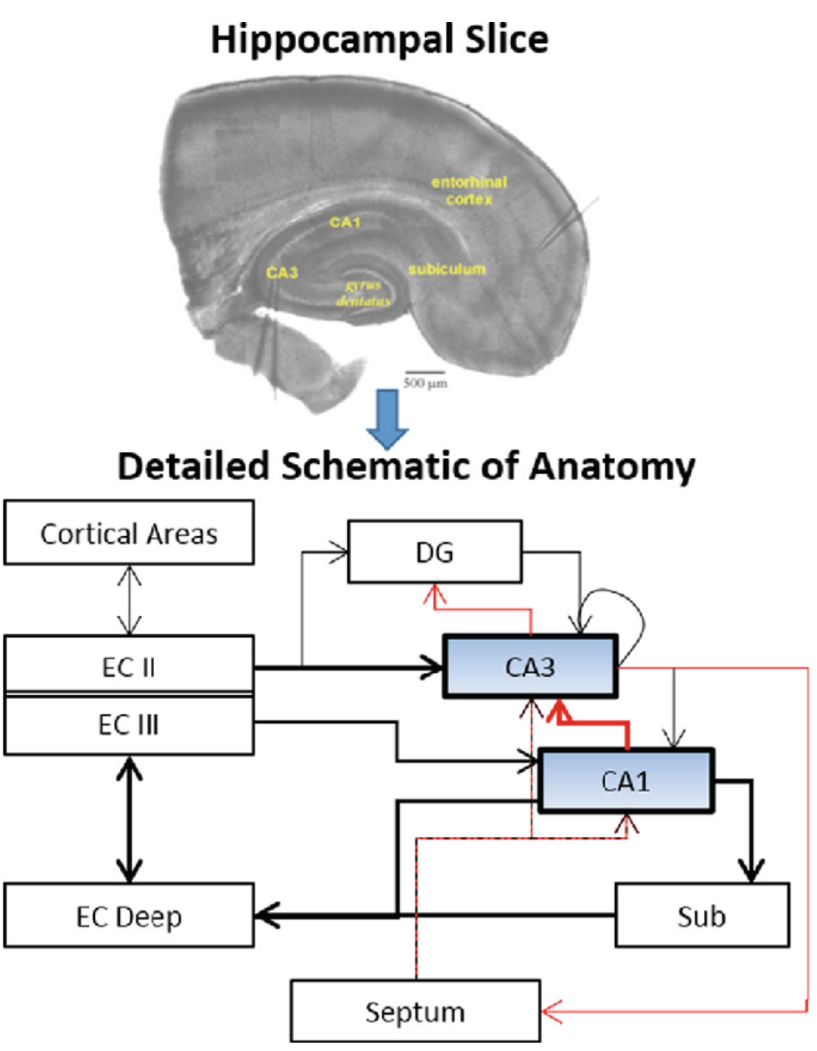
The Gatekeepers: Meet The AACs
AAC
The Identity: Inhibitory interneurons visually famous for their chandelier-like shape
The "Choke Point" Control: Synapse directly on Axon Initial Segment (AIS), granting them ultimate veto power to stop a signal.
"Theta Off, Ripple On" (TORO) cells.
The Main Output: CA1 Pyramidal neurons broadcast all navigation and memory signals. (A.K.A: Place Cells)
CA1
AACs hold the "mute button" that decides when the brain can update its map or store a memory.
Notes:
Double check arrow locaiton
Role: It processes non-spatial information, specifically Object and Context information.
Connection: It provides the upstream input that drives Type 1 Dentate Spikes (DS1).
Anatomical Target: Its inputs target the Outer Molecular Layer (OML) of the Dentate Gyrus.

Slide 62
The Gatekeepers: Meet The AACs
The Identity: Inhibitory interneurons visually famous for their chandelier-like shape
The "Choke Point" Control: Synapse directly on Axon Initial Segment (AIS), granting them ultimate veto power to stop a signal.
"Theta Off, Ripple On" (TORO) cells.
The Main Output: CA1 Pyramidal neurons broadcast all navigation and memory signals. (A.K.A: Place Cells)
AACs hold the "mute button" that decides when the brain can update its map or store a memory.
AAC
CA1 →
Notes:
Double check arrow locaiton
Role: It processes non-spatial information, specifically Object and Context information.
Connection: It provides the upstream input that drives Type 1 Dentate Spikes (DS1).
Anatomical Target: Its inputs target the Outer Molecular Layer (OML) of the Dentate Gyrus.

Slide 63
The Gatekeepers: Meet The AACs
The Identity: Inhibitory interneurons visually famous for their chandelier-like shape
The "Choke Point" Control: Synapse directly on Axon Initial Segment (AIS), granting them ultimate veto power to stop a signal.
"Theta Off, Ripple On" (TORO) cells.
The Main Output: CA1 Pyramidal neurons broadcast all navigation and memory signals. (A.K.A: Place Cells)
AACs hold the "mute button" that decides when the brain can update its map or store a memory.
AAC
CA1 → Subiculum
Notes:
Double check arrow locaiton
Role: It processes non-spatial information, specifically Object and Context information.
Connection: It provides the upstream input that drives Type 1 Dentate Spikes (DS1).
Anatomical Target: Its inputs target the Outer Molecular Layer (OML) of the Dentate Gyrus.

Slide 64
The Gatekeepers: Meet The AACs
The Identity: Inhibitory interneurons visually famous for their chandelier-like shape
The "Choke Point" Control: Synapse directly on Axon Initial Segment (AIS), granting them ultimate veto power to stop a signal.
"Theta Off, Ripple On" (TORO) cells.
The Main Output: CA1 Pyramidal neurons broadcast all navigation and memory signals. (A.K.A: Place Cells)
AACs hold the "mute button" that decides when the brain can update its map or store a memory.
AAC
CA1 → Subiculum →Entorhinal Cortex
Notes:
Double check arrow locaiton
Role: It processes non-spatial information, specifically Object and Context information.
Connection: It provides the upstream input that drives Type 1 Dentate Spikes (DS1).
Anatomical Target: Its inputs target the Outer Molecular Layer (OML) of the Dentate Gyrus.

Slide 65
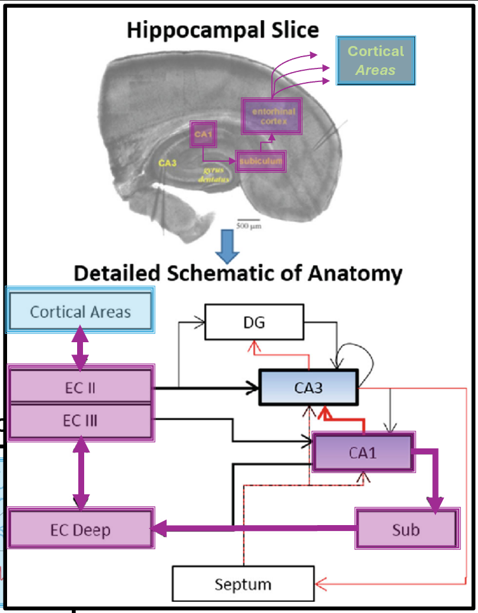
The Gatekeepers: Meet The AACs
Cortical
Areas
The Identity: Inhibitory interneurons visually famous for their chandelier-like shape
The "Choke Point" Control: Synapse directly on Axon Initial Segment (AIS), granting them ultimate veto power to stop a signal.
"Theta Off, Ripple On" (TORO) cells.
The Main Output: CA1 Pyramidal neurons broadcast all navigation and memory signals. (A.K.A: Place Cells)
AACs hold the "mute button" that decides when the brain can update its map or store a memory.
AAC
CA1 → Subiculum →Entorhinal Cortex → Cortical Areas
Notes:
Double check arrow locaiton
Role: It processes non-spatial information, specifically Object and Context information.
Connection: It provides the upstream input that drives Type 1 Dentate Spikes (DS1).
Anatomical Target: Its inputs target the Outer Molecular Layer (OML) of the Dentate Gyrus.

Slide 66
The Gatekeepers: Meet The AACs
The Identity: Inhibitory interneurons visually famous for their chandelier-like shape
AAC
The "Choke Point" Control: Synapse directly on Axon Initial Segment (AIS), granting them ultimate veto power to stop a signal.
"Theta Off, Ripple On" (TORO) cells.
The Main Output: CA1 Pyramidal neurons broadcast all navigation and memory signals. (A.K.A: Place Cells)
CA1 → Subiculum →Entorhinal Cortex → Cortical Areas
AACs hold the "mute button" that decides when the brain can update its map or store a memory.
Notes:
Double check arrow locaiton
Role: It processes non-spatial information, specifically Object and Context information.
Connection: It provides the upstream input that drives Type 1 Dentate Spikes (DS1).
Anatomical Target: Its inputs target the Outer Molecular Layer (OML) of the Dentate Gyrus.

Slide 67
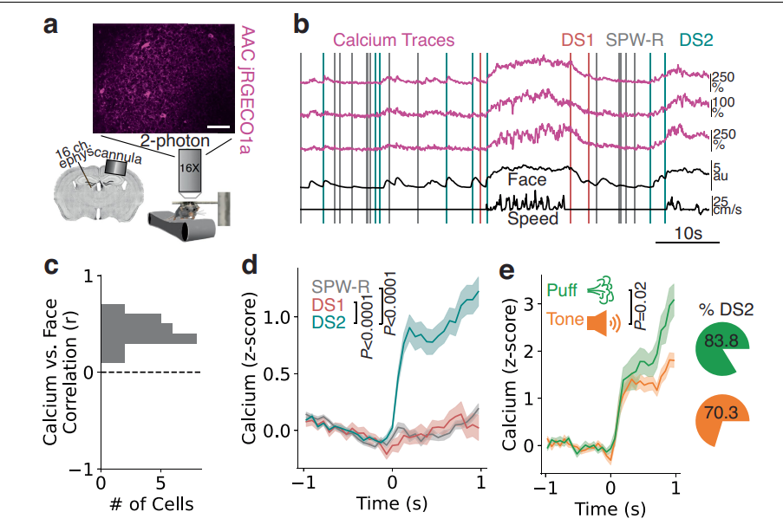
The Gatekeepers: Meet The AACs
The Identity: Inhibitory interneurons visually famous for their chandelier-like shape
AAC
The "Choke Point" Control: Synapse directly on Axon Initial Segment (AIS), granting them ultimate veto power to stop a signal.
"Theta Off, Ripple On" (TORO) cells.
The Main Output: CA1 Pyramidal neurons broadcast all navigation and memory signals. (A.K.A: Place Cells)
CA1 → Subiculum →Entorhinal Cortex → Cortical Areas
AACs hold the "mute button" that decides when the brain can update its map or store a memory.
Notes:
Double check arrow locaiton
Role: It processes non-spatial information, specifically Object and Context information.
Connection: It provides the upstream input that drives Type 1 Dentate Spikes (DS1).
Anatomical Target: Its inputs target the Outer Molecular Layer (OML) of the Dentate Gyrus.

Slide 68
"Theta Off, Ripple On" (TORO) cells.
AAC
Extended Data Fig. 6a (Experimental Setup): Imaging AACs during behavior
The "Choke Point" Control: Synapse directly on Axon Initial Segment (AIS), granting them ultimate veto power to stop a signal.
The Main Output: CA1 Pyramidal neurons broadcast all navigation and memory signals. (A.K.A: Place Cells)
AACs hold the "mute button" that decides when the brain can update its map or store a memory.
Linking AACs with DS2
Notes:
Double check arrow locaiton
Role: It processes non-spatial information, specifically Object and Context information.
Connection: It provides the upstream input that drives Type 1 Dentate Spikes (DS1).
Anatomical Target: Its inputs target the Outer Molecular Layer (OML) of the Dentate Gyrus.

Slide 69
"Theta Off, Ripple On" (TORO) cells.
Linking AACs with DS2
Extended Data Fig. 6b (Raw Traces): AACs track start of movement and DS2
Extended Data Fig. 6a (Experimental Setup): Imaging AACs during behavior
The Main Output: CA1 Pyramidal neurons broadcast all navigation and memory signals. (A.K.A: Place Cells)
AACs hold the "mute button" that decides when the brain can update its map or store a memory.
Notes:
Double check arrow locaiton
Role: It processes non-spatial information, specifically Object and Context information.
Connection: It provides the upstream input that drives Type 1 Dentate Spikes (DS1).
Anatomical Target: Its inputs target the Outer Molecular Layer (OML) of the Dentate Gyrus.

Slide 70
"Theta Off, Ripple On" (TORO) cells.
Linking AACs with DS2
Extended Data Fig. 6b (Raw Traces): AACs track start of movement and DS2
The Main Output: CA1 Pyramidal neurons broadcast all navigation and memory signals. (A.K.A: Place Cells)
AACs hold the "mute button" that decides when the brain can update its map or store a memory.
Extended Data Fig. 6a (Experimental Setup):Imaging AACs during behavior
Notes:
Double check arrow locaiton
Role: It processes non-spatial information, specifically Object and Context information.
Connection: It provides the upstream input that drives Type 1 Dentate Spikes (DS1).
Anatomical Target: Its inputs target the Outer Molecular Layer (OML) of the Dentate Gyrus.

Slide 71
"Theta Off, Ripple On" (TORO) cells.
Linking AACs with DS2
Extended Data Fig. 6b (Raw Traces): AACs track start of movement and DS2
The Main Output: CA1 Pyramidal neurons broadcast all navigation and memory signals. (A.K.A: Place Cells)
AACs hold the "mute button" that decides when the brain can update its map or store a memory.
Extended Data Fig. 6a (Experimental Setup):Imaging AACs during behavior
Notes:
Double check arrow locaiton
Role: It processes non-spatial information, specifically Object and Context information.
Connection: It provides the upstream input that drives Type 1 Dentate Spikes (DS1).
Anatomical Target: Its inputs target the Outer Molecular Layer (OML) of the Dentate Gyrus.

Slide 72
"Theta Off, Ripple On" (TORO) cells.
Linking AACs with DS2
Extended Data Fig. 6b (Raw Traces): AACs track start of movement and DS2
The Main Output: CA1 Pyramidal neurons broadcast all navigation and memory signals. (A.K.A: Place Cells)
AACs hold the "mute button" that decides when the brain can update its map or store a memory.
Extended Data Fig. 6a (Experimental Setup):Imaging AACs during behavior
Notes:
Double check arrow locaiton
Role: It processes non-spatial information, specifically Object and Context information.
Connection: It provides the upstream input that drives Type 1 Dentate Spikes (DS1).
Anatomical Target: Its inputs target the Outer Molecular Layer (OML) of the Dentate Gyrus.

Slide 73
"Theta Off, Ripple On" (TORO) cells.
Linking AACs with DS2
Extended Data Fig. 6b (Raw Traces): AACs track start of movement and DS2
The Main Output: CA1 Pyramidal neurons broadcast all navigation and memory signals. (A.K.A: Place Cells)
AACs hold the "mute button" that decides when the brain can update its map or store a memory.
Extended Data Fig. 6a (Experimental Setup):Imaging AACs during behavior
Notes:
Double check arrow locaiton
Role: It processes non-spatial information, specifically Object and Context information.
Connection: It provides the upstream input that drives Type 1 Dentate Spikes (DS1).
Anatomical Target: Its inputs target the Outer Molecular Layer (OML) of the Dentate Gyrus.

Slide 74
"Theta Off, Ripple On" (TORO) cells.
Linking AACs with DS2
Extended Data Fig. 6b (Raw Traces): AACs track start of movement and DS2
The Main Output: CA1 Pyramidal neurons broadcast all navigation and memory signals. (A.K.A: Place Cells)
AACs hold the "mute button" that decides when the brain can update its map or store a memory.
Extended Data Fig. 6a (Experimental Setup):Imaging AACs during behavior
Notes:
Double check arrow locaiton
Role: It processes non-spatial information, specifically Object and Context information.
Connection: It provides the upstream input that drives Type 1 Dentate Spikes (DS1).
Anatomical Target: Its inputs target the Outer Molecular Layer (OML) of the Dentate Gyrus.

Slide 75
"Theta Off, Ripple On" (TORO) cells.
Linking AACs with DS2
Extended Data Fig. 6b (Raw Traces): AACs track start of movement and DS2
Extended Data Fig. 6c (Behavioral Correlation): AAC activity correlates with facial motion
AACs hold the "mute button" that decides when the brain can update its map or store a memory.
Extended Data Fig. 6a (Experimental Setup):Imaging AACs during behavior
Notes:
Double check arrow locaiton
Role: It processes non-spatial information, specifically Object and Context information.
Connection: It provides the upstream input that drives Type 1 Dentate Spikes (DS1).
Anatomical Target: Its inputs target the Outer Molecular Layer (OML) of the Dentate Gyrus.

Slide 76
"Theta Off, Ripple On" (TORO) cells.
Linking AACs with DS2
Extended Data Fig. 6d (Event Coupling): AACs selectively active during DS2
Extended Data Fig. 6c (Behavioral Correlation): AAC activity correlates with facial motion
Extended Data Fig. 6a (Experimental Setup):Imaging AACs during behavior
Extended Data Fig. 6b (Raw Traces): AACs track start of movement and DS2
Notes:
Double check arrow locaiton
Role: It processes non-spatial information, specifically Object and Context information.
Connection: It provides the upstream input that drives Type 1 Dentate Spikes (DS1).
Anatomical Target: Its inputs target the Outer Molecular Layer (OML) of the Dentate Gyrus.

Slide 77
"Theta Off, Ripple On" (TORO) cells.
Linking AACs with DS2
Extended Data Fig. 6d (Event Coupling): AACs selectively active during DS2
Extended Data Fig. 6e (Sensory Response):
Sensory stimuli evoke AAC activity
Extended Data Fig. 6a (Experimental Setup):Imaging AACs during behavior
Extended Data Fig. 6b (Raw Traces): AACs track start of movement and DS2
Extended Data Fig. 6c (Behavioral Correlation): AAC activity correlates with facial motion
Notes:
Double check arrow locaiton
Role: It processes non-spatial information, specifically Object and Context information.
Connection: It provides the upstream input that drives Type 1 Dentate Spikes (DS1).
Anatomical Target: Its inputs target the Outer Molecular Layer (OML) of the Dentate Gyrus.

Slide 78
"Theta Off, Ripple On" (TORO) cells.
Linking AACs with DS2
CORE INSIGHT
AACs are selectively recruited to "direct information flow" during the onset of the Online (DS2) state, while remaining silent during Offline (SPW-R) replay.
Extended Data Fig. 6e (Sensory Response):
Sensory stimuli evoke AAC activity
Extended Data Fig. 6a (Experimental Setup):Imaging AACs during behavior
Extended Data Fig. 6b (Raw Traces): AACs track start of movement and DS2
Extended Data Fig. 6c (Behavioral Correlation): AAC activity correlates with facial motion
Extended Data Fig. 6d (Event Coupling): AACs selectively active during DS2
Notes:
Double check arrow locaiton
Role: It processes non-spatial information, specifically Object and Context information.
Connection: It provides the upstream input that drives Type 1 Dentate Spikes (DS1).
Anatomical Target: Its inputs target the Outer Molecular Layer (OML) of the Dentate Gyrus.

Slide 79
Linking AACs with DS2
Extended Data Fig. 6a (Experimental Setup):Imaging AACs during behavior
Extended Data Fig. 6b (Raw Traces): AACs track start of movement and DS2
CORE INSIGHT
AACs are selectively recruited to "direct information flow" during the onset of the Online (DS2) state, while remaining silent during Offline (SPW-R) replay.
"Theta Off, Ripple On" (TORO) cells.
Extended Data Fig. 6c (Behavioral Correlation): AAC activity correlates with facial motion
Extended Data Fig. 6d (Event Coupling): AACs selectively active during DS2
Extended Data Fig. 6e (Sensory Response):
Sensory stimuli evoke AAC activity
Notes:
Double check arrow locaiton
Role: It processes non-spatial information, specifically Object and Context information.
Connection: It provides the upstream input that drives Type 1 Dentate Spikes (DS1).
Anatomical Target: Its inputs target the Outer Molecular Layer (OML) of the Dentate Gyrus.

Slide 80
The Gatekeepers
Extended Data Fig. 6a (Experimental Setup):Imaging AACs during behavior
Extended Data Fig. 6b (Raw Traces): AACs track start of movement and DS2
Two distinct inhibitory cell types act as opposing “Gatekeepers"
CORE INSIGHT
AACs are selectively recruited to "direct information flow" during the onset of the Online (DS2) state, while remaining strictly silent during Offline (SPW-R) replay.
GABAergic axo-axonic cell (AAC)
a.k.a Chandelier Cells (ChC)
"Theta Off, Ripple On" (TORO) cells.
Extended Data Fig. 6c (Behavioral Correlation): AAC activity correlates with facial motion
Extended Data Fig. 6d (Event Coupling): AACs selectively active during DS2
Extended Data Fig. 6e (Sensory Response):
Sensory stimuli evoke AAC activity
Notes:
Double check arrow locaiton
Role: It processes non-spatial information, specifically Object and Context information.
Connection: It provides the upstream input that drives Type 1 Dentate Spikes (DS1).
Anatomical Target: Its inputs target the Outer Molecular Layer (OML) of the Dentate Gyrus.

Slide 81


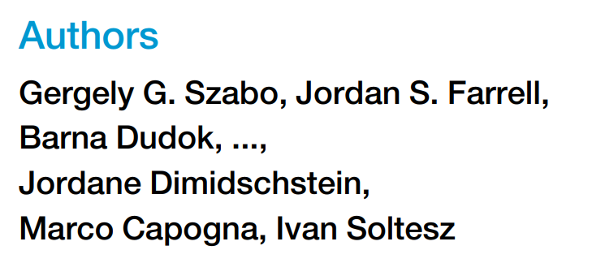

CORE INSIGHT
AACs are selectively recruited to "direct information flow" during the onset of the Online (DS2) state, while remaining strictly silent during Offline (SPW-R) replay.
The Gatekeepers
Two distinct inhibitory cell types act as opposing “Gatekeepers"
Extended Data Fig. 6a (Experimental Setup):Imaging AACs during behavior
Extended Data Fig. 6b (Raw Traces): AACs track start of movement and DS2
GABAergic axo-axonic cell (AAC)
a.k.a Chandelier Cells (ChC)
"Theta Off, Ripple On" (TORO) cells.
A specific class of GABAergic neurons located in the CA1 region.
Extended Data Fig. 6c (Behavioral Correlation): AAC activity correlates with facial motion
Extended Data Fig. 6d (Event Coupling): AACs selectively active during DS2
Extended Data Fig. 6e (Sensory Response):
Sensory stimuli evoke AAC activity
YOU ARE HERE
Notes:
Double check arrow locaiton
Role: It processes non-spatial information, specifically Object and Context information.
Connection: It provides the upstream input that drives Type 1 Dentate Spikes (DS1).
Anatomical Target: Its inputs target the Outer Molecular Layer (OML) of the Dentate Gyrus.

Slide 82
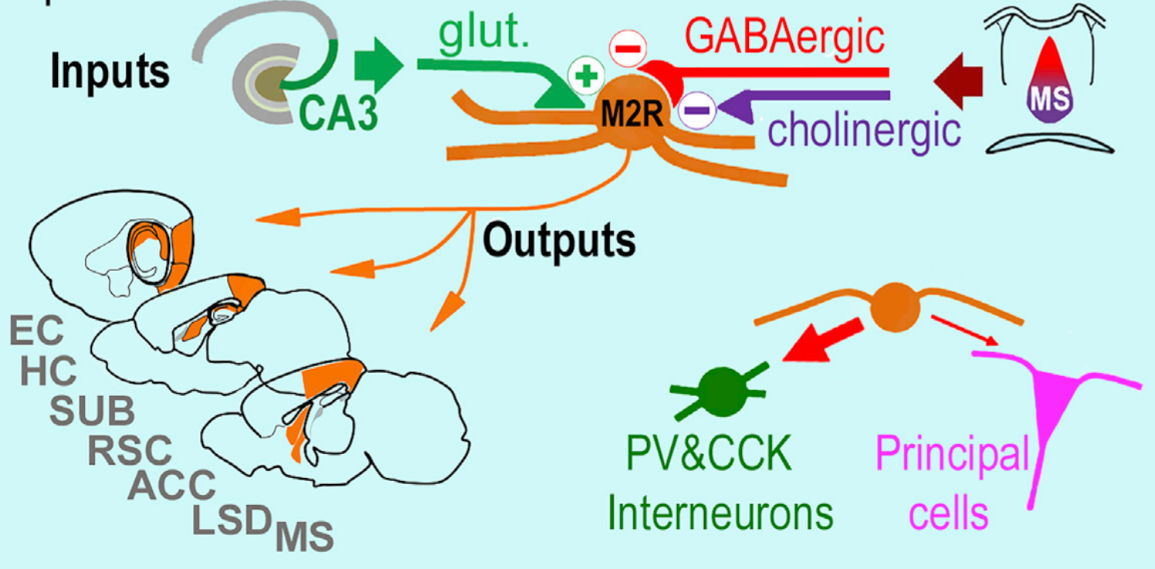
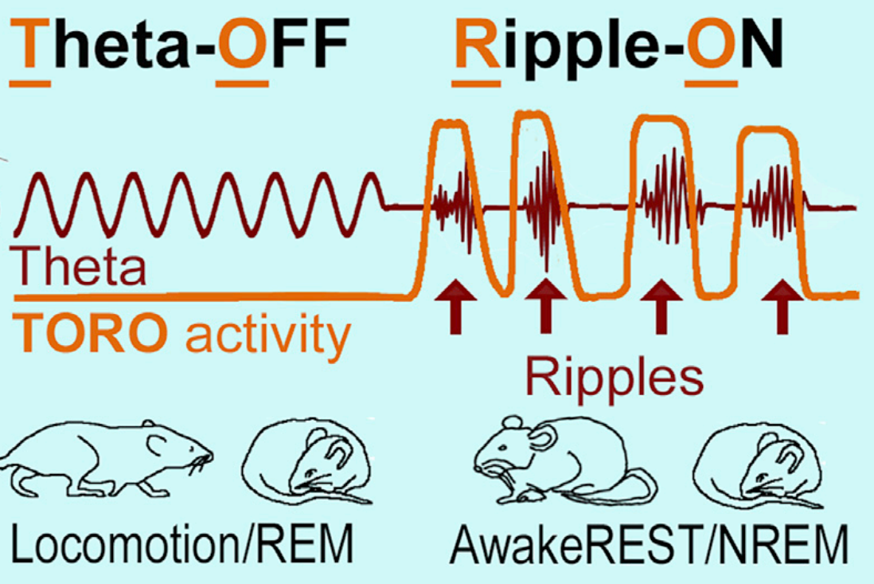
The Gatekeepers: Meet The TORO Cells
Two distinct inhibitory cell types act as opposing “Gatekeepers"
CORE INSIGHT
AACs are selectively recruited to "direct information flow" during the onset of the Online (DS2) state, while remaining strictly silent during Offline (SPW-R) replay.
GABAergic axo-axonic cell (AAC)
a.k.a Chandelier Cells (ChC)
"Theta Off, Ripple On" (TORO) cells.
A specific class of GABAergic neurons located in the CA1 region.
Extended Data Fig. 6c (Behavioral Correlation): AAC activity correlates with facial motion
Extended Data Fig. 6d (Event Coupling): AACs selectively active during DS2
M2 receptors; sensitive to Acetylcholine (the "Alertness/Arousal" neurotransmitter).
Arousal → Ach flood→ TORO inhibition → Theta
Extended Data Fig. 6e (Sensory Response):
Sensory stimuli evoke AAC activity
YOU ARE HERE
Notes:
Double check arrow locaiton
Role: It processes non-spatial information, specifically Object and Context information.
Connection: It provides the upstream input that drives Type 1 Dentate Spikes (DS1).
Anatomical Target: Its inputs target the Outer Molecular Layer (OML) of the Dentate Gyrus.

Slide 83
The Gatekeepers: Meet The TORO Cells
Two distinct inhibitory cell types act as opposing “Gatekeepers"
CORE INSIGHT
AACs are selectively recruited to "direct information flow" during the onset of the Online (DS2) state, while remaining strictly silent during Offline (SPW-R) replay.
GABAergic axo-axonic cell (AAC)
a.k.a Chandelier Cells (ChC)
"Theta Off, Ripple On" (TORO) cells.
A specific class of GABAergic neurons located in the CA1 region.
Extended Data Fig. 6c (Behavioral Correlation): AAC activity correlates with facial motion
Extended Data Fig. 6d (Event Coupling): AACs selectively active during DS2
M2 receptors; sensitive to Acetylcholine (the "Alertness/Arousal" neurotransmitter).
Arousal → Ach flood→ TORO inhibition → Theta
Extended Data Fig. 6e (Sensory Response):
Sensory stimuli evoke AAC activity
YOU ARE HERE
Notes:
Double check arrow locaiton
Role: It processes non-spatial information, specifically Object and Context information.
Connection: It provides the upstream input that drives Type 1 Dentate Spikes (DS1).
Anatomical Target: Its inputs target the Outer Molecular Layer (OML) of the Dentate Gyrus.

Slide 84
The Gatekeepers: Meet The TORO Cells
Two distinct inhibitory cell types act as opposing “Gatekeepers"
CORE INSIGHT
AACs are selectively recruited to "direct information flow" during the onset of the Online (DS2) state, while remaining strictly silent during Offline (SPW-R) replay.
GABAergic axo-axonic cell (AAC)
a.k.a Chandelier Cells (ChC)
"Theta Off, Ripple On" (TORO) cells.
A specific class of GABAergic neurons located in the CA1 region.
Extended Data Fig. 6c (Behavioral Correlation): AAC activity correlates with facial motion
Extended Data Fig. 6d (Event Coupling): AACs selectively active during DS2
Extended Data Fig. 6e (Sensory Response):
Sensory stimuli evoke AAC activity
YOU ARE HERE
Notes:
Double check arrow locaiton
Role: It processes non-spatial information, specifically Object and Context information.
Connection: It provides the upstream input that drives Type 1 Dentate Spikes (DS1).
Anatomical Target: Its inputs target the Outer Molecular Layer (OML) of the Dentate Gyrus.

Slide 85
The Gatekeepers: Meet The TORO Cells
Two distinct inhibitory cell types act as opposing “Gatekeepers"
CORE INSIGHT
AACs are selectively recruited to "direct information flow" during the onset of the Online (DS2) state, while remaining strictly silent during Offline (SPW-R) replay.
GABAergic axo-axonic cell (AAC)
a.k.a Chandelier Cells (ChC)
"Theta Off, Ripple On" (TORO) cells.
A specific class of GABAergic neurons located in the CA1 region.
M2 receptors; sensitive to Acetylcholine (the "Alertness/Arousal" neurotransmitter).
Extended Data Fig. 6c (Behavioral Correlation): AAC activity correlates with facial motion
Extended Data Fig. 6d (Event Coupling): AACs selectively active during DS2
Arousal →
Extended Data Fig. 6e (Sensory Response):
Sensory stimuli evoke AAC activity
YOU ARE HERE
Notes:
Double check arrow locaiton
Role: It processes non-spatial information, specifically Object and Context information.
Connection: It provides the upstream input that drives Type 1 Dentate Spikes (DS1).
Anatomical Target: Its inputs target the Outer Molecular Layer (OML) of the Dentate Gyrus.

Slide 86
The Gatekeepers: Meet The TORO Cells
Two distinct inhibitory cell types act as opposing “Gatekeepers"
CORE INSIGHT
AACs are selectively recruited to "direct information flow" during the onset of the Online (DS2) state, while remaining strictly silent during Offline (SPW-R) replay.
GABAergic axo-axonic cell (AAC)
a.k.a Chandelier Cells (ChC)
"Theta Off, Ripple On" (TORO) cells.
A specific class of GABAergic neurons located in the CA1 region.
M2 receptors; sensitive to Acetylcholine (the "Alertness/Arousal" neurotransmitter).
Extended Data Fig. 6c (Behavioral Correlation): AAC activity correlates with facial motion
Extended Data Fig. 6d (Event Coupling): AACs selectively active during DS2
Arousal →
Extended Data Fig. 6e (Sensory Response):
Sensory stimuli evoke AAC activity
YOU ARE HERE
Notes:
Double check arrow locaiton
Role: It processes non-spatial information, specifically Object and Context information.
Connection: It provides the upstream input that drives Type 1 Dentate Spikes (DS1).
Anatomical Target: Its inputs target the Outer Molecular Layer (OML) of the Dentate Gyrus.

Slide 87

The Gatekeepers: Meet The TORO Cells
Two distinct inhibitory cell types act as opposing “Gatekeepers"
CORE INSIGHT
AACs are selectively recruited to "direct information flow" during the onset of the Online (DS2) state, while remaining strictly silent during Offline (SPW-R) replay.
"Theta Off, Ripple On" (TORO) cells.
A specific class of GABAergic neurons located in the CA1 region.
M2 receptors; sensitive to Acetylcholine (the "Alertness/Arousal" neurotransmitter).
Extended Data Fig. 6c (Behavioral Correlation): AAC activity correlates with facial motion
Extended Data Fig. 6d (Event Coupling): AACs selectively active during DS2
Arousal →
Extended Data Fig. 6e (Sensory Response):
Sensory stimuli evoke AAC activity
YOU ARE HERE
Notes:
Double check arrow locaiton
Role: It processes non-spatial information, specifically Object and Context information.
Connection: It provides the upstream input that drives Type 1 Dentate Spikes (DS1).
Anatomical Target: Its inputs target the Outer Molecular Layer (OML) of the Dentate Gyrus.

Slide 88
The Gatekeepers: Meet The TORO Cells
Two distinct inhibitory cell types act as opposing “Gatekeepers"
CORE INSIGHT
AACs are selectively recruited to "direct information flow" during the onset of the Online (DS2) state, while remaining strictly silent during Offline (SPW-R) replay.
"Theta Off, Ripple On" (TORO) cells.
A specific class of GABAergic neurons located in the CA1 region.
M2 receptors; sensitive to Acetylcholine (the "Alertness/Arousal" neurotransmitter).
Extended Data Fig. 6c (Behavioral Correlation): AAC activity correlates with facial motion
Extended Data Fig. 6d (Event Coupling): AACs selectively active during DS2
Arousal → ACh Flood →
Extended Data Fig. 6e (Sensory Response):
Sensory stimuli evoke AAC activity
YOU ARE HERE
Notes:
Double check arrow locaiton
Role: It processes non-spatial information, specifically Object and Context information.
Connection: It provides the upstream input that drives Type 1 Dentate Spikes (DS1).
Anatomical Target: Its inputs target the Outer Molecular Layer (OML) of the Dentate Gyrus.

Slide 89
The Gatekeepers: Meet The TORO Cells
Two distinct inhibitory cell types act as opposing “Gatekeepers"
CORE INSIGHT
AACs are selectively recruited to "direct information flow" during the onset of the Online (DS2) state, while remaining strictly silent during Offline (SPW-R) replay.
"Theta Off, Ripple On" (TORO) cells.
A specific class of GABAergic neurons located in the CA1 region.
M2 receptors; sensitive to Acetylcholine (the "Alertness/Arousal" neurotransmitter).
Extended Data Fig. 6c (Behavioral Correlation): AAC activity correlates with facial motion
Extended Data Fig. 6d (Event Coupling): AACs selectively active during DS2
Arousal → ACh Flood → TORO Off →
Extended Data Fig. 6e (Sensory Response):
Sensory stimuli evoke AAC activity
YOU ARE HERE
Notes:
Double check arrow locaiton
Role: It processes non-spatial information, specifically Object and Context information.
Connection: It provides the upstream input that drives Type 1 Dentate Spikes (DS1).
Anatomical Target: Its inputs target the Outer Molecular Layer (OML) of the Dentate Gyrus.

Slide 90
The Gatekeepers: Meet The TORO Cells
Two distinct inhibitory cell types act as opposing “Gatekeepers"
CORE INSIGHT
AACs are selectively recruited to "direct information flow" during the onset of the Online (DS2) state, while remaining strictly silent during Offline (SPW-R) replay.
"Theta Off, Ripple On" (TORO) cells.
A specific class of GABAergic neurons located in the CA1 region.
M2 receptors; sensitive to Acetylcholine (the "Alertness/Arousal" neurotransmitter).
Extended Data Fig. 6c (Behavioral Correlation): AAC activity correlates with facial motion
Extended Data Fig. 6d (Event Coupling): AACs selectively active during DS2
Arousal → ACh Flood → TORO Off → Theta
Extended Data Fig. 6e (Sensory Response):
Sensory stimuli evoke AAC activity
YOU ARE HERE
Notes:
Double check arrow locaiton
Role: It processes non-spatial information, specifically Object and Context information.
Connection: It provides the upstream input that drives Type 1 Dentate Spikes (DS1).
Anatomical Target: Its inputs target the Outer Molecular Layer (OML) of the Dentate Gyrus.

Slide 91
The Gatekeepers: Meet The TORO Cells
Two distinct inhibitory cell types act as opposing “Gatekeepers"
CORE INSIGHT
AACs are selectively recruited to "direct information flow" during the onset of the Online (DS2) state, while remaining strictly silent during Offline (SPW-R) replay.
"Theta Off, Ripple On" (TORO) cells.
A specific class of GABAergic neurons located in the CA1 region.
M2 receptors; sensitive to Acetylcholine (the "Alertness/Arousal" neurotransmitter).
Extended Data Fig. 6c (Behavioral Correlation): AAC activity correlates with facial motion
Extended Data Fig. 6d (Event Coupling): AACs selectively active during DS2
Arousal → ACh Flood → TORO Off → Theta
Extended Data Fig. 6e (Sensory Response):
Sensory stimuli evoke AAC activity
YOU ARE HERE
Notes:
Double check arrow locaiton
Role: It processes non-spatial information, specifically Object and Context information.
Connection: It provides the upstream input that drives Type 1 Dentate Spikes (DS1).
Anatomical Target: Its inputs target the Outer Molecular Layer (OML) of the Dentate Gyrus.

Slide 92
The Gatekeepers: Meet The TORO Cells
Two distinct inhibitory cell types act as opposing “Gatekeepers"
CORE INSIGHT
AACs are selectively recruited to "direct information flow" during the onset of the Online (DS2) state, while remaining strictly silent during Offline (SPW-R) replay.
"Theta Off, Ripple On" (TORO) cells.
A specific class of GABAergic neurons located in the CA1 region.
M2 receptors; sensitive to Acetylcholine (the "Alertness/Arousal" neurotransmitter).
Extended Data Fig. 6c (Behavioral Correlation): AAC activity correlates with facial motion
Extended Data Fig. 6d (Event Coupling): AACs selectively active during DS2
Arousal → ACh Flood → TORO Off → Theta
Extended Data Fig. 6e (Sensory Response):
Sensory stimuli evoke AAC activity
YOU ARE HERE
Notes:
Double check arrow locaiton
Role: It processes non-spatial information, specifically Object and Context information.
Connection: It provides the upstream input that drives Type 1 Dentate Spikes (DS1).
Anatomical Target: Its inputs target the Outer Molecular Layer (OML) of the Dentate Gyrus.

Slide 93
The Gatekeepers: Meet The TORO Cells
Two distinct inhibitory cell types act as opposing “Gatekeepers"
CORE INSIGHT
AACs are selectively recruited to "direct information flow" during the onset of the Online (DS2) state, while remaining strictly silent during Offline (SPW-R) replay.
"Theta Off, Ripple On" (TORO) cells.
A specific class of GABAergic neurons located in the CA1 region.
M2 receptors; sensitive to Acetylcholine (the "Alertness/Arousal" neurotransmitter).
Extended Data Fig. 6c (Behavioral Correlation): AAC activity correlates with facial motion
Extended Data Fig. 6d (Event Coupling): AACs selectively active during DS2
Arousal → ACh Flood → TORO Off → Theta
Extended Data Fig. 6e (Sensory Response):
Sensory stimuli evoke AAC activity
Rest →
Notes:
Double check arrow locaiton
Role: It processes non-spatial information, specifically Object and Context information.
Connection: It provides the upstream input that drives Type 1 Dentate Spikes (DS1).
Anatomical Target: Its inputs target the Outer Molecular Layer (OML) of the Dentate Gyrus.

Slide 94
The Gatekeepers: Meet The TORO Cells
Two distinct inhibitory cell types act as opposing “Gatekeepers"
CORE INSIGHT
AACs are selectively recruited to "direct information flow" during the onset of the Online (DS2) state, while remaining strictly silent during Offline (SPW-R) replay.
"Theta Off, Ripple On" (TORO) cells.
A specific class of GABAergic neurons located in the CA1 region.
M2 receptors; sensitive to Acetylcholine (the "Alertness/Arousal" neurotransmitter).
Extended Data Fig. 6c (Behavioral Correlation): AAC activity correlates with facial motion
Extended Data Fig. 6d (Event Coupling): AACs selectively active during DS2
Arousal → ACh Flood → TORO Off → Theta
Extended Data Fig. 6e (Sensory Response):
Sensory stimuli evoke AAC activity
Rest → No ACh Flood →
Notes:
Double check arrow locaiton
Role: It processes non-spatial information, specifically Object and Context information.
Connection: It provides the upstream input that drives Type 1 Dentate Spikes (DS1).
Anatomical Target: Its inputs target the Outer Molecular Layer (OML) of the Dentate Gyrus.

Slide 95
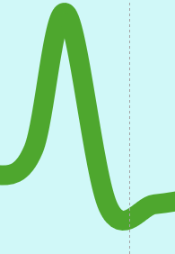

The Gatekeepers: Meet The TORO Cells
Two distinct inhibitory cell types act as opposing “Gatekeepers"
CORE INSIGHT
AACs are selectively recruited to "direct information flow" during the onset of the Online (DS2) state, while remaining strictly silent during Offline (SPW-R) replay.
"Theta Off, Ripple On" (TORO) cells.
A specific class of GABAergic neurons located in the CA1 region.
M2 receptors; sensitive to Acetylcholine (the "Alertness/Arousal" neurotransmitter).
Extended Data Fig. 6c (Behavioral Correlation): AAC activity correlates with facial motion
Extended Data Fig. 6d (Event Coupling): AACs selectively active during DS2
Arousal → ACh Flood → TORO Off → Theta
Extended Data Fig. 6e (Sensory Response):
Sensory stimuli evoke AAC activity
Rest → No ACh Flood → TORO On →
Notes:
Double check arrow locaiton
Role: It processes non-spatial information, specifically Object and Context information.
Connection: It provides the upstream input that drives Type 1 Dentate Spikes (DS1).
Anatomical Target: Its inputs target the Outer Molecular Layer (OML) of the Dentate Gyrus.

Slide 96
The Gatekeepers: Meet The TORO Cells
Two distinct inhibitory cell types act as opposing “Gatekeepers"
CORE INSIGHT
AACs are selectively recruited to "direct information flow" during the onset of the Online (DS2) state, while remaining strictly silent during Offline (SPW-R) replay.
"Theta Off, Ripple On" (TORO) cells.
A specific class of GABAergic neurons located in the CA1 region.
M2 receptors; sensitive to Acetylcholine (the "Alertness/Arousal" neurotransmitter).
Extended Data Fig. 6c (Behavioral Correlation): AAC activity correlates with facial motion
Extended Data Fig. 6d (Event Coupling): AACs selectively active during DS2
Arousal → ACh Flood → TORO Off → Theta
Extended Data Fig. 6e (Sensory Response):
Sensory stimuli evoke AAC activity
Rest → No ACh Flood → TORO On → SPW-R
Notes:
Double check arrow locaiton
Role: It processes non-spatial information, specifically Object and Context information.
Connection: It provides the upstream input that drives Type 1 Dentate Spikes (DS1).
Anatomical Target: Its inputs target the Outer Molecular Layer (OML) of the Dentate Gyrus.

Slide 97
The Gatekeepers: Meet The TORO Cells
Two distinct inhibitory cell types act as opposing “Gatekeepers"
CORE INSIGHT
AACs are selectively recruited to "direct information flow" during the onset of the Online (DS2) state, while remaining strictly silent during Offline (SPW-R) replay.
"Theta Off, Ripple On" (TORO) cells.
A specific class of GABAergic neurons located in the CA1 region.
M2 receptors; sensitive to Acetylcholine (the "Alertness/Arousal" neurotransmitter).
Extended Data Fig. 6c (Behavioral Correlation): AAC activity correlates with facial motion
Extended Data Fig. 6d (Event Coupling): AACs selectively active during DS2
Arousal → ACh Flood → TORO Off → Theta
Extended Data Fig. 6e (Sensory Response):
Sensory stimuli evoke AAC activity
Rest → No ACh Flood → TORO On → SPW-R
Notes:
Double check arrow locaiton
Role: It processes non-spatial information, specifically Object and Context information.
Connection: It provides the upstream input that drives Type 1 Dentate Spikes (DS1).
Anatomical Target: Its inputs target the Outer Molecular Layer (OML) of the Dentate Gyrus.

Slide 98
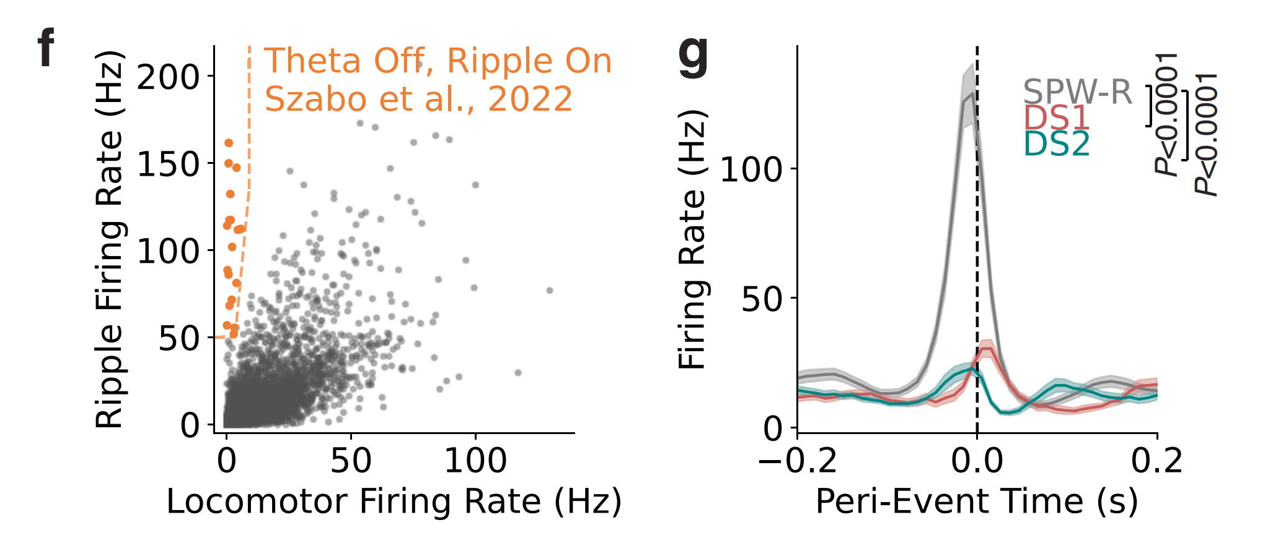
The Gatekeepers: Meet The TORO Cells
Two distinct inhibitory cell types act as opposing “Gatekeepers"
CORE INSIGHT
AACs are selectively recruited to "direct information flow" during the onset of the Online (DS2) state, while remaining strictly silent during Offline (SPW-R) replay.
"Theta Off, Ripple On" (TORO) cells.
A specific class of GABAergic neurons located in the CA1 region.
Arousal → ACh Flood → TORO Off → Theta
Extended Data Fig. 6c (Behavioral Correlation): AAC activity correlates with facial motion
Extended Data Fig. 6d (Event Coupling): AACs selectively active during DS2
M2 receptors; sensitive to Acetylcholine (the "Alertness/Arousal" neurotransmitter).
Rest → No ACh Flood → TORO On → SPW-R
Extended Data Fig. 6e (Sensory Response):
Sensory stimuli evoke AAC activity
Notes:
Double check arrow locaiton
Role: It processes non-spatial information, specifically Object and Context information.
Connection: It provides the upstream input that drives Type 1 Dentate Spikes (DS1).
Anatomical Target: Its inputs target the Outer Molecular Layer (OML) of the Dentate Gyrus.

Slide 99
Extended Data Fig. 6f (TORO Cell Identification):
TORO cells identified; favor ripples over locomotion
The "Choke Point" Control: Synapse directly on Axon Initial Segment (AIS), granting them ultimate veto power to stop a signal.
"Theta Off, Ripple On" (TORO) cells.
The Main Output: CA1 Pyramidal neurons broadcast all navigation and memory signals. (A.K.A: Place Cells)
AACs hold the "mute button" that decides when the brain can update its map or store a memory.
Linking TORO Cells With SPW-R (And Not DS2)
Two distinct inhibitory cell types act as opposing “Gatekeepers"
Notes:
Double check arrow locaiton
Role: It processes non-spatial information, specifically Object and Context information.
Connection: It provides the upstream input that drives Type 1 Dentate Spikes (DS1).
Anatomical Target: Its inputs target the Outer Molecular Layer (OML) of the Dentate Gyrus.

Slide 100
Linking TORO Cells With SPW-R
Extended Data Fig. 6f (TORO Cell Identification):
TORO cells identified; favor ripples over locomotion
Extended Data Extended Data Fig. 6b (Real-Time Switching): Raw data traces reveal a binary operating mode where AACs fire rapidly during arousal (facial movement) but remain strictly silent during "offline" Sharp-Wave Ripples .
The Main Output: CA1 Pyramidal neurons broadcast all navigation and memory signals. (A.K.A: Place Cells)
AACs hold the "mute button" that decides when the brain can update its map or store a memory.
Notes:
Double check arrow locaiton
Role: It processes non-spatial information, specifically Object and Context information.
Connection: It provides the upstream input that drives Type 1 Dentate Spikes (DS1).
Anatomical Target: Its inputs target the Outer Molecular Layer (OML) of the Dentate Gyrus.

Slide 101
"Theta Off, Ripple On" (TORO) cells.
Linking TORO Cells With SPW-R
Extended Data Fig. 6f (TORO Cell Identification):
TORO cells identified; favor ripples over locomotion
Extended Data Extended Data Fig. 6b (Real-Time Switching): Raw data traces reveal a binary operating mode where AACs fire rapidly during arousal (facial movement) but remain strictly silent during "offline" Sharp-Wave Ripples .
The Main Output: CA1 Pyramidal neurons broadcast all navigation and memory signals. (A.K.A: Place Cells)
AACs hold the "mute button" that decides when the brain can update its map or store a memory.
Notes:
Double check arrow locaiton
Role: It processes non-spatial information, specifically Object and Context information.
Connection: It provides the upstream input that drives Type 1 Dentate Spikes (DS1).
Anatomical Target: Its inputs target the Outer Molecular Layer (OML) of the Dentate Gyrus.

Slide 102
"Theta Off, Ripple On" (TORO) cells.
Linking TORO Cells With SPW-R
Extended Data Fig. 6f (TORO Cell Identification):
TORO cells identified; favor ripples over locomotion
Extended Data Fig. 6g (Opposite Tuning):
TORO cells selective for SPW-R
Extended Data Extended Data Fig. 6b (Real-Time Switching): Raw data traces reveal a binary operating mode where AACs fire rapidly during arousal (facial movement) but remain strictly silent during "offline" Sharp-Wave Ripples .
The Main Output: CA1 Pyramidal neurons broadcast all navigation and memory signals. (A.K.A: Place Cells)
AACs hold the "mute button" that decides when the brain can update its map or store a memory.
Notes:
Double check arrow locaiton
Role: It processes non-spatial information, specifically Object and Context information.
Connection: It provides the upstream input that drives Type 1 Dentate Spikes (DS1).
Anatomical Target: Its inputs target the Outer Molecular Layer (OML) of the Dentate Gyrus.

Slide 103
"Theta Off, Ripple On" (TORO) cells.
Linking TORO Cells With SPW-R
Extended Data Fig. 6f (TORO Cell Identification): TORO cells identified; favor ripples over locomotion
Extended Data Fig. 6g (Opposite Tuning):
TORO cells selective for SPW-R
Extended Data Extended Data Fig. 6b (Real-Time Switching): Raw data traces reveal a binary operating mode where AACs fire rapidly during arousal (facial movement) but remain strictly silent during "offline" Sharp-Wave Ripples .
The Main Output: CA1 Pyramidal neurons broadcast all navigation and memory signals. (A.K.A: Place Cells)
AACs hold the "mute button" that decides when the brain can update its map or store a memory.
Notes:
Double check arrow locaiton
Role: It processes non-spatial information, specifically Object and Context information.
Connection: It provides the upstream input that drives Type 1 Dentate Spikes (DS1).
Anatomical Target: Its inputs target the Outer Molecular Layer (OML) of the Dentate Gyrus.

Slide 104
"Theta Off, Ripple On" (TORO) cells.
Linking TORO Cells With SPW-R
CORE INSIGHT
TORO cells surge during Ripples but remain silent during DS2, confirming these events engage opposing neural circuits .
Extended Data Fig. 6f (TORO Cell Identification): TORO cells identified; favor ripples over locomotion
Extended Data Fig. 6g (Opposite Tuning):
TORO cells selective for SPW-R
Extended Data Extended Data Fig. 6b (Real-Time Switching): Raw data traces reveal a binary operating mode where AACs fire rapidly during arousal (facial movement) but remain strictly silent during "offline" Sharp-Wave Ripples .
The Main Output: CA1 Pyramidal neurons broadcast all navigation and memory signals. (A.K.A: Place Cells)
AACs hold the "mute button" that decides when the brain can update its map or store a memory.
Notes:
Double check arrow locaiton
Role: It processes non-spatial information, specifically Object and Context information.
Connection: It provides the upstream input that drives Type 1 Dentate Spikes (DS1).
Anatomical Target: Its inputs target the Outer Molecular Layer (OML) of the Dentate Gyrus.

Slide 105
"Theta Off, Ripple On" (TORO) cells.
Linking TORO Cells With SPW-R
CORE INSIGHT
TORO cells surge during Ripples but remain silent during DS2, confirming these events engage opposing neural circuits .
Extended Data Fig. 6f (TORO Cell Identification): TORO cells identified; favor ripples over locomotion
Extended Data Fig. 6g (Opposite Tuning): TORO cells selective for SPW-R
Extended Data Extended Data Fig. 6b (Real-Time Switching): Raw data traces reveal a binary operating mode where AACs fire rapidly during arousal (facial movement) but remain strictly silent during "offline" Sharp-Wave Ripples .
The Main Output: CA1 Pyramidal neurons broadcast all navigation and memory signals. (A.K.A: Place Cells)
AACs hold the "mute button" that decides when the brain can update its map or store a memory.
The Question: How does the hippocampus toggle between “Offline" (SPW-R) and “Online" (DS2)?
Notes:
Double check arrow locaiton
Role: It processes non-spatial information, specifically Object and Context information.
Connection: It provides the upstream input that drives Type 1 Dentate Spikes (DS1).
Anatomical Target: Its inputs target the Outer Molecular Layer (OML) of the Dentate Gyrus.

Slide 106
CORE INSIGHT
The Physiological Contrast: TORO cells fire intensely during Ripples but are strictly silent during DS2, confirming that these two events engage opposite cellular mechanisms.
Circuit Mechanisms (The Gatekeepers)
Extended Data Fig. 5 (The "Offline" Precondition): Low prior arousal predicts evoked DS2
Extended Data Fig. 6f (TORO Cell Identification): TORO cells identified; favor ripples over locomotion
Reflex magnitude is identical across trials (P>0.5), yet DS2 generation is strictly gated by pre-stimulus immobility (P<0.0001).
Extended Data Fig. 6g (Opposite Tuning): TORO cells selective for SPW-R
"Theta Off, Ripple On" (TORO) cells.
The Question: How does the hippocampus toggle between "Offline" (SPW-R) and "Online" (via DS2)?
CORE INSIGHT
"DS2 is a high-speed, sensory-driven reflex that instantly toggles the brain from 'Offline' to 'Online'."
GABAergic axo-axonic cell (AAC)
a.k.a Chandelier Cells (ChC)
"Theta Off, Ripple On" (TORO) cells.
Notes:
Double check arrow locaiton
Role: It processes non-spatial information, specifically Object and Context information.
Connection: It provides the upstream input that drives Type 1 Dentate Spikes (DS1).
Anatomical Target: Its inputs target the Outer Molecular Layer (OML) of the Dentate Gyrus.

Slide 107
The Gatekeepers
The Question: How does the hippocampus toggle between “Offline" (SPW-R) and “Online" (DS2)?
GABAergic axo-axonic cell (AAC)
a.k.a Chandelier Cells (ChC)
"Theta Off, Ripple On" (TORO) cells.
Notes:
Double check arrow locaiton
Role: It processes non-spatial information, specifically Object and Context information.
Connection: It provides the upstream input that drives Type 1 Dentate Spikes (DS1).
Anatomical Target: Its inputs target the Outer Molecular Layer (OML) of the Dentate Gyrus.

Slide 108
The Gatekeepers
The Question: How does the hippocampus toggle between "Offline" (SPW-R) and "Online" ( via DS2)?
GABAergic axo-axonic cell (AAC)
a.k.a Chandelier Cells (ChC)
"Theta Off, Ripple On" (TORO) cells.
Because DS2 represents "transient arousal," the authors predicted it would drive a distinct global brain state, unlike the localized "Offline" Ripple.
Notes:
Double check arrow locaiton
Role: It processes non-spatial information, specifically Object and Context information.
Connection: It provides the upstream input that drives Type 1 Dentate Spikes (DS1).
Anatomical Target: Its inputs target the Outer Molecular Layer (OML) of the Dentate Gyrus.

Slide 109
CORE INSIGHT
The Physiological Contrast: TORO cells fire intensely during Ripples but are strictly silent during DS2, confirming that these two events engage opposite cellular mechanisms.
Global Hypothesis
Extended Data Fig. 5 (The "Offline" Precondition): Low prior arousal predicts evoked DS2
Extended Data Fig. 6f (TORO Cell Identification): TORO cells identified; favor ripples over locomotion
Reflex magnitude is identical across trials (P>0.5), yet DS2 generation is strictly gated by pre-stimulus immobility (P<0.0001).
Extended Data Fig. 6g (Opposite Tuning): TORO cells selective for SPW-R
"Theta Off, Ripple On" (TORO) cells.
Because DS2 represents "transient arousal," the authors predicted it would drive a distinct global brain state.
CORE INSIGHT
"DS2 is a high-speed, sensory-driven reflex that instantly toggles the brain from 'Offline' to 'Online'."
GABAergic axo-axonic cell (AAC)
a.k.a Chandelier Cells (ChC)
"Theta Off, Ripple On" (TORO) cells.
Spoiler Alert: DS2 is a global spkie
Notes:
Double check arrow locaiton
Role: It processes non-spatial information, specifically Object and Context information.
Connection: It provides the upstream input that drives Type 1 Dentate Spikes (DS1).
Anatomical Target: Its inputs target the Outer Molecular Layer (OML) of the Dentate Gyrus.

Slide 110
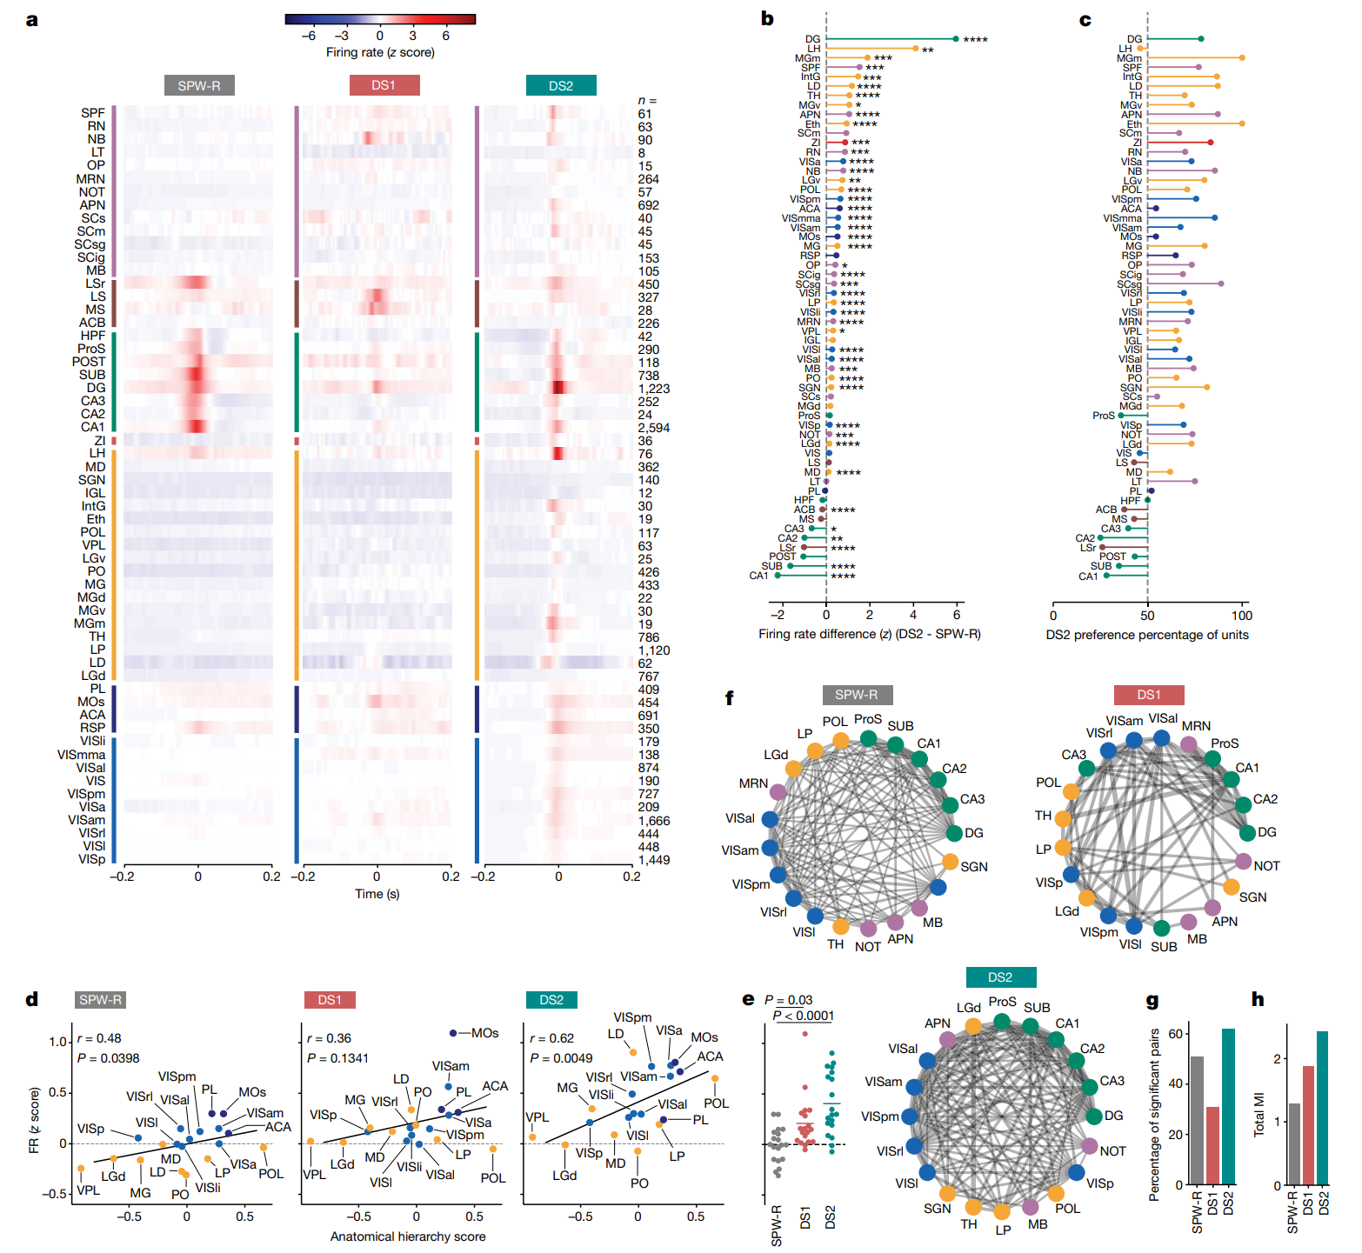
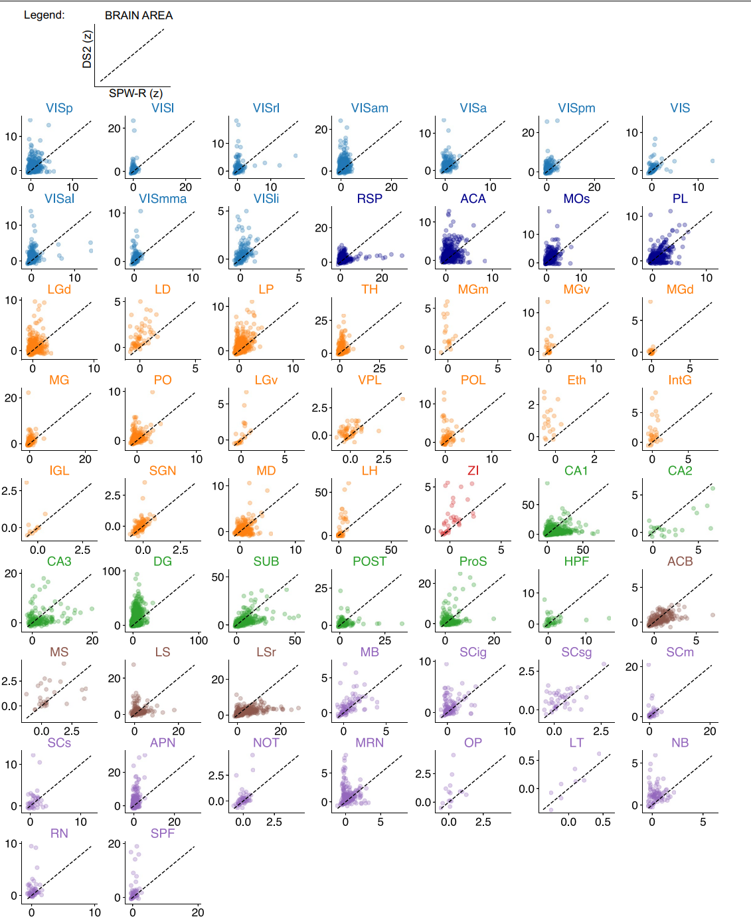
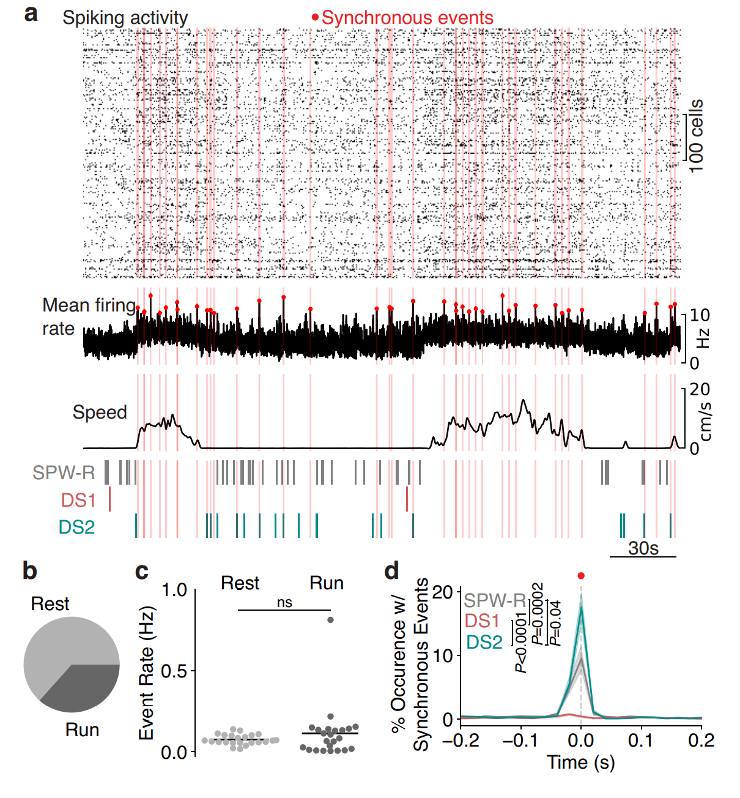
CORE INSIGHT
The Physiological Contrast: TORO cells fire intensely during Ripples but are strictly silent during DS2, confirming that these two events engage opposite cellular mechanisms.
Global Hypothesis
Extended Data Fig. 5 (The "Offline" Precondition): Low prior arousal predicts evoked DS2
Extended Data Fig. 6f (TORO Cell Identification): TORO cells identified; favor ripples over locomotion
Reflex magnitude is identical across trials (P>0.5), yet DS2 generation is strictly gated by pre-stimulus immobility (P<0.0001).
Extended Data Fig. 6g (Opposite Tuning): TORO cells selective for SPW-R
"Theta Off, Ripple On" (TORO) cells.
Because DS2 represents "transient arousal," the authors predicted it would drive a distinct global brain state.
CORE INSIGHT
"DS2 is a high-speed, sensory-driven reflex that instantly toggles the brain from 'Offline' to 'Online'."
Spoiler Alert: DS2 is a global spike
Notes:
Double check arrow locaiton
Role: It processes non-spatial information, specifically Object and Context information.
Connection: It provides the upstream input that drives Type 1 Dentate Spikes (DS1).
Anatomical Target: Its inputs target the Outer Molecular Layer (OML) of the Dentate Gyrus.

Slide 111
DS2 Is A Global Spike
Notes:
Double check arrow locaiton
Role: It processes non-spatial information, specifically Object and Context information.
Connection: It provides the upstream input that drives Type 1 Dentate Spikes (DS1).
Anatomical Target: Its inputs target the Outer Molecular Layer (OML) of the Dentate Gyrus.

Slide 112
DS2 Is A Global Spike
Figure 2a (The "Eye Test" Heatmap): DS2 drives widespread elevated firing
Left Y-axis: Grouped Brain Regions
Notes:
Double check arrow locaiton
Role: It processes non-spatial information, specifically Object and Context information.
Connection: It provides the upstream input that drives Type 1 Dentate Spikes (DS1).
Anatomical Target: Its inputs target the Outer Molecular Layer (OML) of the Dentate Gyrus.

Slide 113
DS2 Is A Global Spike
Figure 2a (The "Eye Test" Heatmap): DS2 drives widespread elevated firing
Left Y-axis: Grouped Brain Regions
Extended Data Fig. 6b (Raw Traces): AACs track start of movement and DS2
Extended Data Fig. 6c (Behavioral Correlation): AAC activity correlates with facial motion
Extended Data Fig. 6d (Event Coupling): AACs selectively active during DS2
Extended Data Fig. 6e (Sensory Response):
Sensory stimuli evoke AAC activity
Notes:
Purple (Top): Midbrain
Brown: Septum and Basal Ganglia
Green: Hippocampal Formation
Red (Small Bar): Zona Incerta
Yellow: Thalamus
Dark Blue: Higher-Order / Association Cortex
Light Blue (Bottom): Visual Cortex

Slide 114
DS2 Is A Global Spike
Figure 2a (The "Eye Test" Heatmap): DS2 drives widespread elevated firing
Columns: Activity of each brain regions for each spike
Extended Data Fig. 6b (Raw Traces): AACs track start of movement and DS2
Left Y-axis: Grouped Brain Regions
Extended Data Fig. 6c (Behavioral Correlation): AAC activity correlates with facial motion
Extended Data Fig. 6d (Event Coupling): AACs selectively active during DS2
Extended Data Fig. 6e (Sensory Response):
Sensory stimuli evoke AAC activity
Figure 2a (The "Eye Test" Heatmap): DS2 drives widespread elevated firing
Notes:
Double check arrow locaiton
Role: It processes non-spatial information, specifically Object and Context information.
Connection: It provides the upstream input that drives Type 1 Dentate Spikes (DS1).
Anatomical Target: Its inputs target the Outer Molecular Layer (OML) of the Dentate Gyrus.

Slide 115
DS2 Is A Global Spike
Figure 2a (The "Eye Test" Heatmap): DS2 drives widespread elevated firing
Eye balling it: DS2 > SPW-R > DS1
Extended Data Fig. 6b (Raw Traces): AACs track start of movement and DS2
Columns: Activity of each brain regions for each spike
Extended Data Fig. 6c (Behavioral Correlation): AAC activity correlates with facial motion
Extended Data Fig. 6d (Event Coupling): AACs selectively active during DS2
Extended Data Fig. 6e (Sensory Response):
Sensory stimuli evoke AAC activity
Notes:
Double check arrow locaiton
Role: It processes non-spatial information, specifically Object and Context information.
Connection: It provides the upstream input that drives Type 1 Dentate Spikes (DS1).
Anatomical Target: Its inputs target the Outer Molecular Layer (OML) of the Dentate Gyrus.

Slide 116
DS2 Is A Global Spike
Figure 2a (The "Eye Test" Heatmap): DS2 drives widespread elevated firing
Columns: Activity of each brain regions for each spike
Extended Data Fig. 6a (Experimental Setup):Imaging AACs during behavior
Extended Data Fig. 6b (Raw Traces): AACs track start of movement and DS2
Eye balling it: DS2 > SPW-R > DS1
Extended Data Fig. 6c (Behavioral Correlation): AAC activity correlates with facial motion
Extended Data Fig. 6d (Event Coupling): AACs selectively active during DS2
Extended Data Fig. 6e (Sensory Response):
Sensory stimuli evoke AAC activity
Figure 2b (The Difference Ranking): DS2 firing exceeds SPW-R brain-wide
X-axis: (DS2 Firing Rate) minus (SPW-R Firing Rate)
DS2 Global Firing Rate > SPW-R Global Firing Rate
Notes:
Double check arrow locaiton
Role: It processes non-spatial information, specifically Object and Context information.
Connection: It provides the upstream input that drives Type 1 Dentate Spikes (DS1).
Anatomical Target: Its inputs target the Outer Molecular Layer (OML) of the Dentate Gyrus.

Slide 117
DS2 Is A Global Spike
Figure 2a (The "Eye Test" Heatmap): DS2 drives widespread elevated firing
Eye balling it: DS2 > SPW-R > DS1
Columns: Activity of each brain regions for each spike
Figure 2b (The Difference Ranking): DS2 firing exceeds SPW-R brain-wide
DS2 Global Firing Rate > SPW-R Global Firing Rate
X-axis: (DS2 Firing Rate) minus (SPW-R Firing Rate)
Notes:
Double check arrow locaiton
Role: It processes non-spatial information, specifically Object and Context information.
Connection: It provides the upstream input that drives Type 1 Dentate Spikes (DS1).
Anatomical Target: Its inputs target the Outer Molecular Layer (OML) of the Dentate Gyrus.

Slide 118
DS2 Is A Global Spike
Figure 2a (The "Eye Test" Heatmap): DS2 drives widespread elevated firing
Eye balling it: DS2 > SPW-R > DS1
Columns: Activity of each brain regions for each spike
Figure 2b (The Difference Ranking): DS2 firing exceeds SPW-R brain-wide
DS2 Local Firing Rate > SPW-R Global Firing Rate
X-axis: (DS2 Firing Rate) minus (SPW-R Firing Rate)
DS2 Global Firing Rate > SPW-R Global Firing Rate
Notes:
Double check arrow locaiton
Role: It processes non-spatial information, specifically Object and Context information.
Connection: It provides the upstream input that drives Type 1 Dentate Spikes (DS1).
Anatomical Target: Its inputs target the Outer Molecular Layer (OML) of the Dentate Gyrus.

Slide 119
DS2 Is A Global Spike
Figure 2a (The "Eye Test" Heatmap): DS2 drives widespread elevated firing
Eye balling it: DS2 > SPW-R > DS1
Columns: Activity of each brain regions for each spike
Figure 2b (The Difference Ranking): DS2 firing exceeds SPW-R brain-wide
DS2 Global Firing Rate > SPW-R Global Firing Rate
X-axis: (DS2 Firing Rate) minus (SPW-R Firing Rate)
DS2 Local Firing Rate < SPW-R Global Firing Rate
Figure 2c (Neural Recruitment): Neurons preferentially fire during DS2
Notes:
Double check arrow locaiton
Role: It processes non-spatial information, specifically Object and Context information.
Connection: It provides the upstream input that drives Type 1 Dentate Spikes (DS1).
Anatomical Target: Its inputs target the Outer Molecular Layer (OML) of the Dentate Gyrus.

Slide 120
DS2 Is A Global Spike
Figure 2a (The "Eye Test" Heatmap): DS2 drives widespread elevated firing
Eye balling it: DS2 > SPW-R > DS1
Columns: Activity of each brain regions for each spike
Figure 2d (Hierarchical Activation): DS2 recruits higher-order brain networks
Figure 2b (The Difference Ranking): DS2 firing exceeds SPW-R brain-wide
DS2 Global Firing Rate > SPW-R Global Firing Rate
X-axis: (DS2 Firing Rate) minus (SPW-R Firing Rate)
DS2 Local Firing Rate > SPW-R Global Firing Rate
Figure 2c (Neural Recruitment): Neurons preferentially fire during DS2
Anatomical hierarchy score: ranking regions from primary sensory processing to higher-order association areas
Notes:
Double check arrow locaiton
Role: It processes non-spatial information, specifically Object and Context information.
Connection: It provides the upstream input that drives Type 1 Dentate Spikes (DS1).
Anatomical Target: Its inputs target the Outer Molecular Layer (OML) of the Dentate Gyrus.

Slide 121
DS2 Is A Global Spike
Figure 2a (The "Eye Test" Heatmap): DS2 drives widespread elevated firing
Eye balling it: DS2 > SPW-R > DS1
Columns: Activity of each brain regions for each spike
Figure 2d (Hierarchical Activation): DS2 recruits higher-order brain networks
Figure 2b (The Difference Ranking): DS2 firing exceeds SPW-R brain-wide
DS2 Global Firing Rate > SPW-R Global Firing Rate
X-axis: (DS2 Firing Rate) minus (SPW-R Firing Rate)
DS2 Local Firing Rate > SPW-R Global Firing Rate
Figure 2c (Neural Recruitment): Neurons preferentially fire during DS2
Anatomical hierarchy score: ranking regions from primary sensory processing to higher-order association areas
Notes:
Double check arrow locaiton
Role: It processes non-spatial information, specifically Object and Context information.
Connection: It provides the upstream input that drives Type 1 Dentate Spikes (DS1).
Anatomical Target: Its inputs target the Outer Molecular Layer (OML) of the Dentate Gyrus.

Slide 122
DS2 Is A Global Spike
Figure 2d (Hierarchical Activation): DS2 recruits higher-order brain networks
Anatomical hierarchy score: ranking regions from primary sensory processing to higher-order association areas
Figure 2a (The "Eye Test" Heatmap): DS2 drives widespread elevated firing
Figure 2b (The Difference Ranking): DS2 firing exceeds SPW-R brain-wide
Eye balling it: DS2 > SPW-R > DS1
Columns: Activity of each brain regions for each spike
Figure 2c (Neural Recruitment): Neurons preferentially fire during DS2
DS2 Global Firing Rate > SPW-R Global Firing Rate
X-axis: (DS2 Firing Rate) minus (SPW-R Firing Rate)
DS2 Local Firing Rate > SPW-R Global Firing Rate
A
Notes:
Julie A. Harris (2019) about 3000 viral injections, Allen Institute.

Slide 123
DS2 Is A Global Spike
Figure 2d (Hierarchical Activation): DS2 recruits higher-order brain networks
Figure 2a (The "Eye Test" Heatmap): DS2 drives widespread elevated firing
Figure 2b (The Difference Ranking): DS2 firing exceeds SPW-R brain-wide
Eye balling it: DS2 > SPW-R > DS1
Columns: Activity of each brain regions for each spike
Figure 2c (Neural Recruitment): Neurons preferentially fire during DS2
DS2 Global Firing Rate > SPW-R Global Firing Rate
Anatomical hierarchy score: ranking regions from primary sensory processing to higher-order association areas
X-axis: (DS2 Firing Rate) minus (SPW-R Firing Rate)
DS2 Local Firing Rate > SPW-R Global Firing Rate
A
Notes:
Julie A. Harris (2019) about 3000 viral injections, Allen Institute.

Slide 124
DS2 Is A Global Spike
Figure 2d (Hierarchical Activation): DS2 recruits higher-order brain networks
Anatomical hierarchy score: ranking regions from primary sensory processing to higher-order association areas
Figure 2a (The "Eye Test" Heatmap): DS2 drives widespread elevated firing
Figure 2b (The Difference Ranking): DS2 firing exceeds SPW-R brain-wide
Figure 2c (Neural Recruitment): Neurons preferentially fire during DS2
Figure 2e (Peak Firing Intensity): DS2 yields highest global firing
A
Notes:
Julie A. Harris (2019) about 3000 viral injections, Allen Institute.

Slide 125
DS2 Is A Global Spike
Figure 2a (The "Eye Test" Heatmap): DS2 drives widespread elevated firing
Figure 2b (The Difference Ranking): DS2 firing exceeds SPW-R brain-wide
Figure 2c (Neural Recruitment): Neurons preferentially fire during DS2
Figure 2d (Hierarchical Activation): DS2 recruits higher-order brain networks
Figure 2e (Peak Firing Intensity): DS2 yields highest global firing
Figure 2f (Network Connectivity): Dense brain-wide coupling during DS2
A
Notes:
Julie A. Harris (2019) about 3000 viral injections, Allen Institute.

Slide 126
DS2 Is A Global Spike
Figure 2a (The "Eye Test" Heatmap): DS2 drives widespread elevated firing
Figure 2b (The Difference Ranking): DS2 firing exceeds SPW-R brain-wide
Figure 2c (Neural Recruitment): Neurons preferentially fire during DS2
Figure 2d (Hierarchical Activation): DS2 recruits higher-order brain networks
Figure 2e (Peak Firing Intensity): DS2 yields highest global firing
Figure 2f (Network Connectivity): Dense brain-wide coupling during DS2
"Breadth" of Communication
Figures 2g-h (Global Coordination): DS2 maximizes brain-wide information flow
A
Notes:
Julie A. Harris (2019) about 3000 viral injections, Allen Institute.

Slide 127
DS2 Is A Global Spike
Figure 2a (The "Eye Test" Heatmap): DS2 drives widespread elevated firing
Figure 2b (The Difference Ranking): DS2 firing exceeds SPW-R brain-wide
Figure 2c (Neural Recruitment): Neurons preferentially fire during DS2
Figure 2d (Hierarchical Activation): DS2 recruits higher-order brain networks
Figure 2e (Peak Firing Intensity): DS2 yields highest global firing
Figure 2f (Network Connectivity): Dense brain-wide coupling during DS2
"Breadth" of Communication
Figures 2g-h (Global Coordination): DS2 maximizes brain-wide information flow
A
Notes:
Double check arrow locaiton
Role: It processes non-spatial information, specifically Object and Context information.
Connection: It provides the upstream input that drives Type 1 Dentate Spikes (DS1).
Anatomical Target: Its inputs target the Outer Molecular Layer (OML) of the Dentate Gyrus.

Slide 128
DS2 Is A Global Spike
Figure 2a (The "Eye Test" Heatmap): DS2 drives widespread elevated firing
Figure 2b (The Difference Ranking): DS2 firing exceeds SPW-R brain-wide
Figure 2c (Neural Recruitment): Neurons preferentially fire during DS2
Figure 2d (Hierarchical Activation): DS2 recruits higher-order brain networks
Figure 2e (Peak Firing Intensity): DS2 yields highest global firing
Figure 2f (Network Connectivity): Dense brain-wide coupling during DS2
"Breadth" of Communication
Figures 2g-h (Global Coordination): DS2 maximizes brain-wide information flow
"Intensity" of Communication
A
Notes:
Double check arrow locaiton
Role: It processes non-spatial information, specifically Object and Context information.
Connection: It provides the upstream input that drives Type 1 Dentate Spikes (DS1).
Anatomical Target: Its inputs target the Outer Molecular Layer (OML) of the Dentate Gyrus.

Slide 129
DS2 Is A Global Spike
Figure 2a (The "Eye Test" Heatmap): DS2 drives widespread elevated firing
Figure 2b (The Difference Ranking): DS2 firing exceeds SPW-R brain-wide
Figure 2c (Neural Recruitment): Neurons preferentially fire during DS2
Figure 2d (Hierarchical Activation): DS2 recruits higher-order brain networks
Figure 2e (Peak Firing Intensity): DS2 yields highest global firing
Figure 2f (Network Connectivity): Dense brain-wide coupling during DS2
"Breadth" of Communication
Figures 2g-h (Global Coordination): DS2 maximizes brain-wide information flow
"Intensity" of Communication
A
Notes:
Double check arrow locaiton
Role: It processes non-spatial information, specifically Object and Context information.
Connection: It provides the upstream input that drives Type 1 Dentate Spikes (DS1).
Anatomical Target: Its inputs target the Outer Molecular Layer (OML) of the Dentate Gyrus.

Slide 130
DS2 Is A Global Spike
Figure 2a (The "Eye Test" Heatmap): DS2 drives widespread elevated firing
Figure 2b (The Difference Ranking): DS2 firing exceeds SPW-R brain-wide
Figure 2c (Neural Recruitment): Neurons preferentially fire during DS2
Figure 2d (Hierarchical Activation): DS2 recruits higher-order brain networks
Figure 2e (Peak Firing Intensity): DS2 yields highest global firing
Figure 2f (Network Connectivity): Dense brain-wide coupling during DS2
Figures 2g-h (Global Coordination): DS2 maximizes brain-wide information flow
"Breadth" of Communication
"Intensity" of Communication
Extended Data Fig. 7: (Global Activity) DS2 and SPW-R recruit distinct neurons
Notes:
Double check arrow locaiton
Role: It processes non-spatial information, specifically Object and Context information.
Connection: It provides the upstream input that drives Type 1 Dentate Spikes (DS1).
Anatomical Target: Its inputs target the Outer Molecular Layer (OML) of the Dentate Gyrus.

Slide 131
DS2 Is A Global Spike
Figure 2a (The "Eye Test" Heatmap): DS2 drives widespread elevated firing
Figure 2b (The Difference Ranking): DS2 firing exceeds SPW-R brain-wide
Figure 2c (Neural Recruitment): Neurons preferentially fire during DS2
Extended Data Fig. 7: (Global Activity) DS2 and SPW-R recruit distinct neurons
Figure 2d (Hierarchical Activation): DS2 recruits higher-order brain networks
Figure 2e (Peak Firing Intensity): DS2 yields highest global firing
Figure 2f (Network Connectivity): Dense brain-wide coupling during DS2
Figures 2g-h (Global Coordination): DS2 maximizes brain-wide information flow
"Breadth" of Communication
"Intensity" of Communication
Notes:
Double check arrow locaiton
Role: It processes non-spatial information, specifically Object and Context information.
Connection: It provides the upstream input that drives Type 1 Dentate Spikes (DS1).
Anatomical Target: Its inputs target the Outer Molecular Layer (OML) of the Dentate Gyrus.

Slide 132
DS2 Is A Global Spike
Figure 2a (The "Eye Test" Heatmap): DS2 drives widespread elevated firing
Figure 2b (The Difference Ranking): DS2 firing exceeds SPW-R brain-wide
Figure 2c (Neural Recruitment): Neurons preferentially fire during DS2
Extended Data Fig. 7: (Global Activity) DS2 and SPW-R recruit distinct neurons
Figure 2d (Hierarchical Activation): DS2 recruits higher-order brain networks
Figure 2e (Peak Firing Intensity): DS2 yields highest global firing
Figure 2f (Network Connectivity): Dense brain-wide coupling during DS2
Figures 2g-h (Global Coordination): DS2 maximizes brain-wide information flow
"Breadth" of Communication
"Intensity" of Communication
Notes:
Double check arrow locaiton
Role: It processes non-spatial information, specifically Object and Context information.
Connection: It provides the upstream input that drives Type 1 Dentate Spikes (DS1).
Anatomical Target: Its inputs target the Outer Molecular Layer (OML) of the Dentate Gyrus.

Slide 133
DS2 Is A Global Spike
Figure 2a (The "Eye Test" Heatmap): DS2 drives widespread elevated firing
Figure 2b (The Difference Ranking): DS2 firing exceeds SPW-R brain-wide
Figure 2c (Neural Recruitment): Neurons preferentially fire during DS2
Extended Data Fig. 7: (Global Activity) DS2 and SPW-R recruit distinct neurons
Figure 2d (Hierarchical Activation): DS2 recruits higher-order brain networks
Figure 2e (Peak Firing Intensity): DS2 yields highest global firing
Figure 2f (Network Connectivity): Dense brain-wide coupling during DS2
Figures 2g-h (Global Coordination): DS2 maximizes brain-wide information flow
"Breadth" of Communication
"Intensity" of Communication
Notes:
Double check arrow locaiton
Role: It processes non-spatial information, specifically Object and Context information.
Connection: It provides the upstream input that drives Type 1 Dentate Spikes (DS1).
Anatomical Target: Its inputs target the Outer Molecular Layer (OML) of the Dentate Gyrus.

Slide 134
DS2 Is A Global Spike
Figure 2a (The "Eye Test" Heatmap): DS2 drives widespread elevated firing
Figure 2b (The Difference Ranking): DS2 firing exceeds SPW-R brain-wide
Figure 2c (Neural Recruitment): Neurons preferentially fire during DS2
Extended Data Fig. 7: (Global Activity) DS2 and SPW-R recruit distinct neurons
Figure 2d (Hierarchical Activation): DS2 recruits higher-order brain networks
Figure 2e (Peak Firing Intensity): DS2 yields highest global firing
Figure 2f (Network Connectivity): Dense brain-wide coupling during DS2
Figures 2g-h (Global Coordination): DS2 maximizes brain-wide information flow
"Breadth" of Communication
"Intensity" of Communication
Notes:
Double check arrow locaiton
Role: It processes non-spatial information, specifically Object and Context information.
Connection: It provides the upstream input that drives Type 1 Dentate Spikes (DS1).
Anatomical Target: Its inputs target the Outer Molecular Layer (OML) of the Dentate Gyrus.

Slide 135
DS2 Is A Global Spike
Figure 2a (The "Eye Test" Heatmap): DS2 drives widespread elevated firing
Figure 2b (The Difference Ranking): DS2 firing exceeds SPW-R brain-wide
Figure 2c (Neural Recruitment): Neurons preferentially fire during DS2
Figure 2d (Hierarchical Activation): DS2 recruits higher-order brain networks
Extended Data Fig. 7: (Global Activity) DS2 and SPW-R recruit distinct neurons
Figure 2e (Peak Firing Intensity): DS2 yields highest global firing
Figure 2f (Network Connectivity): Dense brain-wide coupling during DS2
Figures 2g-h (Global Coordination): DS2 maximizes brain-wide information flow
"Breadth" of Communication
"Intensity" of Communication
Notes:
Double check arrow locaiton
Role: It processes non-spatial information, specifically Object and Context information.
Connection: It provides the upstream input that drives Type 1 Dentate Spikes (DS1).
Anatomical Target: Its inputs target the Outer Molecular Layer (OML) of the Dentate Gyrus.

Slide 136
DS2 Is A Global Spike
Extended Data Figure 8a:
Global firing peaks align with DS2 events.
Top 0.1% of global neural activity.
Figure 2a (The "Eye Test" Heatmap): DS2 drives widespread elevated firing
Figure 2b (The Difference Ranking): DS2 firing exceeds SPW-R brain-wide
Figure 2c (Neural Recruitment): Neurons preferentially fire during DS2
Figure 2d (Hierarchical Activation): DS2 recruits higher-order brain networks
Extended Data Fig. 7: (Global Activity) DS2 and SPW-R recruit distinct neurons
Figure 2e (Peak Firing Intensity): DS2 yields highest global firing
Figure 2f (Network Connectivity): Dense brain-wide coupling during DS2
Figures 2g-h (Global Coordination): DS2 maximizes brain-wide information flow
"Breadth" of Communication
"Intensity" of Communication
Notes:
Double check arrow locaiton
Role: It processes non-spatial information, specifically Object and Context information.
Connection: It provides the upstream input that drives Type 1 Dentate Spikes (DS1).
Anatomical Target: Its inputs target the Outer Molecular Layer (OML) of the Dentate Gyrus.

Slide 137
DS2 Is A Global Spike
Extended Data Figure 8a:
Global firing peaks align with DS2 events.
Top 0.1% of global neural activity.
Figure 2a (The "Eye Test" Heatmap): DS2 drives widespread elevated firing
Figure 2b (The Difference Ranking): DS2 firing exceeds SPW-R brain-wide
Figure 2c (Neural Recruitment): Neurons preferentially fire during DS2
Figure 2d (Hierarchical Activation): DS2 recruits higher-order brain networks
Extended Data Fig. 7: (Global Activity) DS2 and SPW-R recruit distinct neurons
Figure 2e (Peak Firing Intensity): DS2 yields highest global firing
Figure 2f (Network Connectivity): Dense brain-wide coupling during DS2
Figures 2g-h (Global Coordination): DS2 maximizes brain-wide information flow
"Breadth" of Communication
"Intensity" of Communication
Notes:
Double check arrow locaiton
Role: It processes non-spatial information, specifically Object and Context information.
Connection: It provides the upstream input that drives Type 1 Dentate Spikes (DS1).
Anatomical Target: Its inputs target the Outer Molecular Layer (OML) of the Dentate Gyrus.

Slide 138
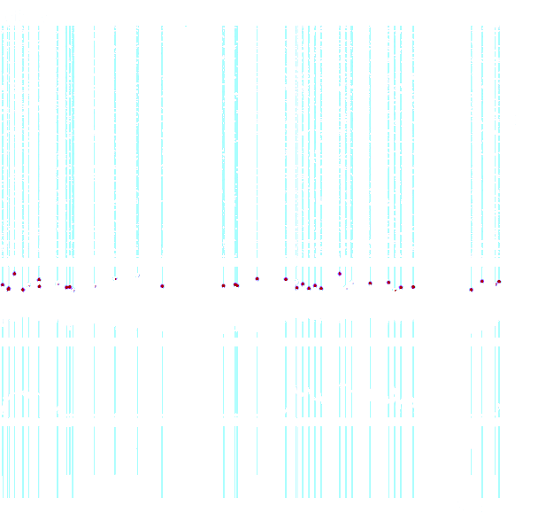
DS2 Is A Global Spike
Extended Data Figure 8a:
Global firing peaks align with DS2 events.
Top 0.1% of global neural activity.
Figure 2a (The "Eye Test" Heatmap): DS2 drives widespread elevated firing
Figure 2b (The Difference Ranking): DS2 firing exceeds SPW-R brain-wide
Figure 2c (Neural Recruitment): Neurons preferentially fire during DS2
Figure 2d (Hierarchical Activation): DS2 recruits higher-order brain networks
Extended Data Fig. 7: (Global Activity) DS2 and SPW-R recruit distinct neurons
Figure 2e (Peak Firing Intensity): DS2 yields highest global firing
Figure 2f (Network Connectivity): Dense brain-wide coupling during DS2
Figures 2g-h (Global Coordination): DS2 maximizes brain-wide information flow
"Breadth" of Communication
"Intensity" of Communication
Notes:
Double check arrow locaiton
Role: It processes non-spatial information, specifically Object and Context information.
Connection: It provides the upstream input that drives Type 1 Dentate Spikes (DS1).
Anatomical Target: Its inputs target the Outer Molecular Layer (OML) of the Dentate Gyrus.

Slide 139
DS2 Is A Global Spike
Extended Data Figure 8a:
Global firing peaks align with DS2 events.
Top 0.1% of global neural activity.
Figure 2a (The "Eye Test" Heatmap): DS2 drives widespread elevated firing
Figure 2b (The Difference Ranking): DS2 firing exceeds SPW-R brain-wide
Figure 2c (Neural Recruitment): Neurons preferentially fire during DS2
Figure 2d (Hierarchical Activation): DS2 recruits higher-order brain networks
Extended Data Fig. 7: (Global Activity) DS2 and SPW-R recruit distinct neurons
Figure 2e (Peak Firing Intensity): DS2 yields highest global firing
Figure 2f (Network Connectivity): Dense brain-wide coupling during DS2
Figures 2g-h (Global Coordination): DS2 maximizes brain-wide information flow
"Breadth" of Communication
"Intensity" of Communication
Notes:
Double check arrow locaiton
Role: It processes non-spatial information, specifically Object and Context information.
Connection: It provides the upstream input that drives Type 1 Dentate Spikes (DS1).
Anatomical Target: Its inputs target the Outer Molecular Layer (OML) of the Dentate Gyrus.

Slide 140
DS2 Is A Global Spike
Extended Data Figure 8a:
Global firing peaks align with DS2 events.
Top 0.1% of global neural activity.
Figure 2a (The "Eye Test" Heatmap): DS2 drives widespread elevated firing
Figure 2b (The Difference Ranking): DS2 firing exceeds SPW-R brain-wide
Figure 2c (Neural Recruitment): Neurons preferentially fire during DS2
Figure 2d (Hierarchical Activation): DS2 recruits higher-order brain networks
Extended Data Fig. 7: (Global Activity) DS2 and SPW-R recruit distinct neurons
Figure 2e (Peak Firing Intensity): DS2 yields highest global firing
Figure 2f (Network Connectivity): Dense brain-wide coupling during DS2
Figures 2g-h (Global Coordination): DS2 maximizes brain-wide information flow
"Breadth" of Communication
"Intensity" of Communication
Notes:
Double check arrow locaiton
Role: It processes non-spatial information, specifically Object and Context information.
Connection: It provides the upstream input that drives Type 1 Dentate Spikes (DS1).
Anatomical Target: Its inputs target the Outer Molecular Layer (OML) of the Dentate Gyrus.

Slide 141
DS2 Is A Global Spike
Extended Data Figure 8a:
Global firing peaks align with DS2 events.
Top 0.1% of global neural activity.
Figure 2a (The "Eye Test" Heatmap): DS2 drives widespread elevated firing
Figure 2b (The Difference Ranking): DS2 firing exceeds SPW-R brain-wide
Figure 2c (Neural Recruitment): Neurons preferentially fire during DS2
Figure 2d (Hierarchical Activation): DS2 recruits higher-order brain networks
Extended Data Fig. 7: (Global Activity) DS2 and SPW-R recruit distinct neurons
Figure 2e (Peak Firing Intensity): DS2 yields highest global firing
Figure 2f (Network Connectivity): Dense brain-wide coupling during DS2
Figures 2g-h (Global Coordination): DS2 maximizes brain-wide information flow
"Breadth" of Communication
"Intensity" of Communication
Notes:
Double check arrow locaiton
Role: It processes non-spatial information, specifically Object and Context information.
Connection: It provides the upstream input that drives Type 1 Dentate Spikes (DS1).
Anatomical Target: Its inputs target the Outer Molecular Layer (OML) of the Dentate Gyrus.

Slide 142
DS2 Is A Global Spike
Extended Data Figure 8a:
Global firing peaks align with DS2 events.
Top 0.1% of global neural activity.
Figure 2a (The "Eye Test" Heatmap): DS2 drives widespread elevated firing
Figure 2b (The Difference Ranking): DS2 firing exceeds SPW-R brain-wide
Figure 2c (Neural Recruitment): Neurons preferentially fire during DS2
Figure 2d (Hierarchical Activation): DS2 recruits higher-order brain networks
Extended Data Fig. 7: (Global Activity) DS2 and SPW-R recruit distinct neurons
Figure 2e (Peak Firing Intensity): DS2 yields highest global firing
Figure 2f (Network Connectivity): Dense brain-wide coupling during DS2
Figures 2g-h (Global Coordination): DS2 maximizes brain-wide information flow
"Breadth" of Communication
"Intensity" of Communication
Notes:
Double check arrow locaiton
Role: It processes non-spatial information, specifically Object and Context information.
Connection: It provides the upstream input that drives Type 1 Dentate Spikes (DS1).
Anatomical Target: Its inputs target the Outer Molecular Layer (OML) of the Dentate Gyrus.

Slide 143
DS2 Is A Global Spike
Extended Data Figure 8a:
Global firing peaks align with DS2 events.
Top 0.1% of global neural activity.
Figure 2a (The "Eye Test" Heatmap): DS2 drives widespread elevated firing
Figure 2b (The Difference Ranking): DS2 firing exceeds SPW-R brain-wide
Figure 2c (Neural Recruitment): Neurons preferentially fire during DS2
Figure 2d (Hierarchical Activation): DS2 recruits higher-order brain networks
Extended Data Fig. 7: (Global Activity) DS2 and SPW-R recruit distinct neurons
Figure 2e (Peak Firing Intensity): DS2 yields highest global firing
Figure 2f (Network Connectivity): Dense brain-wide coupling during DS2
Figures 2g-h (Global Coordination): DS2 maximizes brain-wide information flow
"Breadth" of Communication
"Intensity" of Communication
Notes:
Double check arrow locaiton
Role: It processes non-spatial information, specifically Object and Context information.
Connection: It provides the upstream input that drives Type 1 Dentate Spikes (DS1).
Anatomical Target: Its inputs target the Outer Molecular Layer (OML) of the Dentate Gyrus.

Slide 144
DS2 Is A Global Spike
Extended Data Figure 8a:
Global firing peaks align with DS2 events.
Extended Data Figure 8b: Global synchrony occurs predominantly during rest.
Top 0.1% of global neural activity.
Figure 2a (The "Eye Test" Heatmap): DS2 drives widespread elevated firing
Figure 2b (The Difference Ranking): DS2 firing exceeds SPW-R brain-wide
Figure 2c (Neural Recruitment): Neurons preferentially fire during DS2
Figure 2d (Hierarchical Activation): DS2 recruits higher-order brain networks
Extended Data Fig. 7: (Global Activity) DS2 and SPW-R recruit distinct neurons
Figure 2e (Peak Firing Intensity): DS2 yields highest global firing
Figure 2f (Network Connectivity): Dense brain-wide coupling during DS2
Figures 2g-h (Global Coordination): DS2 maximizes brain-wide information flow
"Breadth" of Communication
"Intensity" of Communication
Notes:
Double check arrow locaiton
Role: It processes non-spatial information, specifically Object and Context information.
Connection: It provides the upstream input that drives Type 1 Dentate Spikes (DS1).
Anatomical Target: Its inputs target the Outer Molecular Layer (OML) of the Dentate Gyrus.

Slide 145
DS2 Is A Global Spike
Extended Data Figure 8a: Global firing peaks align with DS2 events.
Top 0.1% of global neural activity.
Extended Data Figure 8d DS2 specifically predicts brain-wide synchrony.
Extended Data Figure 8d: DS2 specifically predicts brain-wide synchrony.
Figure 2a (The "Eye Test" Heatmap): DS2 drives widespread elevated firing
Figure 2b (The Difference Ranking): DS2 firing exceeds SPW-R brain-wide
Figure 2c (Neural Recruitment): Neurons preferentially fire during DS2
Figure 2d (Hierarchical Activation): DS2 recruits higher-order brain networks
Extended Data Fig. 7: (Global Activity) DS2 and SPW-R recruit distinct neurons
Figure 2e (Peak Firing Intensity): DS2 yields highest global firing
Figure 2f (Network Connectivity): Dense brain-wide coupling during DS2
Figures 2g-h (Global Coordination): DS2 maximizes brain-wide information flow
"Breadth" of Communication
"Intensity" of Communication
Notes:
Double check arrow locaiton
Role: It processes non-spatial information, specifically Object and Context information.
Connection: It provides the upstream input that drives Type 1 Dentate Spikes (DS1).
Anatomical Target: Its inputs target the Outer Molecular Layer (OML) of the Dentate Gyrus.

Slide 146
DS2 Is A Global Spike
Figure 2a (The "Eye Test" Heatmap): DS2 drives widespread elevated firing
Figure 2b (The Difference Ranking): DS2 firing exceeds SPW-R brain-wide
Figure 2c (Neural Recruitment): Neurons preferentially fire during DS2
Extended Data Fig. 7: (Global Activity) DS2 and SPW-R recruit distinct neurons
Figure 2d (Hierarchical Activation): DS2 recruits higher-order brain networks
Extended Data Figure 8a: Global firing peaks align with DS2 events.
Top 0.1% of global neural activity.
Figure 2e (Peak Firing Intensity): DS2 yields highest global firing
Extended Data Figure 8d: DS2 specifically predicts brain-wide synchrony.
Figure 2f (Network Connectivity): Dense brain-wide coupling during DS2
Figures 2g-h (Global Coordination): DS2 maximizes brain-wide information flow
"Breadth" of Communication
"Intensity" of Communication
Notes:
Double check arrow locaiton
Role: It processes non-spatial information, specifically Object and Context information.
Connection: It provides the upstream input that drives Type 1 Dentate Spikes (DS1).
Anatomical Target: Its inputs target the Outer Molecular Layer (OML) of the Dentate Gyrus.

Slide 147
DS2 Directionality
CORE INSIGHT: DS2 Is A Global Spike
Figure 2a (The "Eye Test" Heatmap): DS2 drives widespread elevated firing
Figure 2b (The Difference Ranking): DS2 firing exceeds SPW-R brain-wide
Figure 2c (Neural Recruitment): Neurons preferentially fire during DS2
If DS2 is a global spike, which way is it going? Top-Down, Bottom-Up, Side-Ways?
Extended Data Fig. 7: (Global Activity) DS2 and SPW-R recruit distinct neurons
Figure 2d (Hierarchical Activation): DS2 recruits higher-order brain networks
Extended Data Figure 8a: Global firing peaks align with DS2 events.
Top 0.1% of global neural activity.
Figure 2e (Peak Firing Intensity): DS2 yields highest global firing
Extended Data Figure 8b: Global synchrony occurs predominantly during rest.
Figure 2f (Network Connectivity): Dense brain-wide coupling during DS2
Figures 2g-h (Global Coordination): DS2 maximizes brain-wide information flow
Extended Data Figure 8c: AND Synchrony frequency is stable across states.
"Breadth" of Communication
"Intensity" of Communication
Spoiler Alert: DS2 is a TOP DOWN global spike
Extended Data Figure 8d: DS2 specifically predicts brain-wide synchrony.
Notes:
Double check arrow locaiton
Role: It processes non-spatial information, specifically Object and Context information.
Connection: It provides the upstream input that drives Type 1 Dentate Spikes (DS1).
Anatomical Target: Its inputs target the Outer Molecular Layer (OML) of the Dentate Gyrus.

Slide 148
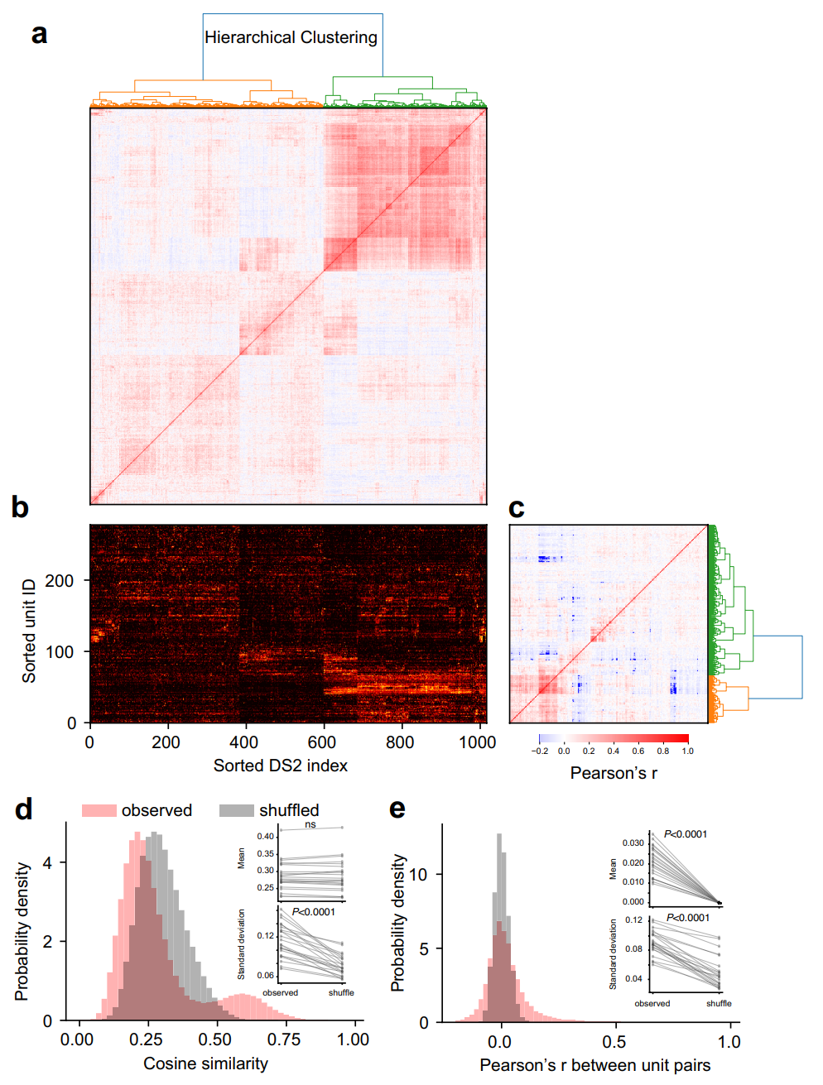
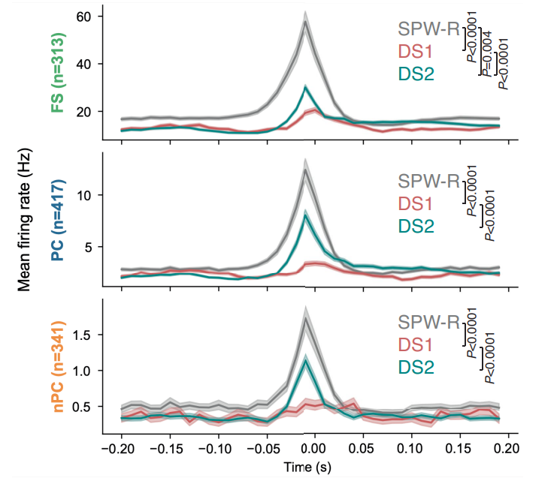
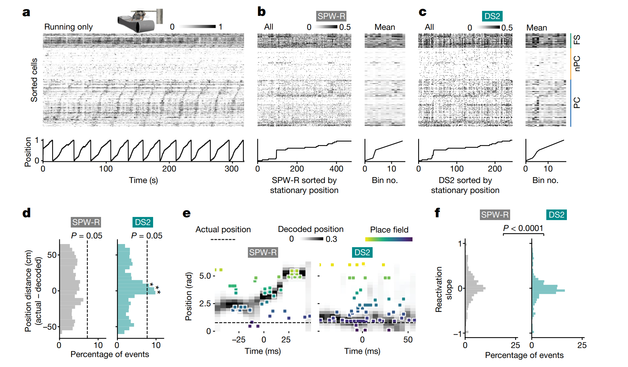
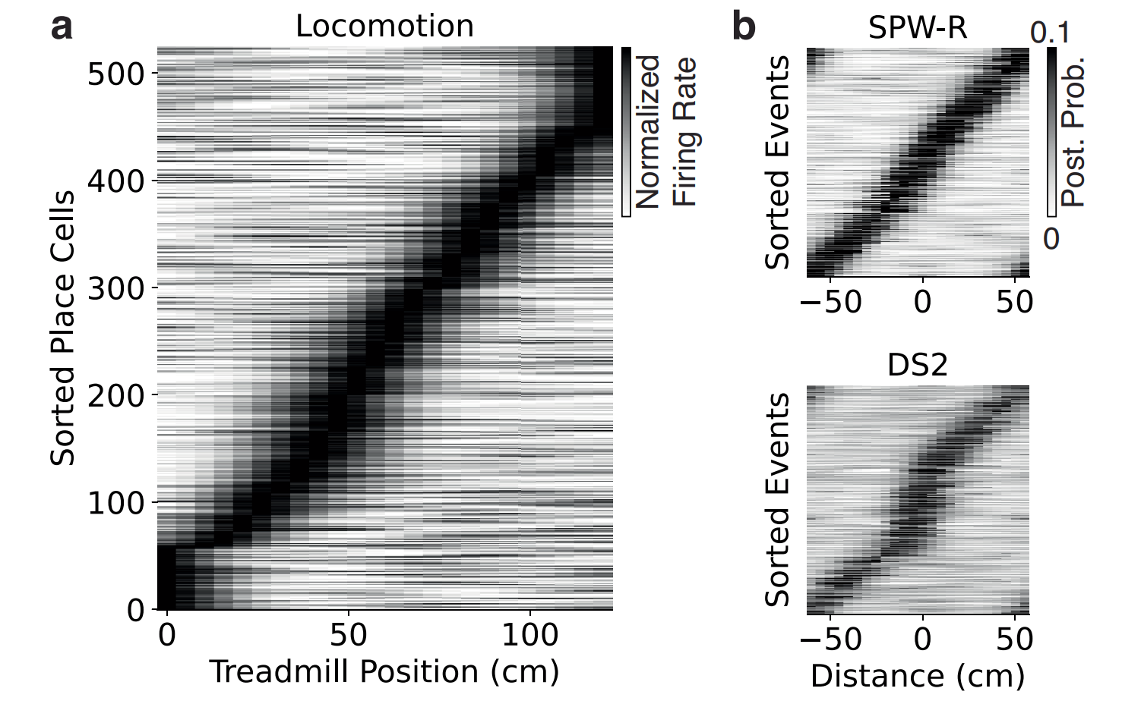
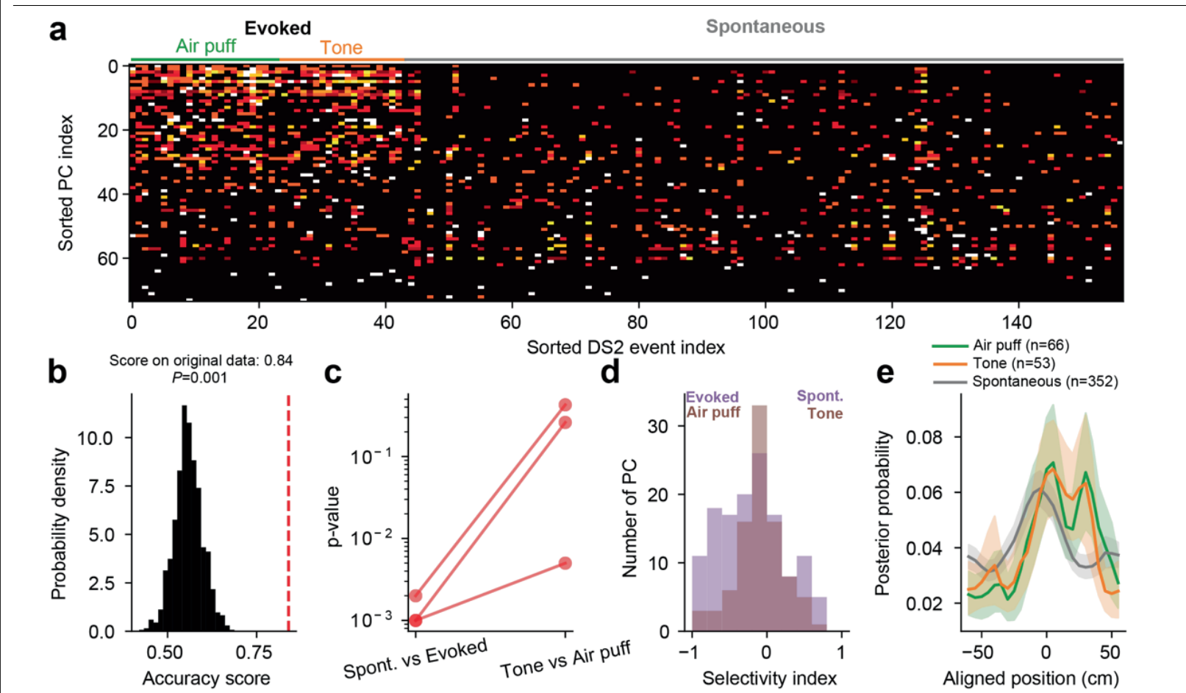
What does DS2 encode?
We know when it happens, where it goes, which neurons control it, but what is it doing?
Spoiler Alert: DS2 encodes stationary, real-world position.
CORE INSIGHT
The Physiological Contrast: TORO cells fire intensely during Ripples but are strictly silent during DS2, confirming that these two events engage opposite cellular mechanisms.
Extended Data Fig. 5 (The "Offline" Precondition): Low prior arousal predicts evoked DS2
Extended Data Fig. 6f (TORO Cell Identification): TORO cells identified; favor ripples over locomotion
Reflex magnitude is identical across trials (P>0.5), yet DS2 generation is strictly gated by pre-stimulus immobility (P<0.0001).
Extended Data Fig. 6g (Opposite Tuning): TORO cells selective for SPW-R
"Theta Off, Ripple On" (TORO) cells.
CORE INSIGHT: DS2 Is A Global Spike
CORE INSIGHT
"DS2 is a high-speed, sensory-driven reflex that instantly toggles the brain from 'Offline' to 'Online'."
Notes:
Double check arrow locaiton
Role: It processes non-spatial information, specifically Object and Context information.
Connection: It provides the upstream input that drives Type 1 Dentate Spikes (DS1).
Anatomical Target: Its inputs target the Outer Molecular Layer (OML) of the Dentate Gyrus.

Slide 149

What does DS2 encode?
We know when it happens, where it goes, which neurons control it, but what is it doing?
Spoiler Alert: DS2 encodes stationary, real-world position.
CORE INSIGHT
The Physiological Contrast: TORO cells fire intensely during Ripples but are strictly silent during DS2, confirming that these two events engage opposite cellular mechanisms.
Extended Data Fig. 5 (The "Offline" Precondition): Low prior arousal predicts evoked DS2
Extended Data Fig. 6f (TORO Cell Identification): TORO cells identified; favor ripples over locomotion
Reflex magnitude is identical across trials (P>0.5), yet DS2 generation is strictly gated by pre-stimulus immobility (P<0.0001).
Extended Data Fig. 6g (Opposite Tuning): TORO cells selective for SPW-R
"Theta Off, Ripple On" (TORO) cells.
CORE INSIGHT: DS2 Is A Global Spike
CORE INSIGHT
"DS2 is a high-speed, sensory-driven reflex that instantly toggles the brain from 'Offline' to 'Online'."
Notes:
Double check arrow locaiton
Role: It processes non-spatial information, specifically Object and Context information.
Connection: It provides the upstream input that drives Type 1 Dentate Spikes (DS1).
Anatomical Target: Its inputs target the Outer Molecular Layer (OML) of the Dentate Gyrus.

Slide 150
What does DS2 encode?
We know when it happens, where it goes, which neurons control it, but what is it doing?
DS2 encodes stationary, real-world position
Extended Data Figure 10a: DS2 events form repeating, non-random neural patterns.
Hierarchical clustering reveals distinct DS2 ensembles.
CORE INSIGHT
The Physiological Contrast: TORO cells fire intensely during Ripples but are strictly silent during DS2, confirming that these two events engage opposite cellular mechanisms.
Extended Data Fig. 5 (The "Offline" Precondition): Low prior arousal predicts evoked DS2
Extended Data Fig. 6f (TORO Cell Identification): TORO cells identified; favor ripples over locomotion
Reflex magnitude is identical across trials (P>0.5), yet DS2 generation is strictly gated by pre-stimulus immobility (P<0.0001).
Extended Data Fig. 6g (Opposite Tuning): TORO cells selective for SPW-R
"Theta Off, Ripple On" (TORO) cells.
CORE INSIGHT: DS2 Is A Global Spike
CORE INSIGHT
"DS2 is a high-speed, sensory-driven reflex that instantly toggles the brain from 'Offline' to 'Online'."
Notes:
Double check arrow locaiton
Role: It processes non-spatial information, specifically Object and Context information.
Connection: It provides the upstream input that drives Type 1 Dentate Spikes (DS1).
Anatomical Target: Its inputs target the Outer Molecular Layer (OML) of the Dentate Gyrus.

Slide 151
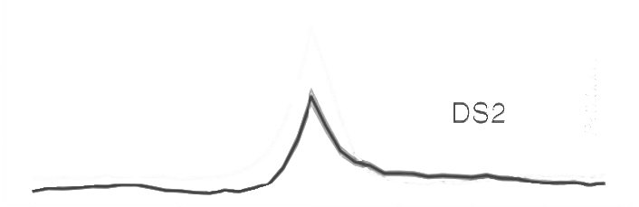
Extended Data Figure 10a: DS2 events form repeating, non-random neural patterns.
Hierarchical clustering reveals distinct DS2 ensembles.
No comments on distinct role of these two types…
Extended Data Figure 10b: Structured neural ensembles drive distinct DS2 categories.
Again, no comments on distinct role of these types…
X-axis: ~1,000 recorded DS2 events, sorted by the same hierarchical clusters as Panel a.
Y-axis: Neurons which were re-ordered based on similar firing preferences.
Extended Data Figure 10d,e:
d: Neural patterns are more similar than chance; e: Neural ensembles fire with high reliability.
DS2 encodes stationary, real-world position
DS2 spikes are highly organized
Extended Data Figure 11: CA1 place cells (PC) fire robustly during DS2 events.
Place Cells: Excitatory neurons that form the spatial map.
Extended Data Fig. 5 (The "Offline" Precondition): Low prior arousal predicts evoked DS2
Extended Data Fig. 6f (TORO Cell Identification): TORO cells identified; favor ripples over locomotion
Reflex magnitude is identical across trials (P>0.5), yet DS2 generation is strictly gated by pre-stimulus immobility (P<0.0001).
Extended Data Fig. 6g (Opposite Tuning): TORO cells selective for SPW-R
"Theta Off, Ripple On" (TORO) cells.
CORE INSIGHT: DS2 Is A Global Spike
CORE INSIGHT
"DS2 is a high-speed, sensory-driven reflex that instantly toggles the brain from 'Offline' to 'Online'."
Notes:
Double check arrow locaiton
Role: It processes non-spatial information, specifically Object and Context information.
Connection: It provides the upstream input that drives Type 1 Dentate Spikes (DS1).
Anatomical Target: Its inputs target the Outer Molecular Layer (OML) of the Dentate Gyrus.

Slide 152

Extended Data Figure 10a: DS2 events form repeating, non-random neural patterns.
Hierarchical clustering reveals distinct DS2 ensembles.
No comments on distinct role of these two types…
Extended Data Figure 10b: Structured neural ensembles drive distinct DS2 categories.
Again, no comments on distinct role of these types…
X-axis: ~1,000 recorded DS2 events, sorted by the same hierarchical clusters as Panel a.
Y-axis: Neurons which were re-ordered based on similar firing preferences.
Extended Data Figure 10d,e:
d: Neural patterns are more similar than chance; e: Neural ensembles fire with high reliability.
DS2 encodes stationary, real-world position
Figure 3a: Locomotion creates a diagonal spatial map.
CA1 place cells (PC) fire robustly during DS2 events
Y-Axis Focus:117 individual CA1 Place Cells (PCs).
Extended Data Fig. 5 (The "Offline" Precondition): Low prior arousal predicts evoked DS2
Extended Data Fig. 6f (TORO Cell Identification): TORO cells identified; favor ripples over locomotion
Reflex magnitude is identical across trials (P>0.5), yet DS2 generation is strictly gated by pre-stimulus immobility (P<0.0001).
Extended Data Fig. 6g (Opposite Tuning): TORO cells selective for SPW-R
"Theta Off, Ripple On" (TORO) cells.
CORE INSIGHT: DS2 Is A Global Spike
CORE INSIGHT
"DS2 is a high-speed, sensory-driven reflex that instantly toggles the brain from 'Offline' to 'Online'."
Notes:
Double check arrow locaiton
Role: It processes non-spatial information, specifically Object and Context information.
Connection: It provides the upstream input that drives Type 1 Dentate Spikes (DS1).
Anatomical Target: Its inputs target the Outer Molecular Layer (OML) of the Dentate Gyrus.

Slide 153
Extended Data Figure 10a: DS2 events form repeating, non-random neural patterns.
Hierarchical clustering reveals distinct DS2 ensembles.
No comments on distinct role of these two types…
Extended Data Figure 10b: Structured neural ensembles drive distinct DS2 categories.
Again, no comments on distinct role of these types…
X-axis: ~1,000 recorded DS2 events, sorted by the same hierarchical clusters as Panel a.
Y-axis: Neurons which were re-ordered based on similar firing preferences.
Extended Data Figure 10d,e:
d: Neural patterns are more similar than chance; e: Neural ensembles fire with high reliability.
DS2 encodes stationary, real-world position
DS2 spikes are highly organized
CA1 place cells (PC) fire robustly during DS2 events
Figure 3a: Locomotion creates a diagonal spatial map.
The Sorting: ordered by their "preferred location"—the specific spot on the 120-cm treadmill where they fire most.
Y-Axis Focus:117 individual CA1 Place Cells (PCs).
Fast-Spiking Cells: The inhibitory interneurons (the "brakes").
Place Cells: Excitatory neurons that form the spatial map.
CA1 Non-Place Cells: Broadly recruited, non-spatial neural population.
Extended Data Fig. 5 (The "Offline" Precondition): Low prior arousal predicts evoked DS2
Extended Data Fig. 6f (TORO Cell Identification): TORO cells identified; favor ripples over locomotion
Reflex magnitude is identical across trials (P>0.5), yet DS2 generation is strictly gated by pre-stimulus immobility (P<0.0001).
Extended Data Fig. 6g (Opposite Tuning): TORO cells selective for SPW-R
"Theta Off, Ripple On" (TORO) cells.
CORE INSIGHT: DS2 Is A Global Spike
CORE INSIGHT
"DS2 is a high-speed, sensory-driven reflex that instantly toggles the brain from 'Offline' to 'Online'."
Notes:
Double check arrow locaiton
Role: It processes non-spatial information, specifically Object and Context information.
Connection: It provides the upstream input that drives Type 1 Dentate Spikes (DS1).
Anatomical Target: Its inputs target the Outer Molecular Layer (OML) of the Dentate Gyrus.

Slide 154

Extended Data Figure 10a: DS2 events form repeating, non-random neural patterns.
Hierarchical clustering reveals distinct DS2 ensembles.
No comments on distinct role of these two types…
Extended Data Figure 10b: Structured neural ensembles drive distinct DS2 categories.
Again, no comments on distinct role of these types…
X-axis: ~1,000 recorded DS2 events, sorted by the same hierarchical clusters as Panel a.
Y-axis: Neurons which were re-ordered based on similar firing preferences.
Extended Data Figure 10d,e:
d: Neural patterns are more similar than chance; e: Neural ensembles fire with high reliability.
DS2 encodes stationary, real-world position
DS2 spikes are highly organized
CA1 place cells (PC) fire robustly during DS2 events
Figure 3a: Locomotion creates a diagonal spatial map.
Y-Axis Focus:117 individual CA1 Place Cells (PCs).
Fast-Spiking Cells: The inhibitory interneurons (the "brakes").
Place Cells: Excitatory neurons that form the spatial map.
The Sorting: ordered by their "preferred location"—the specific spot on the 120-cm treadmill where they fire most.
Result: This created the clear diagonal line of activity
CA1 Non-Place Cells: Broadly recruited, non-spatial neural population.
Extended Data Fig. 5 (The "Offline" Precondition): Low prior arousal predicts evoked DS2
Extended Data Fig. 6f (TORO Cell Identification): TORO cells identified; favor ripples over locomotion
Reflex magnitude is identical across trials (P>0.5), yet DS2 generation is strictly gated by pre-stimulus immobility (P<0.0001).
Extended Data Fig. 6g (Opposite Tuning): TORO cells selective for SPW-R
"Theta Off, Ripple On" (TORO) cells.
CORE INSIGHT: DS2 Is A Global Spike
CORE INSIGHT
"DS2 is a high-speed, sensory-driven reflex that instantly toggles the brain from 'Offline' to 'Online'."
Notes:
Double check arrow locaiton
Role: It processes non-spatial information, specifically Object and Context information.
Connection: It provides the upstream input that drives Type 1 Dentate Spikes (DS1).
Anatomical Target: Its inputs target the Outer Molecular Layer (OML) of the Dentate Gyrus.

Slide 155
Extended Data Figure 10a: DS2 events form repeating, non-random neural patterns.
Hierarchical clustering reveals distinct DS2 ensembles.
No comments on distinct role of these two types…
Extended Data Figure 10b: Structured neural ensembles drive distinct DS2 categories.
Again, no comments on distinct role of these types…
X-axis: ~1,000 recorded DS2 events, sorted by the same hierarchical clusters as Panel a.
Y-axis: Neurons which were re-ordered based on similar firing preferences.
Extended Data Figure 10d,e:
d: Neural patterns are more similar than chance; e: Neural ensembles fire with high reliability.
DS2 encodes stationary, real-world position
DS2 spikes are highly organized
CA1 place cells (PC) fire robustly during DS2 events
Figure 3a: Locomotion creates a diagonal spatial map.
Figure 3b: Ripples do not represent current spatial locations.
Y-Axis Focus:117 individual CA1 Place Cells (PCs).
Fast-Spiking Cells: The inhibitory interneurons (the "brakes").
Place Cells: Excitatory neurons that form the spatial map.
The Sorting: ordered by their "preferred location"—the specific spot on the 120-cm treadmill where they fire most.
CA1 Non-Place Cells: Broadly recruited, non-spatial neural population.
Result: This created the clear diagonal line of activity
Extended Data Fig. 5 (The "Offline" Precondition): Low prior arousal predicts evoked DS2
Extended Data Fig. 6f (TORO Cell Identification): TORO cells identified; favor ripples over locomotion
Reflex magnitude is identical across trials (P>0.5), yet DS2 generation is strictly gated by pre-stimulus immobility (P<0.0001).
Extended Data Fig. 6g (Opposite Tuning): TORO cells selective for SPW-R
"Theta Off, Ripple On" (TORO) cells.
CORE INSIGHT: DS2 Is A Global Spike
CORE INSIGHT
"DS2 is a high-speed, sensory-driven reflex that instantly toggles the brain from 'Offline' to 'Online'."
Notes:
Double check arrow locaiton
Role: It processes non-spatial information, specifically Object and Context information.
Connection: It provides the upstream input that drives Type 1 Dentate Spikes (DS1).
Anatomical Target: Its inputs target the Outer Molecular Layer (OML) of the Dentate Gyrus.

Slide 156
Extended Data Figure 10a: DS2 events form repeating, non-random neural patterns.
Hierarchical clustering reveals distinct DS2 ensembles.
No comments on distinct role of these two types…
Extended Data Figure 10b: Structured neural ensembles drive distinct DS2 categories.
Again, no comments on distinct role of these types…
X-axis: ~1,000 recorded DS2 events, sorted by the same hierarchical clusters as Panel a.
Y-axis: Neurons which were re-ordered based on similar firing preferences.
Extended Data Figure 10d,e:
d: Neural patterns are more similar than chance; e: Neural ensembles fire with high reliability.
DS2 encodes stationary, real-world position
DS2 spikes are highly organized
CA1 place cells (PC) fire robustly during DS2 events
Figure 3a: Locomotion creates a diagonal spatial map.
The Sorting: ordered by their "preferred location"—the specific spot on the 120-cm treadmill where they fire most.
Result: This created the clear diagonal line of activity
Y-Axis Focus:117 individual CA1 Place Cells (PCs).
Figure 3b: Ripples do not represent current spatial locations.
Fast-Spiking Cells: The inhibitory interneurons (the "brakes").
Place Cells: Excitatory neurons that form the spatial map.
CA1 Non-Place Cells: Broadly recruited, non-spatial neural population.
Extended Data Fig. 5 (The "Offline" Precondition): Low prior arousal predicts evoked DS2
Extended Data Fig. 6f (TORO Cell Identification): TORO cells identified; favor ripples over locomotion
Reflex magnitude is identical across trials (P>0.5), yet DS2 generation is strictly gated by pre-stimulus immobility (P<0.0001).
Extended Data Fig. 6g (Opposite Tuning): TORO cells selective for SPW-R
"Theta Off, Ripple On" (TORO) cells.
CORE INSIGHT: DS2 Is A Global Spike
CORE INSIGHT
"DS2 is a high-speed, sensory-driven reflex that instantly toggles the brain from 'Offline' to 'Online'."
Notes:
Double check arrow locaiton
Role: It processes non-spatial information, specifically Object and Context information.
Connection: It provides the upstream input that drives Type 1 Dentate Spikes (DS1).
Anatomical Target: Its inputs target the Outer Molecular Layer (OML) of the Dentate Gyrus.

Slide 157
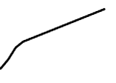
Extended Data Figure 10a: DS2 events form repeating, non-random neural patterns.
Hierarchical clustering reveals distinct DS2 ensembles.
No comments on distinct role of these two types…
Extended Data Figure 10b: Structured neural ensembles drive distinct DS2 categories.
Again, no comments on distinct role of these types…
X-axis: ~1,000 recorded DS2 events, sorted by the same hierarchical clusters as Panel a.
Y-axis: Neurons which were re-ordered based on similar firing preferences.
Extended Data Figure 10d,e:
d: Neural patterns are more similar than chance; e: Neural ensembles fire with high reliability.
DS2 encodes stationary, real-world position
DS2 spikes are highly organized
CA1 place cells (PC) fire robustly during DS2 events
Figure 3a: Locomotion creates a diagonal spatial map.
The Sorting: ordered by their "preferred location"—the specific spot on the 120-cm treadmill where they fire most.
Result: This created the clear diagonal line of activity
Y-Axis Focus:117 individual CA1 Place Cells (PCs).
Figure 3b: Ripples do not represent current spatial locations.
Figure 3c: DS2 firing aligns with current location.
Fast-Spiking Cells: The inhibitory interneurons (the "brakes").
Figure 3d: Decoding confirms DS2 encodes actual position.
Place Cells: Excitatory neurons that form the spatial map.
CA1 Non-Place Cells: Broadly recruited, non-spatial neural population.
Extended Data Fig. 5 (The "Offline" Precondition): Low prior arousal predicts evoked DS2
Extended Data Fig. 6f (TORO Cell Identification): TORO cells identified; favor ripples over locomotion
Reflex magnitude is identical across trials (P>0.5), yet DS2 generation is strictly gated by pre-stimulus immobility (P<0.0001).
Extended Data Fig. 6g (Opposite Tuning): TORO cells selective for SPW-R
"Theta Off, Ripple On" (TORO) cells.
CORE INSIGHT: DS2 Is A Global Spike
CORE INSIGHT
"DS2 is a high-speed, sensory-driven reflex that instantly toggles the brain from 'Offline' to 'Online'."
Notes:
Double check arrow locaiton
Role: It processes non-spatial information, specifically Object and Context information.
Connection: It provides the upstream input that drives Type 1 Dentate Spikes (DS1).
Anatomical Target: Its inputs target the Outer Molecular Layer (OML) of the Dentate Gyrus.

Slide 158
Extended Data Figure 10a: DS2 events form repeating, non-random neural patterns.
Hierarchical clustering reveals distinct DS2 ensembles.
No comments on distinct role of these two types…
Extended Data Figure 10b: Structured neural ensembles drive distinct DS2 categories.
Again, no comments on distinct role of these types…
X-axis: ~1,000 recorded DS2 events, sorted by the same hierarchical clusters as Panel a.
Y-axis: Neurons which were re-ordered based on similar firing preferences.
Extended Data Figure 10d,e:
d: Neural patterns are more similar than chance; e: Neural ensembles fire with high reliability.
DS2 encodes stationary, real-world position
DS2 spikes are highly organized
CA1 place cells (PC) fire robustly during DS2 events
Figure 3a: Locomotion creates a diagonal spatial map.
The Sorting: ordered by their "preferred location"—the specific spot on the 120-cm treadmill where they fire most.
Result: This created the clear diagonal line of activity
Y-Axis Focus:117 individual CA1 Place Cells (PCs).
Figure 3b: Ripples do not represent current spatial locations.
Figure 3c: DS2 firing aligns with current location.
Fast-Spiking Cells: The inhibitory interneurons (the "brakes").
Figure 3d: Decoding confirms DS2 encodes actual position.
Place Cells: Excitatory neurons that form the spatial map.
Figure 3e: DS2 provides a stationary spatial representation.
CA1 Non-Place Cells: Broadly recruited, non-spatial neural population.
Extended Data Fig. 5 (The "Offline" Precondition): Low prior arousal predicts evoked DS2
Extended Data Fig. 6f (TORO Cell Identification): TORO cells identified; favor ripples over locomotion
Reflex magnitude is identical across trials (P>0.5), yet DS2 generation is strictly gated by pre-stimulus immobility (P<0.0001).
Extended Data Fig. 6g (Opposite Tuning): TORO cells selective for SPW-R
"Theta Off, Ripple On" (TORO) cells.
CORE INSIGHT: DS2 Is A Global Spike
CORE INSIGHT
"DS2 is a high-speed, sensory-driven reflex that instantly toggles the brain from 'Offline' to 'Online'."
Notes:
Double check arrow locaiton
Role: It processes non-spatial information, specifically Object and Context information.
Connection: It provides the upstream input that drives Type 1 Dentate Spikes (DS1).
Anatomical Target: Its inputs target the Outer Molecular Layer (OML) of the Dentate Gyrus.

Slide 159
Extended Data Figure 10a: DS2 events form repeating, non-random neural patterns.
Hierarchical clustering reveals distinct DS2 ensembles.
No comments on distinct role of these two types…
Extended Data Figure 10b: Structured neural ensembles drive distinct DS2 categories.
Again, no comments on distinct role of these types…
X-axis: ~1,000 recorded DS2 events, sorted by the same hierarchical clusters as Panel a.
Y-axis: Neurons which were re-ordered based on similar firing preferences.
Extended Data Figure 10d,e:
d: Neural patterns are more similar than chance; e: Neural ensembles fire with high reliability.
DS2 encodes stationary, real-world position
DS2 spikes are highly organized
CA1 place cells (PC) fire robustly during DS2 events
Figure 3a: Locomotion creates a diagonal spatial map.
The Sorting: ordered by their "preferred location"—the specific spot on the 120-cm treadmill where they fire most.
Result: This created the clear diagonal line of activity
Y-Axis Focus:117 individual CA1 Place Cells (PCs).
Figure 3b: Ripples do not represent current spatial locations.
Figure 3c: DS2 firing aligns with current location.
Fast-Spiking Cells: The inhibitory interneurons (the "brakes").
Figure 3d: Decoding confirms DS2 encodes actual position.
Place Cells: Excitatory neurons that form the spatial map.
Figure 3f: DS2 slopes reveal zero mental travel.
CA1 Non-Place Cells: Broadly recruited, non-spatial neural population.
High slope: Moving sequence of distant places.
Low slope: Stationary snapshot of current location.
Extended Data Fig. 5 (The "Offline" Precondition): Low prior arousal predicts evoked DS2
Extended Data Fig. 6f (TORO Cell Identification): TORO cells identified; favor ripples over locomotion
Reflex magnitude is identical across trials (P>0.5), yet DS2 generation is strictly gated by pre-stimulus immobility (P<0.0001).
Extended Data Fig. 6g (Opposite Tuning): TORO cells selective for SPW-R
"Theta Off, Ripple On" (TORO) cells.
CORE INSIGHT: DS2 Is A Global Spike
CORE INSIGHT
"DS2 is a high-speed, sensory-driven reflex that instantly toggles the brain from 'Offline' to 'Online'."
Notes:
Double check arrow locaiton
Role: It processes non-spatial information, specifically Object and Context information.
Connection: It provides the upstream input that drives Type 1 Dentate Spikes (DS1).
Anatomical Target: Its inputs target the Outer Molecular Layer (OML) of the Dentate Gyrus.

Slide 160
Extended Data Figure 10a: DS2 events form repeating, non-random neural patterns.
Hierarchical clustering reveals distinct DS2 ensembles.
No comments on distinct role of these two types…
Extended Data Figure 10b: Structured neural ensembles drive distinct DS2 categories.
Again, no comments on distinct role of these types…
X-axis: ~1,000 recorded DS2 events, sorted by the same hierarchical clusters as Panel a.
Y-axis: Neurons which were re-ordered based on similar firing preferences.
Extended Data Figure 10d,e:
d: Neural patterns are more similar than chance; e: Neural ensembles fire with high reliability.
DS2 encodes stationary, real-world position
CORE INSIGHT
DS2 encodes current location
Figure 3a: Locomotion creates a diagonal spatial map.
The Sorting: ordered by their "preferred location"—the specific spot on the 120-cm treadmill where they fire most.
Result: This created the clear diagonal line of activity
Y-Axis Focus:117 individual CA1 Place Cells (PCs).
Figure 3b: Ripples do not represent current spatial locations.
Figure 3c: DS2 firing aligns with current location.
Fast-Spiking Cells: The inhibitory interneurons (the "brakes").
Figure 3d: Decoding confirms DS2 encodes actual position.
Place Cells: Excitatory neurons that form the spatial map.
Figure 3f: DS2 slopes reveal zero mental travel.
High slope: Moving sequence of distant places.
Low slope: Stationary snapshot of current location.
CA1 Non-Place Cells: Broadly recruited, non-spatial neural population.
Extended Data Fig. 5 (The "Offline" Precondition): Low prior arousal predicts evoked DS2
Extended Data Fig. 6f (TORO Cell Identification): TORO cells identified; favor ripples over locomotion
Reflex magnitude is identical across trials (P>0.5), yet DS2 generation is strictly gated by pre-stimulus immobility (P<0.0001).
Extended Data Fig. 6g (Opposite Tuning): TORO cells selective for SPW-R
"Theta Off, Ripple On" (TORO) cells.
CORE INSIGHT: DS2 Is A Global Spike
CORE INSIGHT
"DS2 is a high-speed, sensory-driven reflex that instantly toggles the brain from 'Offline' to 'Online'."
Notes:
Double check arrow locaiton
Role: It processes non-spatial information, specifically Object and Context information.
Connection: It provides the upstream input that drives Type 1 Dentate Spikes (DS1).
Anatomical Target: Its inputs target the Outer Molecular Layer (OML) of the Dentate Gyrus.

Slide 161
Is DS2 Necessary for Learning?
CORE INSIGHT
DS2 encodes stationary, real-world position
We know when it happens, where it goes, which neurons control it, what it encodes, is it actually vital to learning?
CORE INSIGHT
DS2 encodes current location
Figure 3a: Locomotion creates a diagonal spatial map.
The Sorting: ordered by their "preferred location"—the specific spot on the 120-cm treadmill where they fire most.
Result: This created the clear diagonal line of activity
Y-Axis Focus:117 individual CA1 Place Cells (PCs).
Spoiler Alert: Yes.
Figure 3b: Ripples do not represent current spatial locations.
Figure 3c: DS2 firing aligns with current location.
Figure 3d: Decoding confirms DS2 encodes actual position.
Figure 3f: DS2 slopes reveal zero mental travel.
High slope: Moving sequence of distant places.
Low slope: Stationary snapshot of current location.
Notes:
Double check arrow locaiton
Role: It processes non-spatial information, specifically Object and Context information.
Connection: It provides the upstream input that drives Type 1 Dentate Spikes (DS1).
Anatomical Target: Its inputs target the Outer Molecular Layer (OML) of the Dentate Gyrus.

Slide 162
DS2 spikes are highly organized
CA1 place cells (PC) fire robustly during DS2 events
DS2 encodes current location
Is DS2 Necessary for Learning?
CORE INSIGHT
DS2 encodes stationary, real-world position
We know when it happens, where it goes, which neurons control it, what it encodes, is it actually vital to learning?
DS2 consistently decodes to current position.
DS2 encodes state, not stimulus identity.
Spoiler Alert: Yes.
Notes:
Double check arrow locaiton
Role: It processes non-spatial information, specifically Object and Context information.
Connection: It provides the upstream input that drives Type 1 Dentate Spikes (DS1).
Anatomical Target: Its inputs target the Outer Molecular Layer (OML) of the Dentate Gyrus.

Slide 163
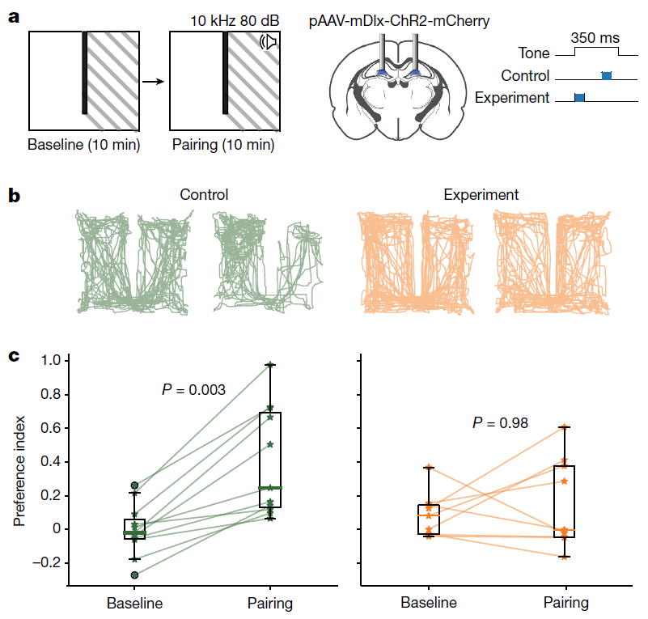
Is DS2 Necessary for Learning?
We know when it happens, where it goes, which neurons control it, what it encodes, is it actually vital to learning?
DS2 Is Needed For Spatial Learning
DS2 spikes are highly organized
CA1 place cells (PC) fire robustly during DS2 events
DS2 encodes current location
CORE INSIGHT
DS2 encodes stationary, real-world position
DS2 consistently decodes to current position.
DS2 encodes state, not stimulus identity.
Extended Figure 4a: Optogenetics silences DS2 during tone.
A Conditioned Place Aversion test
Notes:
Double check arrow locaiton
Role: It processes non-spatial information, specifically Object and Context information.
Connection: It provides the upstream input that drives Type 1 Dentate Spikes (DS1).
Anatomical Target: Its inputs target the Outer Molecular Layer (OML) of the Dentate Gyrus.

Slide 164
Is DS2 Necessary for Learning?
We know when it happens, where it goes, which neurons control it, what it encodes, is it actually vital to learning?
DS2 Is Needed For Spatial Learning
CA1 place cells (PC) fire robustly during DS2 events
DS2 encodes current location
CORE INSIGHT
DS2 encodes stationary, real-world position
DS2 consistently decodes to current position.
DS2 encodes state, not stimulus identity.
Extended Figure 4a: Optogenetics silences DS2 during tone.
A Conditioned Place Aversion test
Notes:
dentate gyrus bilaterally, GABAergic interneurons

Slide 165
Is DS2 Necessary for Learning?
We know when it happens, where it goes, which neurons control it, what it encodes, is it actually vital to learning?
DS2 Is Needed For Spatial Learning
CA1 place cells (PC) fire robustly during DS2 events
DS2 encodes current location
CORE INSIGHT
DS2 encodes stationary, real-world position
DS2 consistently decodes to current position.
DS2 encodes state, not stimulus identity.
Extended Figure 4a: Optogenetics silences DS2 during tone.
Experimental Group: Laser in first 80ms → No DS2
A Conditioned Place Aversion test
Notes:
dentate gyrus bilaterally, GABAergic interneurons

Slide 166
Is DS2 Necessary for Learning?
We know when it happens, where it goes, which neurons control it, what it encodes, is it actually vital to learning?
DS2 Is Needed For Spatial Learning
CA1 place cells (PC) fire robustly during DS2 events
DS2 encodes current location
CORE INSIGHT
DS2 encodes stationary, real-world position
DS2 consistently decodes to current position.
DS2 encodes state, not stimulus identity.
Extended Figure 4a: Optogenetics silences DS2 during tone.
Experimental Group: Laser in first 80ms → No DS2
A Conditioned Place Aversion test
Notes:
dentate gyrus bilaterally, GABAergic interneurons

Slide 167
Is DS2 Necessary for Learning?
We know when it happens, where it goes, which neurons control it, what it encodes, is it actually vital to learning?
DS2 Is Needed For Spatial Learning
CA1 place cells (PC) fire robustly during DS2 events
DS2 encodes current location
CORE INSIGHT
DS2 encodes stationary, real-world position
DS2 consistently decodes to current position.
DS2 encodes state, not stimulus identity.
Extended Figure 4a: Optogenetics silences DS2 during tone.
A Conditioned Place Aversion test
Experimental Group: Laser in first 80ms → No DS2
Control Group: Laser in last 80ms → DS2 intact
Notes:
dentate gyrus bilaterally, GABAergic interneurons

Slide 168
Is DS2 Necessary for Learning?
We know when it happens, where it goes, which neurons control it, what it encodes, is it actually vital to learning?
DS2 Is Needed For Spatial Learning
CA1 place cells (PC) fire robustly during DS2 events
DS2 encodes current location
CORE INSIGHT
DS2 encodes stationary, real-world position
DS2 consistently decodes to current position.
DS2 encodes state, not stimulus identity.
Extended Figure 4a: Optogenetics silences DS2 during tone.
A Conditioned Place Aversion test
Experimental Group: Laser in first 80ms → No DS2
Control Group: Laser in last 80ms → DS2 intact
Notes:
dentate gyrus bilaterally, GABAergic interneurons

Slide 169
Is DS2 Necessary for Learning?
We know when it happens, where it goes, which neurons control it, what it encodes, is it actually vital to learning?
DS2 Is Needed For Spatial Learning
CA1 place cells (PC) fire robustly during DS2 events
DS2 encodes current location
CORE INSIGHT
DS2 encodes stationary, real-world position
Extended Figure 4b: Silenced mice fail to avoid.
DS2 consistently decodes to current position.
DS2 encodes state, not stimulus identity.
Extended Figure 4a: Optogenetics silences DS2 during tone.
Experimental Group: Laser in first 80ms → No DS2
Control Group: Laser in last 80ms → DS2 intact
A Conditioned Place Aversion test

Slide 170


Is DS2 Necessary for Learning?
DS2 Is Needed For Spatial Learning
CA1 place cells (PC) fire robustly during DS2 events
DS2 encodes current location
CORE INSIGHT
DS2 encodes stationary, real-world position
DS2 consistently decodes to current position.
DS2 encodes state, not stimulus identity.
Extended Figure 4c: Stats show DS2 is necessary for learning.
Extended Figure 4a: Optogenetics silences DS2 during tone.
Extended Figure 4b: Silenced mice fail to avoid.
Notes:
Double check arrow locaiton
Role: It processes non-spatial information, specifically Object and Context information.
Connection: It provides the upstream input that drives Type 1 Dentate Spikes (DS1).
Anatomical Target: Its inputs target the Outer Molecular Layer (OML) of the Dentate Gyrus.

Slide 171
Is DS2 Necessary for Learning?
CORE INSIGHT
DS2 Is Needed For Spatial Learning
CA1 place cells (PC) fire robustly during DS2 events
DS2 encodes current location
CORE INSIGHT
DS2 encodes stationary, real-world position
DS2 consistently decodes to current position.
DS2 encodes state, not stimulus identity.
Extended Figure 4a: Optogenetics silences DS2 during tone.
Extended Figure 4b: Silenced mice fail to avoid.
Extended Figure 4c: Stats show DS2 is necessary for learning.
DS2 Is Unique
Circuit Mechanisms
Characterized
Global Hypothesis Substantiated
Encoding Illuminated
Essential for learning
Notes:
Double check arrow locaiton
Role: It processes non-spatial information, specifically Object and Context information.
Connection: It provides the upstream input that drives Type 1 Dentate Spikes (DS1).
Anatomical Target: Its inputs target the Outer Molecular Layer (OML) of the Dentate Gyrus.

Slide 172
Is DS2 Necessary for Learning?
DS2 RECAP
CA1 place cells (PC) fire robustly during DS2 events
DS2 encodes current location
DS2 Is Unique
Circuit Mechanisms
Characterized
Global Hypothesis Substantiated
Encoding Illuminated
Essential for learning
DS2 consistently decodes to current position.
DS2 encodes state, not stimulus identity.
Notes:
Double check arrow locaiton
Role: It processes non-spatial information, specifically Object and Context information.
Connection: It provides the upstream input that drives Type 1 Dentate Spikes (DS1).
Anatomical Target: Its inputs target the Outer Molecular Layer (OML) of the Dentate Gyrus.

Slide 173
Is DS2 Necessary for Learning?
DS2 RECAP
CA1 place cells (PC) fire robustly during DS2 events
DS2 encodes current location
DS2 Is Unique
Circuit Mechanisms
Characterized
Global Hypothesis Substantiated
Encoding Illuminated
Essential for learning
DS2 consistently decodes to current position.
DS2 encodes state, not stimulus identity.
Notes:
Double check arrow locaiton
Role: It processes non-spatial information, specifically Object and Context information.
Connection: It provides the upstream input that drives Type 1 Dentate Spikes (DS1).
Anatomical Target: Its inputs target the Outer Molecular Layer (OML) of the Dentate Gyrus.

Slide 174
Is DS2 Necessary for Learning?
DS2 RECAP
CA1 place cells (PC) fire robustly during DS2 events
DS2 encodes current location
DS2 Is Unique
Circuit Mechanisms
Characterized
Global Hypothesis Substantiated
Encoding Illuminated
Essential for learning
DS2 consistently decodes to current position.
DS2 encodes state, not stimulus identity.
Notes:
Double check arrow locaiton
Role: It processes non-spatial information, specifically Object and Context information.
Connection: It provides the upstream input that drives Type 1 Dentate Spikes (DS1).
Anatomical Target: Its inputs target the Outer Molecular Layer (OML) of the Dentate Gyrus.

Slide 175
Is DS2 Necessary for Learning?
DS2 RECAP
CA1 place cells (PC) fire robustly during DS2 events
DS2 encodes current location
DS2 Is Unique
Circuit Mechanisms
Characterized
Global Hypothesis Substantiated
Encoding Illuminated
Essential for learning
DS2 consistently decodes to current position.
DS2 encodes state, not stimulus identity.
Notes:
Double check arrow locaiton
Role: It processes non-spatial information, specifically Object and Context information.
Connection: It provides the upstream input that drives Type 1 Dentate Spikes (DS1).
Anatomical Target: Its inputs target the Outer Molecular Layer (OML) of the Dentate Gyrus.

Slide 176
Is DS2 Necessary for Learning?
DS2 RECAP
CA1 place cells (PC) fire robustly during DS2 events
DS2 encodes current location
DS2 Is Unique
Circuit Mechanisms
Characterized
Global Hypothesis Substantiated
Encoding Illuminated
Essential for learning
DS2 consistently decodes to current position.
DS2 encodes state, not stimulus identity.
Notes:
Double check arrow locaiton
Role: It processes non-spatial information, specifically Object and Context information.
Connection: It provides the upstream input that drives Type 1 Dentate Spikes (DS1).
Anatomical Target: Its inputs target the Outer Molecular Layer (OML) of the Dentate Gyrus.

Slide 177
Is DS2 Necessary for Learning?
DS2 RECAP
CA1 place cells (PC) fire robustly during DS2 events
DS2 encodes current location
DS2 Is Unique
Circuit Mechanisms
Characterized
Global Hypothesis Substantiated
Encoding Illuminated
Essential for learning
DS2 consistently decodes to current position.
DS2 encodes state, not stimulus identity.
Notes:
Double check arrow locaiton
Role: It processes non-spatial information, specifically Object and Context information.
Connection: It provides the upstream input that drives Type 1 Dentate Spikes (DS1).
Anatomical Target: Its inputs target the Outer Molecular Layer (OML) of the Dentate Gyrus.

Slide 178
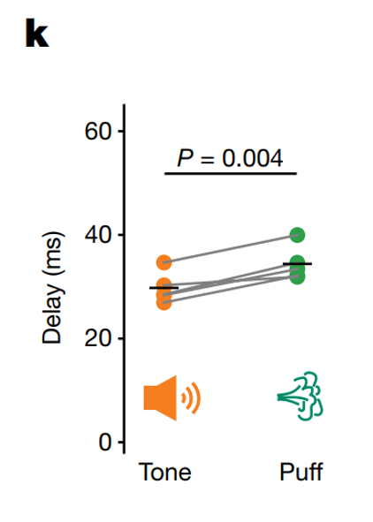
Is DS2 Necessary for Learning?
Discussion
DS2 encodes current location
Mostly reiterates points made in the figures.
No difference in Tone vs Puff
DS2 Triggered most likely by MEC
No sensory activation for DS2
DS2 encodes state, not stimulus identity.
DS2 is generated by spontaneous arousal as well
A “check in” signal
MEC Contains: Neurons that encode self-referenced movement variables, locations, and environmental borders
DS2 Is Unique
Circuit Mechanisms
Characterized
Global Hypothesis Substantiated
Encoding Illuminated
Essential for learning
Notes:
Double check arrow locaiton
Role: It processes non-spatial information, specifically Object and Context information.
Connection: It provides the upstream input that drives Type 1 Dentate Spikes (DS1).
Anatomical Target: Its inputs target the Outer Molecular Layer (OML) of the Dentate Gyrus.

Slide 179
Is DS2 Necessary for Learning?
Discussion
Mostly reiterates points made in the figures.
No difference in Tone vs Puff
DS2 Triggered most likely by MEC
No sensory activation for DS2
DS2 is generated by spontaneous arousal as well
A “check in” signal
MEC Contains: Neurons that encode self-referenced movement variables, locations, and environmental borders
DS2 Is Unique
Circuit Mechanisms
Characterized
Global Hypothesis Substantiated
Encoding Illuminated
Essential for learning
Notes:
Double check arrow locaiton
Role: It processes non-spatial information, specifically Object and Context information.
Connection: It provides the upstream input that drives Type 1 Dentate Spikes (DS1).
Anatomical Target: Its inputs target the Outer Molecular Layer (OML) of the Dentate Gyrus.

Slide 180
Is DS2 Necessary for Learning?
Discussion
Mostly reiterates points made in the figures.
No difference in Tone vs Puff
DS2 Triggered most likely by MEC
No sensory activation for DS2
DS2 is generated by spontaneous arousal as well
A “check in” signal
DS2 Is Unique
Circuit Mechanisms
Characterized
Global Hypothesis Substantiated
Encoding Illuminated
Essential for learning
Notes:
Double check arrow locaiton
Role: It processes non-spatial information, specifically Object and Context information.
Connection: It provides the upstream input that drives Type 1 Dentate Spikes (DS1).
Anatomical Target: Its inputs target the Outer Molecular Layer (OML) of the Dentate Gyrus.

Slide 181
Is DS2 Necessary for Learning?
Discussion
Mostly reiterates points made in the figures.
No difference in Tone vs Puff
DS2 Triggered most likely by MEC
No sensory activation for DS2
DS2 is generated by spontaneous arousal as well
A “check in” signal
MEC Contains: Neurons that encode self-referenced movement variables, locations, and environmental borders
DS2 Is Unique
Circuit Mechanisms
Characterized
Global Hypothesis Substantiated
Encoding Illuminated
Essential for learning
Notes:
Double check arrow locaiton
Role: It processes non-spatial information, specifically Object and Context information.
Connection: It provides the upstream input that drives Type 1 Dentate Spikes (DS1).
Anatomical Target: Its inputs target the Outer Molecular Layer (OML) of the Dentate Gyrus.

Slide 182
Is DS2 Necessary for Learning?
Discussion
Mostly reiterates points made in the figures.
No difference in Tone vs Puff
DS2 Triggered most likely by MEC
No sensory activation for DS2
DS2 is generated by spontaneous arousal as well
A “check in” signal
MEC Contains: Neurons that encode
Self-referenced movement variables
Locations
Environmental borders
DS2 Is Unique
Circuit Mechanisms
Characterized
Global Hypothesis Substantiated
Encoding Illuminated
Essential for learning
Notes:
Double check arrow locaiton
Role: It processes non-spatial information, specifically Object and Context information.
Connection: It provides the upstream input that drives Type 1 Dentate Spikes (DS1).
Anatomical Target: Its inputs target the Outer Molecular Layer (OML) of the Dentate Gyrus.

Slide 183
Is DS2 Necessary for Learning?
Strengths & Weaknesses
Mostly reiterates points made in the figures.
Strengths
Weaknesses
Disruption of the "Binary State" Dogma
No sensory activation for DS2
Causal Verification via Optogenetics
DS2 is generated by spontaneous arousal as well
Cross-Dataset Validation
A “check in” signal
MEC Contains: Neurons that encode self-referenced movement variables, locations, and environmental borders
DS2 Is Unique
Circuit Mechanisms
Characterized
Global Hypothesis Substantiated
Encoding Illuminated
Essential for learning
Notes:
Double check arrow locaiton
Role: It processes non-spatial information, specifically Object and Context information.
Connection: It provides the upstream input that drives Type 1 Dentate Spikes (DS1).
Anatomical Target: Its inputs target the Outer Molecular Layer (OML) of the Dentate Gyrus.

Slide 184
Is DS2 Necessary for Learning?
Strengths & Weaknesses
Mostly reiterates points made in the figures.
Strengths
Weaknesses
Disruption of the "Binary State" Dogma
No sensory activation for DS2
Causal Verification via Optogenetics
DS2 is generated by spontaneous arousal as well
Cross-Dataset Validation
A “check in” signal
MEC Contains: Neurons that encode self-referenced movement variables, locations, and environmental borders
DS2 Is Unique
Circuit Mechanisms
Characterized
Global Hypothesis Substantiated
Encoding Illuminated
Essential for learning
Notes:
Double check arrow locaiton
Role: It processes non-spatial information, specifically Object and Context information.
Connection: It provides the upstream input that drives Type 1 Dentate Spikes (DS1).
Anatomical Target: Its inputs target the Outer Molecular Layer (OML) of the Dentate Gyrus.

Slide 185
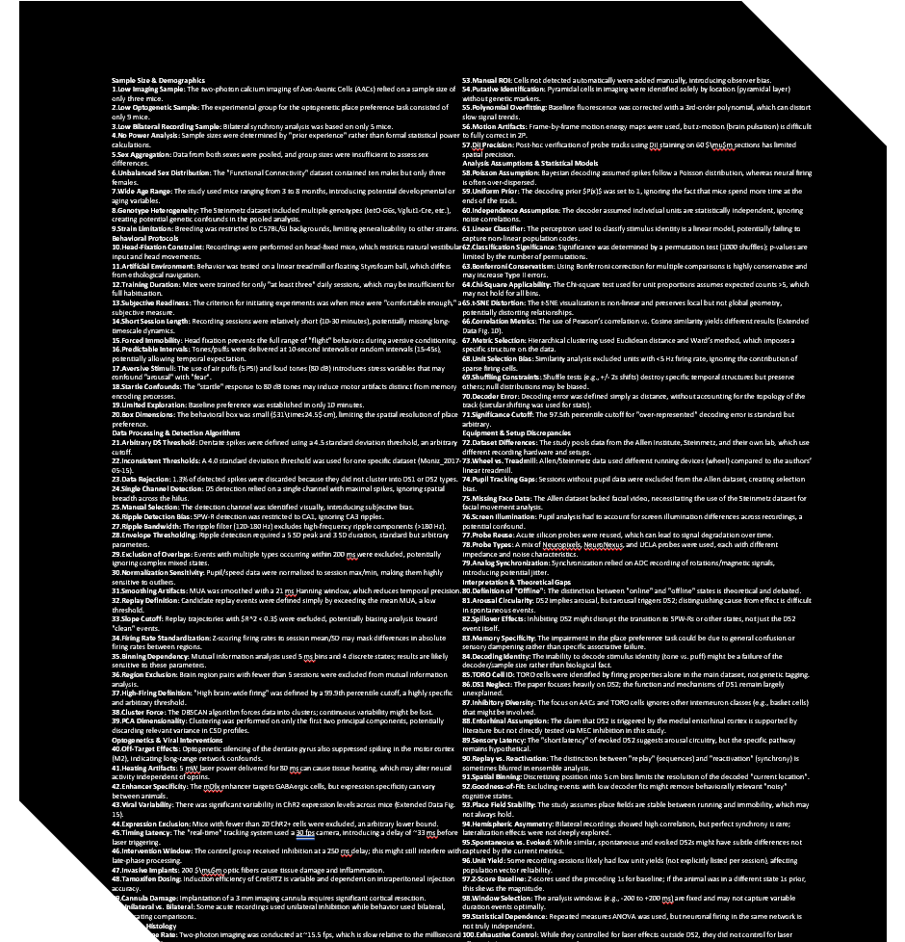
Is DS2 Necessary for Learning?
Strengths & Weaknesses
Mostly reiterates points made in the figures.
Strengths
Weaknesses
Disruption of the "Binary State" Dogma
No sensory activation for DS2
Causal Verification via Optogenetics
DS2 is generated by spontaneous arousal as well
Cross-Dataset Validation
A “check in” signal
MEC Contains: Neurons that encode self-referenced movement variables, locations, and environmental borders
DS2 Is Unique
Circuit Mechanisms
Characterized
Global Hypothesis Substantiated
Encoding Illuminated
Essential for learning
Notes:
Double check arrow locaiton
Role: It processes non-spatial information, specifically Object and Context information.
Connection: It provides the upstream input that drives Type 1 Dentate Spikes (DS1).
Anatomical Target: Its inputs target the Outer Molecular Layer (OML) of the Dentate Gyrus.

Slide 186
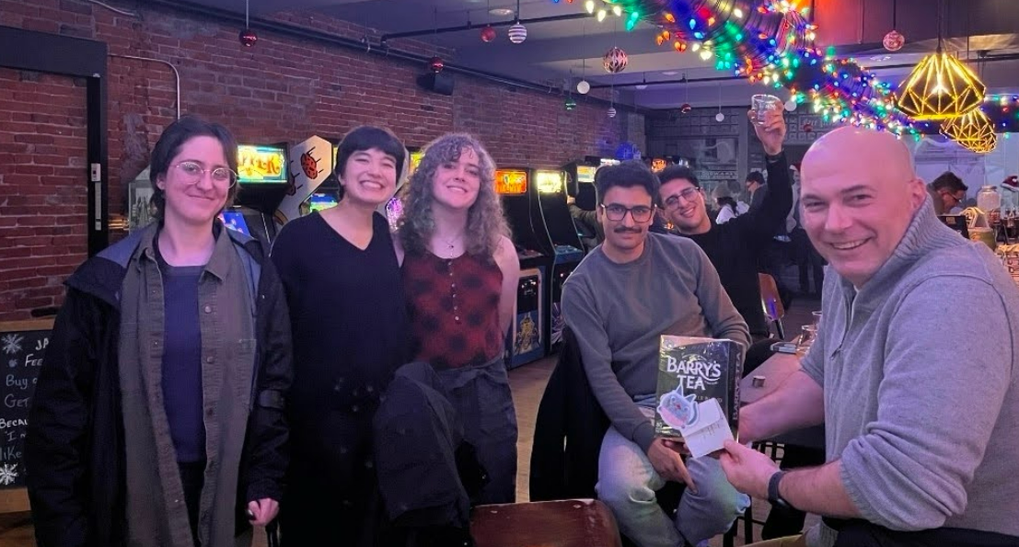
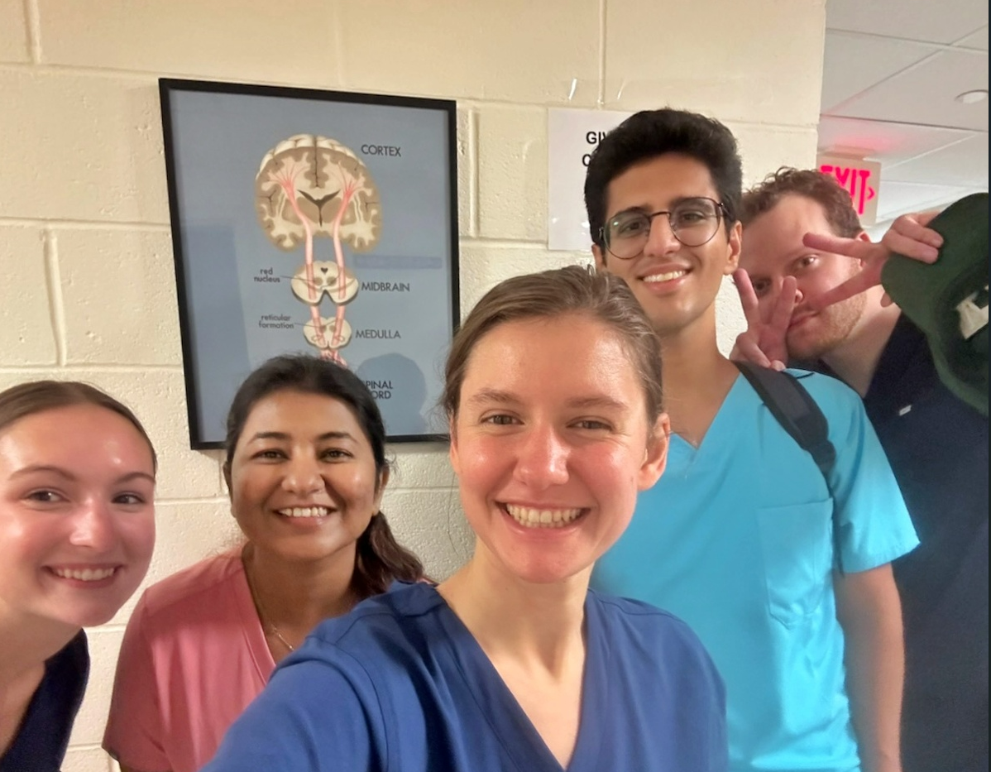

Is DS2 Necessary for Learning?
Strengths & Weaknesses
Mostly reiterates points made in the figures.
Strengths
Weaknesses
Disruption of the "Binary State" Dogma
No sensory activation for DS2
Causal Verification via Optogenetics
DS2 is generated by spontaneous arousal as well
Cross-Dataset Validation
A “check in” signal
MEC Contains: Neurons that encode self-referenced movement variables, locations, and environmental borders
DS2 Is Unique
Circuit Mechanisms
Characterized
Global Hypothesis Substantiated
Encoding Illuminated
Essential for learning
JOM!
Elaine
Et al.
Jeremy Barry
Rain Younger
Mohsen Bayat
Thomas Bausman
Isabella Piatek
Angelina Woychosky
Sylvia Clouse
Hunter Holoubek
NGP Cohort
Adam: Powerpoint mentor
Laura: Immaculate EQ
Maddy: Being so FR
Senjuti: Existential Chitchat
Notes:
Double check arrow locaiton
Role: It processes non-spatial information, specifically Object and Context information.
Connection: It provides the upstream input that drives Type 1 Dentate Spikes (DS1).
Anatomical Target: Its inputs target the Outer Molecular Layer (OML) of the Dentate Gyrus.

Slide 187
Is DS2 Necessary for Learning?
Thank you for your time and attention!
Strengths
Weaknesses
Disruption of the "Binary State" Dogma
Causal Verification via Optogenetics
JOM!
ELAINE!
ET AL.!
Jeremy Barry
Rain Younger
Mohsen Bayat
Thomas Bausman
Isabella Piatek
Angelina Woychosky
Sylvia Clouse
Hunter Holoubek
NGP Cohort
Adam: Powerpoint mentor
Laura: Immaculate EQ
Maddy: Being so FR
Senjuti: Existential Chitchat
Cross-Dataset Validation
DS2 Is Unique
Circuit Mechanisms
Characterized
Global Hypothesis Substantiated
Encoding Illuminated
Essential for learning
Notes:
Double check arrow locaiton
Role: It processes non-spatial information, specifically Object and Context information.
Connection: It provides the upstream input that drives Type 1 Dentate Spikes (DS1).
Anatomical Target: Its inputs target the Outer Molecular Layer (OML) of the Dentate Gyrus.

Slide 188

Is DS2 Necessary for Learning?
Thank you for your time and attention!
Questions?
Disruption of the "Binary State" Dogma
DS2 Is Unique
Circuit Mechanisms
Characterized
Global Hypothesis Substantiated
Encoding Illuminated
Essential for learning
Notes:
Double check arrow locaiton
Role: It processes non-spatial information, specifically Object and Context information.
Connection: It provides the upstream input that drives Type 1 Dentate Spikes (DS1).
Anatomical Target: Its inputs target the Outer Molecular Layer (OML) of the Dentate Gyrus.

